Slide 1


Slide 2
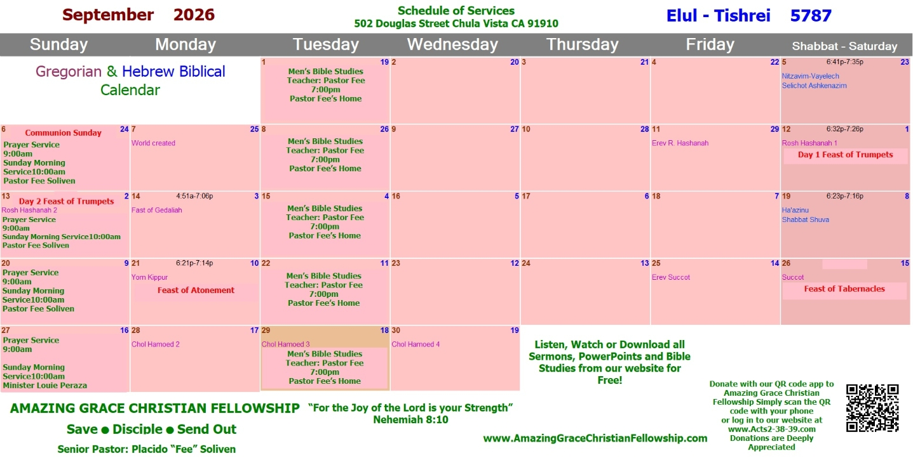

Slide 3


Slide 4


God’s Plan
by Minister Marty Sesma
John 10:16
Sunday Morning
August 30, 2026

Slide 5
John 10:16
And other sheep I have which are not of this fold; them also I must bring, and they will hear My voice; and there will be one flock and one shepherd.

Slide 6
Deuteronomy 7:6-7
6 "For you are a holy people to the LORD your God; the LORD your God has chosen you to be a people for Himself, a special treasure above all the peoples on the face of the earth. 7 The LORD did not set His love on you nor choose you because you were more in number than any other people, for you were the least of all peoples….

Slide 7
Isaiah 49:5-6
5 "And now the LORD says, Who formed Me from the womb to be His Servant, To bring Jacob back to Him, So that Israel is gathered to Him (For I shall be glorious in the eyes of the LORD, And My God shall be My strength), 6 Indeed He says, 'It is too small a thing that You should be My Servant To raise up the tribes of Jacob, And to restore the preserved ones of Israel; I will also give You as a light to the Gentiles, That You should be My salvation to the ends of the earth.'"

Slide 8
Zechariah 2:11
Many nations shall be joined to the LORD in that day, and they shall become My people. And I will dwell in your midst. Then you will know that the LORD of hosts has sent Me to you.

Slide 9
Acts 10:1-8
1 There was a certain man in Caesarea called Cornelius, a centurion of what was called the Italian Regiment, 2 a devout man and one who feared God with all his household, who gave alms generously to the people, and prayed to God always. 3 About the ninth hour of the day he saw clearly in a vision an angel of God coming in and saying to him, "Cornelius!"

Slide 10
4 And when he observed him, he was afraid, and said, "What is it, lord?" So he said to him, "Your prayers and your alms have come up for a memorial before God. 5 Now send men to Joppa, and send for Simon whose surname is Peter. 6 He is lodging with Simon, a tanner, whose house is by the sea. He will tell you what you must do."

Slide 11
7 And when the angel who spoke to him had departed, Cornelius called two of his household servants and a devout soldier from among those who waited on him continually. 8 So when he had explained all these things to them, he sent them to Joppa.

Slide 12
Luke 18:9-14
9 Also He spoke this parable to some who trusted in themselves that they were righteous, and despised others: 10 Two men went up to the temple to pray, one a Pharisee and the other a tax collector. 11 The Pharisee stood and prayed thus with himself, 'God, I thank You that I am not like other men--extortioners, unjust, adulterers, or even as this tax collector.

Slide 13
12 I fast twice a week; I give tithes of all that I possess.' 13 And the tax collector, standing afar off, would not so much as raise his eyes to heaven, but beat his breast, saying, 'God, be merciful to me a sinner!' 14 I tell you, this man went down to his house justified rather than the other; for everyone who exalts himself will be humbled, and he who humbles himself will be exalted."

Slide 14
Acts 10:9-14
9 The next day, as they went on their journey and drew near the city, Peter went up on the housetop to pray, about the sixth hour. 10 Then he became very hungry and wanted to eat; but while they made ready, he fell into a trance 11 and saw heaven opened and an object like a great sheet bound at the four corners, descending to him and let down to the earth.

Slide 15
12 In it were all kinds of four-footed animals of the earth, wild beasts, creeping things, and birds of the air. 13 And a voice came to him, "Rise, Peter; kill and eat." 14 But Peter said, "Not so, Lord! For I have never eaten anything common or unclean."

Slide 16
Mark 7:18-23
18 So He said to them, "Are you thus without understanding also? Do you not perceive that whatever enters a man from outside cannot defile him, 19 because it does not enter his heart but his stomach, and is eliminated, thus purifying all foods?" 20 And He said, "What comes out of a man, that defiles a man.

Slide 17
21 For from within, out of the heart of men, proceed evil thoughts, adulteries, fornications, murders, 22 thefts, covetousness, wickedness, deceit, lewdness, an evil eye, blasphemy, pride, foolishness. 23 All these evil things come from within and defile a man."

Slide 18
Colossians 2:16-17
16 So let no one judge you in food or in drink, or regarding a festival or a new moon or sabbaths, 17 which are a shadow of things to come, but the substance is of Christ.

Slide 19
Acts 10:15-28
15 And a voice spoke to him again the second time, "What God has cleansed you must not call common." 16 This was done three times. And the object was taken up into heaven again. 17 Now while Peter wondered within himself what this vision which he had seen meant, behold, the men who had been sent from Cornelius had made inquiry for Simon's house, and stood before the gate.

Slide 20
18 And they called and asked whether Simon, whose surname was Peter, was lodging there. 19 While Peter thought about the vision, the Spirit said to him, "Behold, three men are seeking you. 20 Arise therefore, go down and go with them, doubting nothing; for I have sent them." 21 Then Peter went down to the men who had been sent to him from Cornelius, and said, "Yes, I am he whom you seek. For what reason have you come?"

Slide 21
22 And they said, "Cornelius the centurion, a just man, one who fears God and has a good reputation among all the nation of the Jews, was divinely instructed by a holy angel to summon you to his house, and to hear words from you." 23 Then he invited them in and lodged them. On the next day Peter went away with them, and some brethren from Joppa accompanied him.

Slide 22
24 And the following day they entered Caesarea. Now Cornelius was waiting for them, and had called together his relatives and close friends. 25 As Peter was coming in, Cornelius met him and fell down at his feet and worshiped him. 26 But Peter lifted him up, saying, "Stand up; I myself am also a man." 27 And as he talked with him, he went in and found many who had come together.

Slide 23
28 Then he said to them, "You know how unlawful it is for a Jewish man to keep company with or go to one of another nation. But God has shown me that I should not call any man common or unclean.

Slide 24
Leviticus 10:10-11
10 that you may distinguish between holy and unholy, and between unclean and clean, 11 and that you may teach the children of Israel all the statutes which the LORD has spoken to them by the hand of Moses."

Slide 25
Acts 10:29-34
29 Therefore I came without objection as soon as I was sent for. I ask, then, for what reason have you sent for me?" 30 So Cornelius said, "Four days ago I was fasting until this hour; and at the ninth hour I prayed in my house, and behold, a man stood before me in bright clothing,

Slide 26
31 and said, 'Cornelius, your prayer has been heard, and your alms are remembered in the sight of God. 32 Send therefore to Joppa and call Simon here, whose surname is Peter. He is lodging in the house of Simon, a tanner, by the sea. When he comes, he will speak to you.'

Slide 27
33 "So I sent to you immediately, and you have done well to come. Now therefore, we are all present before God, to hear all the things commanded you by God." 34 Then Peter opened his mouth and said: "In truth I perceive that God shows no partiality.

Slide 28
Acts 10:35-43
35 But in every nation whoever fears Him and works righteousness is accepted by Him. 36 The word which God sent to the children of Israel, preaching peace through Jesus Christ--He is Lord of all-- 37 that word you know, which was proclaimed throughout all Judea, and began from Galilee after the baptism which John preached:

Slide 29
38 how God anointed Jesus of Nazareth with the Holy Spirit and with power, who went about doing good and healing all who were oppressed by the devil, for God was with Him. 39 And we are witnesses of all things which He did both in the land of the Jews and in Jerusalem, whom they killed by hanging on a tree. 40 Him God raised up on the third day, and showed Him openly,

Slide 30
41 not to all the people, but to witnesses chosen before by God, even to us who ate and drank with Him after He arose from the dead. 42 And He commanded us to preach to the people, and to testify that it is He who was ordained by God to be Judge of the living and the dead. 43 To Him all the prophets witness that, through His name, whoever believes in Him will receive remission of sins."

Slide 31
Acts 10:44-46
44 While Peter was still speaking these words, the Holy Spirit fell upon all those who heard the word. 45 And those of the circumcision who believed were astonished, as many as came with Peter, because the gift of the Holy Spirit had been poured out on the Gentiles also. 46 For they heard them speak with tongues and magnify God. Then Peter answered,

Slide 32
Acts 2:1-17
1 Now when the Day of Pentecost had fully come, they were all with one accord in one place. 2 And suddenly there came a sound from heaven, as of a rushing mighty wind, and it filled the whole house where they were sitting. 3 Then there appeared to them divided tongues, as of fire, and one sat upon each of them. 4 And they were all filled with the Holy Spirit and began to speak with other tongues, as the Spirit gave them utterance.

Slide 33
5 And there were dwelling in Jerusalem Jews, devout men, from every nation under heaven. 6 And when this sound occurred, the multitude came together, and were confused, because everyone heard them speak in his own language. 7 Then they were all amazed and marveled, saying to one another, "Look, are not all these who speak Galileans?

Slide 34
8 And how is it that we hear, each in our own language in which we were born? 9 Parthians and Medes and Elamites, those dwelling in Mesopotamia, Judea and Cappadocia, Pontus and Asia, 10 Phrygia and Pamphylia, Egypt and the parts of Libya adjoining Cyrene, visitors from Rome, both Jews and proselytes, 11 Cretans and Arabs--we hear them speaking in our own tongues the wonderful works of God."

Slide 35
12 So they were all amazed and perplexed, saying to one another, "Whatever could this mean?" 13 Others mocking said, "They are full of new wine." 14 But Peter, standing up with the eleven, raised his voice and said to them, "Men of Judea and all who dwell in Jerusalem, let this be known to you, and heed my words.

Slide 36
15 For these are not drunk, as you suppose, since it is only the third hour of the day. 16 But this is what was spoken by the prophet Joel: 17'And it shall come to pass in the last days, says God, That I will pour out of My Spirit on all flesh; Your sons and your daughters shall prophesy, Your young men shall see visions, Your old men shall dream dreams.

Slide 37
Acts 10:47-48
47 Can anyone forbid water, that these should not be baptized who have received the Holy Spirit just as we have?" 48 And he commanded them to be baptized in the name of the Lord. Then they asked him to stay a few days.

Slide 38
Joel 2:32
And it shall come to pass That whoever calls on the name of the LORD Shall be saved. For in Mount Zion and in Jerusalem there shall be deliverance, As the LORD has said, Among the remnant whom the LORD calls.

Slide 39
Acts 11:1-18
1 Now the apostles and brethren who were in Judea heard that the Gentiles had also received the word of God. 2 And when Peter came up to Jerusalem, those of the circumcision contended with him, 3 saying, "You went in to uncircumcised men and ate with them!" 4 But Peter explained it to them in order from the beginning, saying:

Slide 40
5 "I was in the city of Joppa praying; and in a trance I saw a vision, an object descending like a great sheet, let down from heaven by four corners; and it came to me. 6 When I observed it intently and considered, I saw four-footed animals of the earth, wild beasts, creeping things, and birds of the air. 7 And I heard a voice saying to me, 'Rise, Peter; kill and eat.'
.

Slide 41
8 "But I said, 'Not so, Lord! For nothing common or unclean has at any time entered my mouth.' 9 "But the voice answered me again from heaven, 'What God has cleansed you must not call common.' 10 "Now this was done three times, and all were drawn up again into heaven. 11 At that very moment, three men stood before the house where I was, having been sent to me from Caesarea.

Slide 42
12 Then the Spirit told me to go with them, doubting nothing. Moreover these six brethren accompanied me, and we entered the man's house. 13 And he told us how he had seen an angel standing in his house, who said to him, 'Send men to Joppa, and call for Simon whose surname is Peter, 14 who will tell you words by which you and all your household will be saved.'

Slide 43
15 "And as I began to speak, the Holy Spirit fell upon them, as upon us at the beginning. 16 Then I remembered the word of the Lord, how He said, 'John indeed baptized with water, but you shall be baptized with the Holy Spirit.' 17 "If therefore God gave them the same gift as He gave us when we believed on the Lord Jesus Christ, who was I that I could withstand God?"

Slide 44
18 When they heard these things they became silent; and they glorified God, saying, "Then God has also granted to the Gentiles repentance to life."

Slide 45
1 Thessalonians 4:13-18
13 But I do not want you to be ignorant, brethren, concerning those who have fallen asleep, lest you sorrow as others who have no hope. 14 For if we believe that Jesus died and rose again, even so God will bring with Him those who sleep in Jesus.

Slide 46
15 For this we say to you by the word of the Lord, that we who are alive and remain until the coming of the Lord will by no means precede those who are asleep. 16 For the Lord Himself will descend from heaven with a shout, with the voice of an archangel, and with the trumpet of God. And the dead in Christ will rise first.

Slide 47
17 Then we who are alive and remain shall be caught up together with them in the clouds to meet the Lord in the air. And thus we shall always be with the Lord. 18 Therefore comfort one another with these words.

Slide 48
1 Corinthians 15:50-54
50 Now this I say, brethren, that flesh and blood cannot inherit the kingdom of God; nor does corruption inherit incorruption. 51 Behold, I tell you a mystery: We shall not all sleep, but we shall all be changed-- 52 in a moment, in the twinkling of an eye, at the last trumpet. For the trumpet will sound, and the dead will be raised incorruptible, and we shall be changed.

Slide 49
53 For this corruptible must put on incorruption, and this mortal must put on immortality. 54 So when this corruptible has put on incorruption, and this mortal has put on immortality, then shall be brought to pass the saying that is written: "Death is swallowed up in victory."

Slide 50

20 Again, when a righteous man turns from his righteousness and commits iniquity, and I lay a stumbling block before him, he shall die; because you did not give him warning, he shall die in his sin, and his righteousness which he has done shall not be remembered; but his blood I will require at your hand.

Slide 51
Acts 2:38-39
38 Then Peter said to them, "Repent, and let every one of you be baptized in the name of Jesus Christ for the remission of sins; and you shall receive the gift of the Holy Spirit. 39 For the promise is to you and to your children, and to all who are afar off, as many as the Lord our God will call."

Slide 52
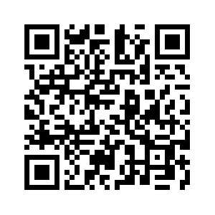
Donate with our QR code app to
Amazing Grace Christian Fellowship
Donations are Deeply Appreciated!

