Slide 1


Slide 2


Slide 3
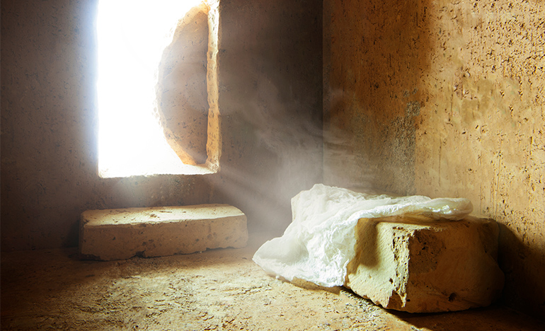

The Power of the Resurrected Christ
by Pastor Fee Soliven
Matthew 28:1-8
Sunday Morning
August 16, 2026

Slide 4
Matthew 28:1-8
1 Now after the Sabbath, as the first day of the week began to dawn, Mary Magdalene and the other Mary came to see the tomb. 2 And behold, there was a great earthquake; for an angel of the Lord descended from heaven, and came and rolled back the stone from the door, and sat on it.

Slide 5
3 His countenance was like lightning, and his clothing as white as snow. 4 And the guards shook for fear of him, and became like dead men. 5 But the angel answered and said to the women, "Do not be afraid, for I know that you seek Jesus who was crucified. 6 He is not here; for He is risen, as He said. Come, see the place where the Lord lay.

Slide 6
7 And go quickly and tell His disciples that He is risen from the dead, and indeed He is going before you into Galilee; there you will see Him. Behold, I have told you." 8 So they went out quickly from the tomb with fear and great joy, and ran to bring His disciples word.

Slide 7
The Power of the Resurrection

Slide 8
1. Jesus is Alive

Slide 9
1 John 2:1
My little children, these things I write to you, so that you may not sin. And if anyone sins, we have an Advocate with the Father, Jesus Christ the righteous

Slide 10
2. Jesus intercedes on our Behalf

Slide 11
Romans 8:34
Who is he who condemns? It is Christ who died, and furthermore is also risen, who is even at the right hand of God, who also makes intercession for us.

Slide 12
3. Jesus enables us to live Godly Lives

Slide 13
John 14:16-17
16 And I will pray the Father, and He will give you another Helper, that He may abide with you forever-- 17 the Spirit of truth, whom the world cannot receive, because it neither sees Him nor knows Him; but you know Him, for He dwells with you and will be in you.

Slide 14
4. Jesus prepares an Eternal Home for Us

Slide 15
John 14:2-3
2 In My Father's house are many mansions; if it were not so, I would have told you. I go to prepare a place for you. 3 And if I go and prepare a place for you, I will come again and receive you to Myself; that where I am, there you may be also.

Slide 16
5. We are Forgiven by Only Jesus

Slide 17
Colossians 2:13-14
13 And you, being dead in your trespasses and the uncircumcision of your flesh, He has made alive together with Him, having forgiven you all trespasses, 14 having wiped out the handwriting of requirements that was against us, which was contrary to us. And He has taken it out of the way, having nailed it to the cross.

Slide 18
Mark 11:25-26
25 "And whenever you stand praying, if you have anything against anyone, forgive him, that your Father in heaven may also forgive you your trespasses. 26 But if you do not forgive, neither will your Father in heaven forgive your trespasses."

Slide 19
6. We are going to Live Forever

Slide 20
2 Corinthians 5:8
"We are confident, yes, well pleased rather to be absent from the body and to be present with the Lord"

Slide 21
7. Eternal life, by definition, is Everlasting

Slide 22
John 3:16-17
16 For God so loved the world that He gave His only begotten Son, that whoever believes in Him should not perish but have everlasting life. 17 For God did not send His Son into the world to condemn the world, but that the world through Him might be saved.

Slide 23
John 10:27-30
27 My sheep hear My voice, and I know them, and they follow Me. 28 And I give them eternal life, and they shall never perish; neither shall anyone snatch them out of My hand. 29 My Father, who has given them to Me, is greater than all; and no one is able to snatch them out of My Father's hand. 30 I and My Father are one."

Slide 24
8. We are sealed by the Holy Spirit as God’s children

Slide 25
Ephesians 1:13-14
13 In Him you also trusted, after you heard the word of truth, the gospel of your salvation; in whom also, having believed, you were sealed with the Holy Spirit of promise, 14 who is the guarantee of our inheritance until the redemption of the purchased possession, to the praise of His glory

Slide 26
9. We will have a Resurrected Body

Slide 27
Luke 24:36-43
36 Now as they said these things, Jesus Himself stood in the midst of them, and said to them, "Peace to you." 37 But they were terrified and frightened, and supposed they had seen a spirit. 38 And He said to them, "Why are you troubled? And why do doubts arise in your hearts? 39 Behold My hands and My feet, that it is I Myself. Handle Me and see, for a spirit does not have flesh and bones as you see I have."

Slide 28
40 When He had said this, He showed them His hands and His feet. 41 But while they still did not believe for joy, and marveled, He said to them, "Have you any food here?" 42 So they gave Him a piece of a broiled fish and some honeycomb. 43 And He took it and ate in their presence.

Slide 29
Luke 24:30-31
30 Now it came to pass, as He sat at the table with them, that He took bread, blessed and broke it, and gave it to them. 31 Then their eyes were opened and they knew Him; and He vanished from their sight.

Slide 30
Romans 8:8-11
8 So then, those who are in the flesh cannot please God. 9 But you are not in the flesh but in the Spirit, if indeed the Spirit of God dwells in you. Now if anyone does not have the Spirit of Christ, he is not His. 10 And if Christ is in you, the body is dead because of sin, but the Spirit is life because of righteousness.

Slide 31
11 But if the Spirit of Him who raised Jesus from the dead dwells in you, He who raised Christ from the dead will also give life to your mortal bodies through His Spirit who dwells in you.

Slide 32
Romans 8:23
Not only that, but we also who have the firstfruits of the Spirit, even we ourselves groan within ourselves, eagerly waiting for the adoption, the redemption of our body.

Slide 33
1 Thessalonians 4:13-18
13 But I do not want you to be ignorant, brethren, concerning those who have fallen asleep, lest you sorrow as others who have no hope. 14 For if we believe that Jesus died and rose again, even so God will bring with Him those who sleep in Jesus.

Slide 34
15 For this we say to you by the word of the Lord, that we who are alive and remain until the coming of the Lord will by no means precede those who are asleep. 16 For the Lord Himself will descend from heaven with a shout, with the voice of an archangel, and with the trumpet of God. And the dead in Christ will rise first.
.

Slide 35
17 Then we who are alive and remain shall be caught up together with them in the clouds to meet the Lord in the air. And thus we shall always be with the Lord. 18 Therefore comfort one another with these words.

Slide 36
10. Heaven is Our Home

Slide 37
Revelation 21:22-27
22 But I saw no temple in it, for the Lord God Almighty and the Lamb are its temple. 23 The city had no need of the sun or of the moon to shine in it, for the glory of God illuminated it. The Lamb is its light. 24 And the nations of those who are saved shall walk in its light, and the kings of the earth bring their glory and honor into it.

Slide 38
25 Its gates shall not be shut at all by day (there shall be no night there). 26 And they shall bring the glory and the honor of the nations into it. 27 But there shall by no means enter it anything that defiles, or causes an abomination or a lie, but only those who are written in the Lamb's Book of Life.

Slide 39
Revelation 22:1-5
1 And he showed me a pure river of water of life, clear as crystal, proceeding from the throne of God and of the Lamb. 2 In the middle of its street, and on either side of the river, was the tree of life, which bore twelve fruits, each tree yielding its fruit every month. The leaves of the tree were for the healing of the nations.

Slide 40
3 And there shall be no more curse, but the throne of God and of the Lamb shall be in it, and His servants shall serve Him. 4 They shall see His face, and His name shall be on their foreheads. 5 There shall be no night there: They need no lamp nor light of the sun, for the Lord God gives them light. And they shall reign forever and ever.

Slide 41
11. God's Resurrection Power is for
Here & Now!

Slide 42
John 14:12-14
12 "Most assuredly, I say to you, he who believes in Me, the works that I do he will do also; and greater works than these he will do, because I go to My Father. 13 And whatever you ask in My name, that I will do, that the Father may be glorified in the Son. 14 If you ask anything in My name, I will do it.

Slide 43
1 Thessalonians 4:13-18
13 But I do not want you to be ignorant, brethren, concerning those who have fallen asleep, lest you sorrow as others who have no hope. 14 For if we believe that Jesus died and rose again, even so God will bring with Him those who sleep in Jesus.

Slide 44
15 For this we say to you by the word of the Lord, that we who are alive and remain until the coming of the Lord will by no means precede those who are asleep. 16 For the Lord Himself will descend from heaven with a shout, with the voice of an archangel, and with the trumpet of God. And the dead in Christ will rise first.

Slide 45
17 Then we who are alive and remain shall be caught up together with them in the clouds to meet the Lord in the air. And thus we shall always be with the Lord. 18 Therefore comfort one another with these words.

Slide 46
1 Corinthians 15:50-54
50 Now this I say, brethren, that flesh and blood cannot inherit the kingdom of God; nor does corruption inherit incorruption. 51 Behold, I tell you a mystery: We shall not all sleep, but we shall all be changed-- 52 in a moment, in the twinkling of an eye, at the last trumpet. For the trumpet will sound, and the dead will be raised incorruptible, and we shall be changed.

Slide 47
53 For this corruptible must put on incorruption, and this mortal must put on immortality. 54 So when this corruptible has put on incorruption, and this mortal has put on immortality, then shall be brought to pass the saying that is written: "Death is swallowed up in victory."

Slide 48

20 Again, when a righteous man turns from his righteousness and commits iniquity, and I lay a stumbling block before him, he shall die; because you did not give him warning, he shall die in his sin, and his righteousness which he has done shall not be remembered; but his blood I will require at your hand.

Slide 49
Acts 2:38-39
38 Then Peter said to them, "Repent, and let every one of you be baptized in the name of Jesus Christ for the remission of sins; and you shall receive the gift of the Holy Spirit. 39 For the promise is to you and to your children, and to all who are afar off, as many as the Lord our God will call."

Slide 50
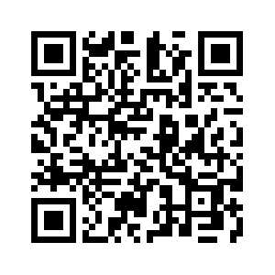
Donate with our QR code app to
Amazing Grace Christian Fellowship
Donations are Deeply Appreciated!

