Slide 1


Slide 2


Slide 3
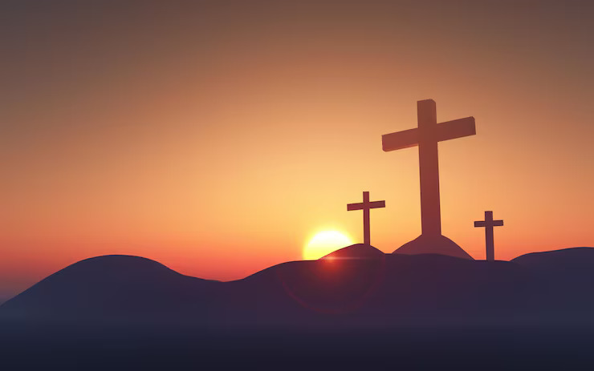

Understanding Who Jesus Is
by Pastor Fee Soliven
1 John 5:6-13
Sunday Morning
August 9, 2026

Slide 4
1 John 5:6-13
6 This is He who came by water and blood--Jesus Christ; not only by water, but by water and blood. And it is the Spirit who bears witness, because the Spirit is truth. 7 For there are three that bear witness in heaven: the Father, the Word, and the Holy Spirit; and these three are one.

Slide 5
8 And there are three that bear witness on earth: the Spirit, the water, and the blood; and these three agree as one. 9 If we receive the witness of men, the witness of God is greater; for this is the witness of God which He has testified of His Son.

Slide 6
10 He who believes in the Son of God has the witness in himself; he who does not believe God has made Him a liar, because he has not believed the testimony that God has given of His Son. 11 And this is the testimony: that God has given us eternal life, and this life is in His Son.

Slide 7
12 He who has the Son has life; he who does not have the Son of God does not have life. 13 These things I have written to you who believe in the name of the Son of God, that you may know that you have eternal life, and that you may continue to believe in the name of the Son of God.

Slide 8
Who is God, and what is He like?

Slide 9
The Born Again Through
True Repentance

Slide 10
Romans 8:11
“But if the Spirit of him that raised up Jesus from the dead dwell in you, he that raised up Christ from the dead shall also quicken your mortal bodies by his Spirit that dwelleth in you”

Slide 11
2 Corinthians 7:9-10
9 Now I rejoice, not that you were made sorry, but that your sorrow led to repentance. For you were made sorry in a godly manner, that you might suffer loss from us in nothing. 10 For godly sorrow produces repentance leading to salvation, not to be regretted; but the sorrow of the world produces death.

Slide 12
Romans 10:9-13
9 that if you confess with your mouth the Lord Jesus and believe in your heart that God has raised Him from the dead, you will be saved. 10 For with the heart one believes unto righteousness, and with the mouth confession is made unto salvation.

Slide 13
11 For the Scripture says, "Whoever believes on Him will not be put to shame." 12 For there is no distinction between Jew and Greek, for the same Lord over all is rich to all who call upon Him. 13 For "whoever calls on the name of the LORD shall be saved."

Slide 14
Acts 2:38-39
38 Then Peter said to them, "Repent, and let every one of you be baptized in the name of Jesus Christ for the remission of sins; and you shall receive the gift of the Holy Spirit. 39 For the promise is to you and to your children, and to all who are afar off, as many as the Lord our God will call."

Slide 15
A right understanding of God is essential because it has eternal ramifications. Knowing God’s Attributes

Slide 16
Romans 1:19-21
19 because what may be known of God is manifest in them, for God has shown it to them. 20 For since the creation of the world His invisible attributes are clearly seen, being understood by the things that are made, even His eternal power and Godhead, so that they are without excuse…

Slide 17
God is an Uncreated Being

Slide 18
Genesis 1:1
“In the beginning God created the heavens and the earth”

Slide 19
Psalm 90:2
“Before the mountains were brought forth, Or ever You had formed the earth and the world, Even from everlasting to everlasting, You are God”

Slide 20
He is Unchangeable

Slide 21
Malachi 3:6
“For I am the LORD, I change not; therefore you are sons of Jacob and are not consumed”

Slide 22
Hebrews 13:8
“Jesus Christ is the same yesterday, today, and forever”

Slide 23
God is Omnipresent

Slide 24
Psalm 139:7-12
7 Where can I go from Your Spirit? Or where can I flee from Your presence? 8 If I ascend into heaven, You are there; If I make my bed in hell, behold, You are there. 9 If I take the wings of the morning, And dwell in the uttermost parts of the sea, 10 Even there Your hand shall lead me, And Your right hand shall hold me.

Slide 25
11 If I say, "Surely the darkness shall fall on me," Even the night shall be light about me; 12 Indeed, the darkness shall not hide from You, But the night shines as the day; The darkness and the light are both alike to You.

Slide 26
God is Omnipotent

Slide 27
1 Samuel 2:6-8
6 "The LORD kills and makes alive; He brings down to the grave and brings up. 7 The LORD makes poor and makes rich; He brings low and lifts up. 8 He raises the poor from the dust And lifts the beggar from the ash heap, To set them among princes And make them inherit the throne of glory

Slide 28
Matthew 19:26
“…With God all things are possible”

Slide 29
Titus 1:2
“In hope of eternal life which God, who cannot lie, promised before time began…”

Slide 30
God is Omniscient

Slide 31
Deuteronomy 29:29
“The secret things belong to the Lord our God, but the things revealed belong to us.”

Slide 32
God is Invisible

Slide 33
1 Timothy 6:15-16
15 which He will manifest in His own time, He who is the blessed and only Potentate, the King of kings and Lord of lords, 16 who alone has immortality, dwelling in unapproachable light, whom no man has seen or can see, to whom be honor and everlasting power.

Slide 34
Colossians 1:15
“He is the image of the invisible God, the firstborn over all creation.”

Slide 35
God is love

Slide 36
1 John 4:16
“And we have known and believed the love that God has for us. God is love, and he who abides in love abides in God, and God in him”

Slide 37
John 3:16
“For God so loved the world that He gave His only begotten Son, that whoever believes in Him should not perish but have everlasting life”

Slide 38
God is Holy

Slide 39
Psalm 99:8-9
8 You answered them, O LORD our God; You were to them God-who-Forgives, Though You took vengeance on their deeds. 9 Exalt the LORD our God, And worship at His holy hill; For the LORD our God is holy.

Slide 40
God is Righteous

Slide 41
He is a God of Wrath

Slide 42
John 3:36
“He who believes in the Son has everlasting life; and he who does not believe the Son shall not see life, but the wrath of God abides on him."

Slide 43
God is our Judge

Slide 44
2 Corinthians 5:10
“For we must all appear before the judgment seat of Christ, that each one may receive the things done in the body, according to what he has done, whether good or bad”

Slide 45
God is our Rewarder

Slide 46
1 Corinthians 3:10-15
10 According to the grace of God which was given to me, as a wise master builder I have laid the foundation, and another builds on it. But let each one take heed how he builds on it.

Slide 47
11 For no other foundation can anyone lay than that which is laid, which is Jesus Christ. 12 Now if anyone builds on this foundation with gold, silver, precious stones, wood, hay, straw, 13 each one's work will become clear; for the Day will declare it, because it will be revealed by fire; and the fire will test each one's work, of what sort it is.

Slide 48
14 If anyone's work which he has built on it endures, he will receive a reward. 15 If anyone's work is burned, he will suffer loss; but he himself will be saved, yet so as through fire.

Slide 49
God is to be Worshipped

Slide 50
Colossians 3:16
“Let the word of Christ dwell in you richly in all wisdom, teaching and admonishing one another in psalms and hymns and spiritual songs, singing with grace in your hearts to the Lord”

Slide 51
John 4:23-25
23 But the hour is coming, and now is, when the true worshipers will worship the Father in spirit and truth; for the Father is seeking such to worship Him. 24 God is Spirit, and those who worship Him must worship in spirit and truth."

Slide 52
1 Thessalonians 4:13-18
13 But I do not want you to be ignorant, brethren, concerning those who have fallen asleep, lest you sorrow as others who have no hope. 14 For if we believe that Jesus died and rose again, even so God will bring with Him those who sleep in Jesus.

Slide 53
15 For this we say to you by the word of the Lord, that we who are alive and remain until the coming of the Lord will by no means precede those who are asleep. 16 For the Lord Himself will descend from heaven with a shout, with the voice of an archangel, and with the trumpet of God. And the dead in Christ will rise first.

Slide 54
17 Then we who are alive and remain shall be caught up together with them in the clouds to meet the Lord in the air. And thus we shall always be with the Lord. 18 Therefore comfort one another with these words.

Slide 55
1 Corinthians 15:50-54
50 Now this I say, brethren, that flesh and blood cannot inherit the kingdom of God; nor does corruption inherit incorruption. 51 Behold, I tell you a mystery: We shall not all sleep, but we shall all be changed-- 52 in a moment, in the twinkling of an eye, at the last trumpet. For the trumpet will sound, and the dead will be raised incorruptible, and we shall be changed.

Slide 56
53 For this corruptible must put on incorruption, and this mortal must put on immortality. 54 So when this corruptible has put on incorruption, and this mortal has put on immortality, then shall be brought to pass the saying that is written: "Death is swallowed up in victory."

Slide 57

20 Again, when a righteous man turns from his righteousness and commits iniquity, and I lay a stumbling block before him, he shall die; because you did not give him warning, he shall die in his sin, and his righteousness which he has done shall not be remembered; but his blood I will require at your hand.

Slide 58
Acts 2:38-39
38 Then Peter said to them, "Repent, and let every one of you be baptized in the name of Jesus Christ for the remission of sins; and you shall receive the gift of the Holy Spirit. 39 For the promise is to you and to your children, and to all who are afar off, as many as the Lord our God will call."

