Slide 1


Slide 2


Slide 3
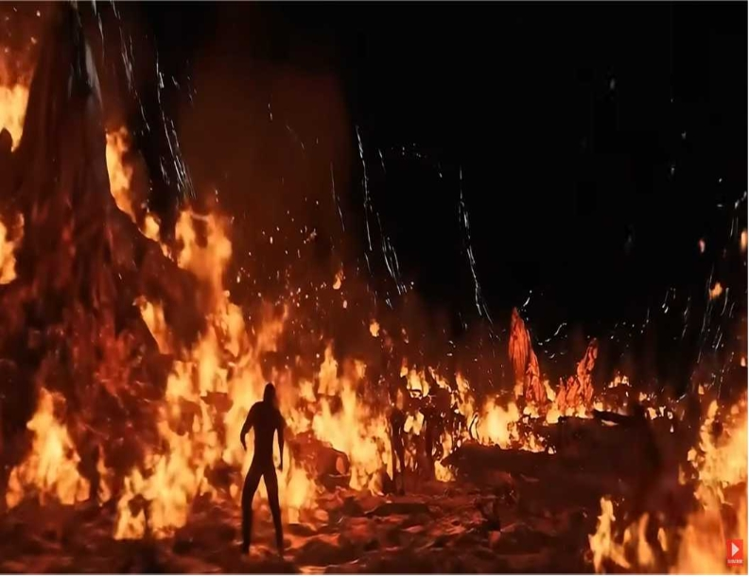

What Jesus Saved Us From
by Pastor Fee Soliven
Revelation 20:11-15
Sunday Morning
August 2, 2026

Slide 4
Revelation 20:11-15
11 Then I saw a great white throne and Him who sat on it, from whose face the earth and the heaven fled away. And there was found no place for them. 12 And I saw the dead, small and great, standing before God, and books were opened. And another book was opened, which is the Book of Life. And the dead were judged according to their works, by the things which were written in the books.

Slide 5
13 The sea gave up the dead who were in it, and Death and Hades delivered up the dead who were in them. And they were judged, each one according to his works. 14 Then Death and Hades were cast into the lake of fire. This is the second death. 15 And anyone not found written in the Book of Life was cast into the lake of fire.

Slide 6
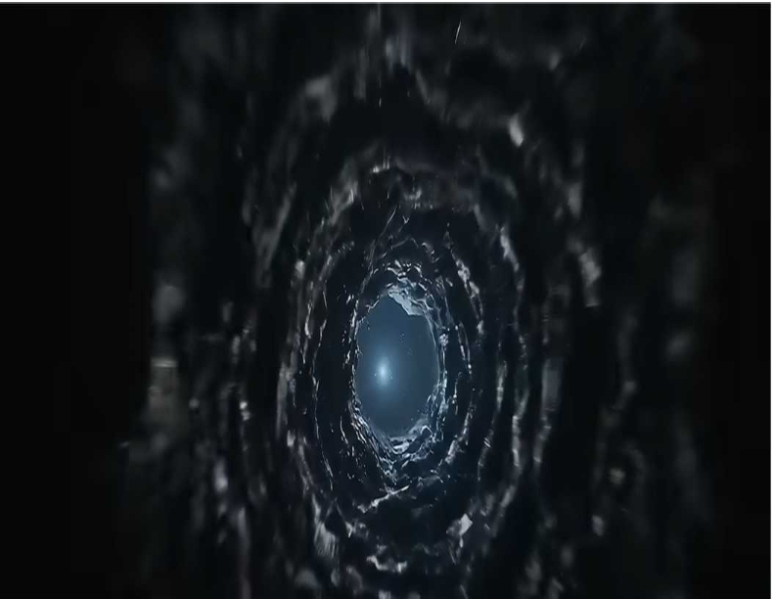
Luke 8:43-48
43 Now a woman, having a flow of blood for twelve years, who had spent all her livelihood on physicians and could not be healed by any, 44 came from behind and touched the border of His garment. And immediately her flow of blood stopped. 45 And Jesus said, "Who touched Me?" When all denied it, Peter and those with him said, "Master, the multitudes throng and press You, and You say, 'Who touched Me?' "

Slide 7
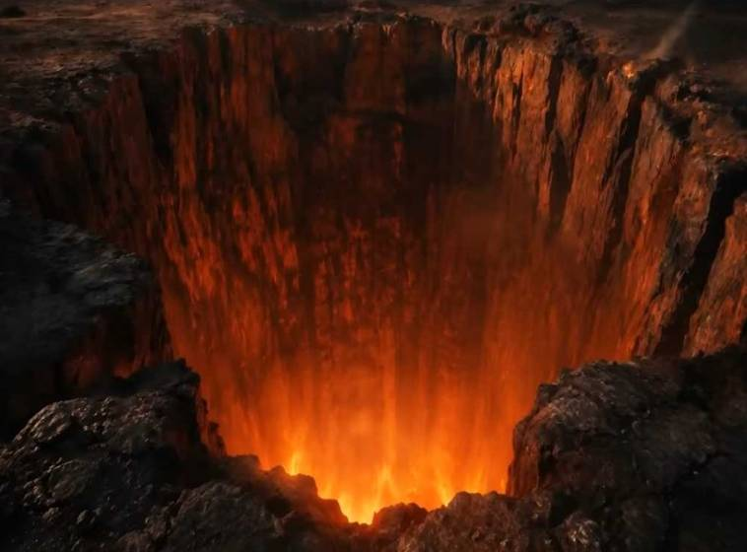
Mark 1:40-42
40 Then a leper came to Him, imploring Him, kneeling down to Him and saying to Him, "If You are willing, You can make me clean." 41 And Jesus, moved with compassion, put out His hand and touched him, and said to him, "I am willing; be cleansed." 42 As soon as He had spoken, immediately the leprosy left him, and he was cleansed.

Slide 8
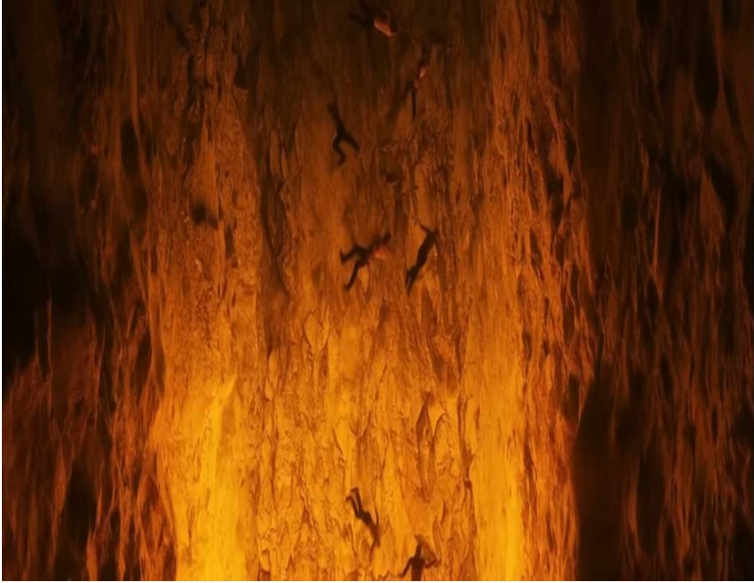
Mark 1:40-42
40 Then a leper came to Him, imploring Him, kneeling down to Him and saying to Him, "If You are willing, You can make me clean." 41 And Jesus, moved with compassion, put out His hand and touched him, and said to him, "I am willing; be cleansed." 42 As soon as He had spoken, immediately the leprosy left him, and he was cleansed.

Slide 9
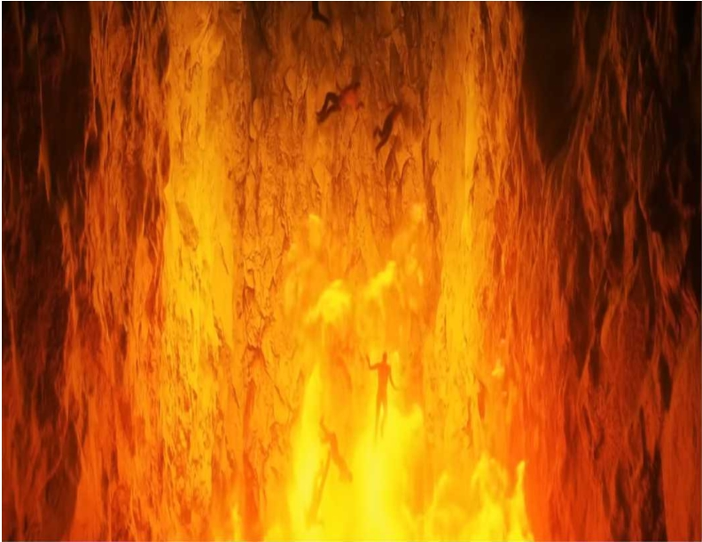
Mark 1:40-42
40 Then a leper came to Him, imploring Him, kneeling down to Him and saying to Him, "If You are willing, You can make me clean." 41 And Jesus, moved with compassion, put out His hand and touched him, and said to him, "I am willing; be cleansed." 42 As soon as He had spoken, immediately the leprosy left him, and he was cleansed.

Slide 10
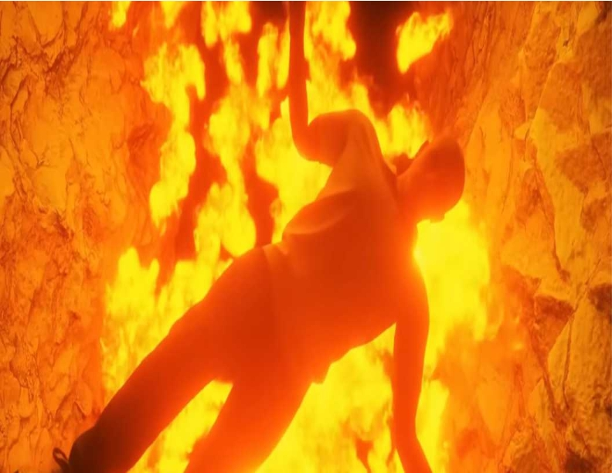
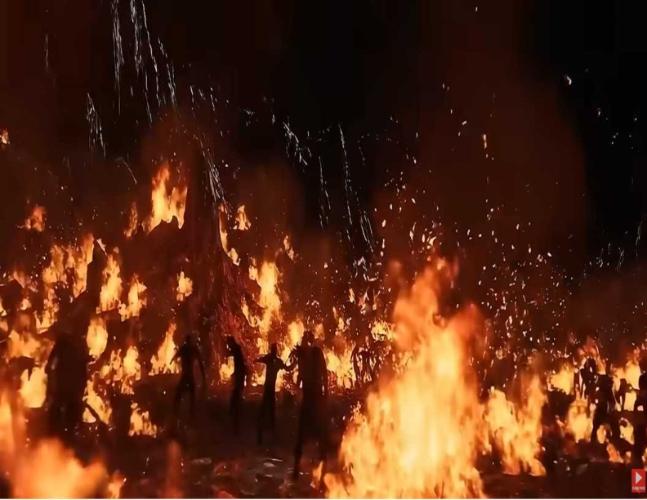
46 But Jesus said, "Somebody touched Me, for I perceived power going out from Me." 47 Now when the woman saw that she was not hidden, she came trembling; and falling down before Him, she declared to Him in the presence of all the people the reason she had touched Him and how she was healed immediately. 48 And He said to her, "Daughter, be of good cheer; your faith has made you well. Go in peace."

Slide 11
46 But Jesus said, "Somebody touched Me, for I perceived power going out from Me." 47 Now when the woman saw that she was not hidden, she came trembling; and falling down before Him, she declared to Him in the presence of all the people the reason she had touched Him and how she was healed immediately. 48 And He said to her, "Daughter, be of good cheer; your faith has made you well. Go in peace."

Slide 12
A Place of No Escape According to
The Prophets

Slide 13
Isaiah 24:22
They will be gathered together, As prisoners are gathered in the pit, And will be shut up in the prison; After many days they will be punished.

Slide 14
Job 26:6
Sheol is naked before Him, And Destruction has no covering.

Slide 15
Proverbs 7:24-27
24 Now therefore, listen to me, my children; Pay attention to the words of my mouth: 25 Do not let your heart turn aside to her ways, Do not stray into her paths; 26 For she has cast down many wounded, And all who were slain by her were strong men. 27 Her house is the way to hell, Descending to the chambers of death.

Slide 16
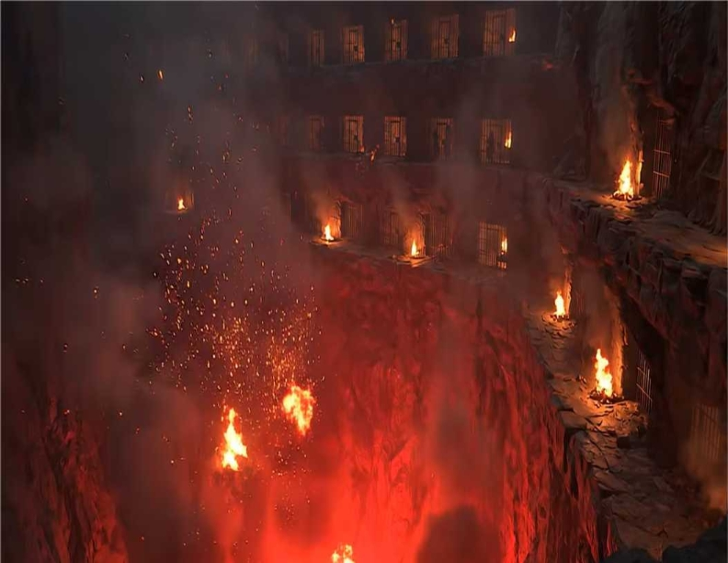
Matthew 9:35-36
35 Then Jesus went about all the cities and villages, teaching in their synagogues, preaching the gospel of the kingdom, and healing every sickness and every disease among the people. 36 But when He saw the multitudes, He was moved with compassion for them, because they were weary and scattered, like sheep having no shepherd.

Slide 17
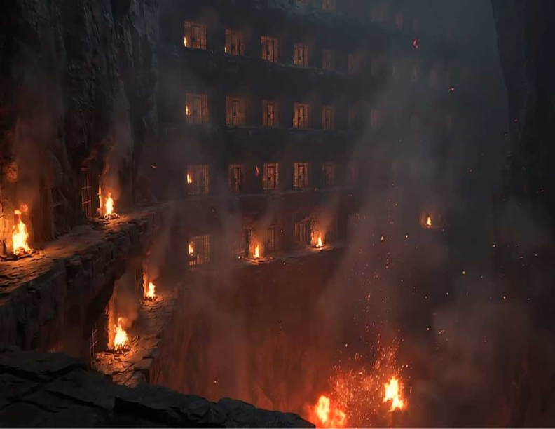
Matthew 9:35-36
35 Then Jesus went about all the cities and villages, teaching in their synagogues, preaching the gospel of the kingdom, and healing every sickness and every disease among the people. 36 But when He saw the multitudes, He was moved with compassion for them, because they were weary and scattered, like sheep having no shepherd.

Slide 18
Isaiah 66:22-24
22 "For as the new heavens and the new earth Which I will make shall remain before Me," says the LORD, "So shall your descendants and your name remain. 23 And it shall come to pass That from one New Moon to another, And from one Sabbath to another, All flesh shall come to worship before Me," says the LORD.

Slide 19
24 "And they shall go forth and look Upon the corpses of the men Who have transgressed against Me. For their worm does not die, And their fire is not quenched. They shall be an abhorrence to all flesh."

Slide 20
Mark 9:42-50
42 "But whoever causes one of these little ones who believe in Me to stumble, it would be better for him if a millstone were hung around his neck, and he were thrown into the sea. 43 If your hand causes you to sin, cut it off. It is better for you to enter into life maimed, rather than having two hands, to go to hell, into the fire that shall never be quenched—

Slide 21
44 where 'Their worm does not die, And the fire is not quenched.' 45 "And if your foot causes you to sin, cut it off. It is better for you to enter life lame, rather than having two feet, to be cast into hell, into the fire that shall never be quenched-- 46 where 'Their worm does not die, And the fire is not quenched.'

Slide 22
47 "And if your eye causes you to sin, pluck it out. It is better for you to enter the kingdom of God with one eye, rather than having two eyes, to be cast into hell fire-- 48 where 'Their worm does not die, And the fire is not quenched.' 49 "For everyone will be seasoned with fire, and every sacrifice will be seasoned with salt. 50 Salt is good, but if the salt loses its flavor, how will you season it? Have salt in yourselves, and have peace with one another."

Slide 23
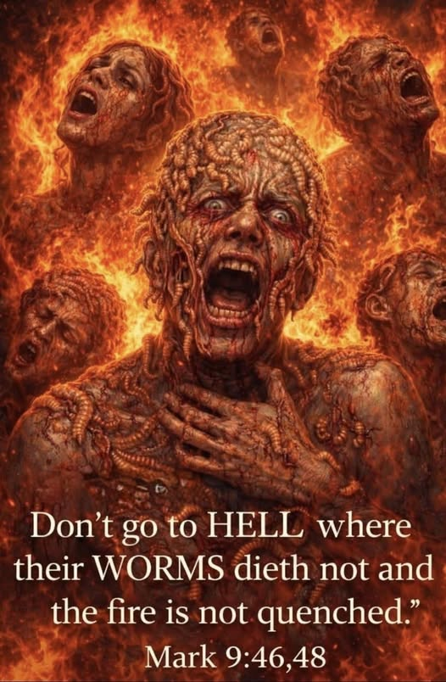

Slide 24
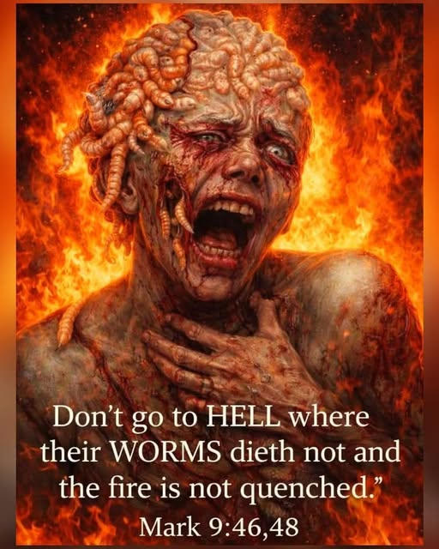

Slide 25
What Are These Demons From Hell?

Slide 26
JOHN PIPER
I know of no one who has overstated the terror of Hell…. We are meant to tremble and feel dread. We are meant to recoil from the reality. Not by denying it, but by fleeing from it into the arms of Jesus, who died to save us from it.

Slide 27
Bill Wiese, 23 Minutes in Hell
I began to look around. Immediately I realized that I was not alone in this cell. I saw two enormous beasts unlike anything I had ever seen before. These creatures were approximately ten to thirteen feet tall.

Slide 28
These towering beasts were far, far beyond intimidating. It is one thing to be threatened by someone much taller than you. But these creatures were not of this natural world.

Slide 29
I recognized that they were entirely evil, and they were gazing at me with pure, unrestrained hatred, which completely paralyzed me with fear. “Evil” and “Terror” stood before me. Those creatures were an intensely concentrated manifestation of those two forces.

Slide 30
The creatures weren’t animals, but they weren’t human either. Each giant beast resembled a reptile in appearance but took on human form.

Slide 31
The beasts’ arms and legs were unequal in length, out of proportion—without symmetry. The first one had bumps and scales all over its grotesque body. It had a huge protruding jaw, gigantic teeth, and large sunken-in eyes.
Wiese, Bill. 23 Minutes in Hell:

Slide 32
I wanted desperately to get up and run. But as I lay on that wretched cell floor, I noticed that I had absolutely no strength in my body. I could barely move. Why didn’t I have strength? I felt so defenseless.

Slide 33
Two more creatures came into the cell, and I had the feeling these four beings had been “assigned” to me. I felt as though I was being “sized up” and that my torment would be their amusement.

Slide 34
As they entered, suddenly the light vanished. It became absolutely pitch-black. I had no idea why the sudden and intense darkness had begun.

Slide 35
But I sensed that the light that had been present had been an intrusion and that the atmosphere had now returned to its normal state of darkness.

Slide 36
The second beast, with its razor-like claws and sharp protruding fins, then grabbed me from behind in a bear hug. As it pressed me into its chest, its sharp fins pierced my back. I felt like a rag doll in its clutches in comparison with his enormous size.

Slide 37
He then reached around and plunged his claws into my chest and ripped them outward. My flesh hung from my body like ribbons as I fell again to the cell floor.

Slide 38
These creatures had no respect for the human body—how remarkably it is made. I have always taken care of myself by eating right, exercising, and staying in shape, but none of that mattered, as my body was being destroyed right before my eyes.

Slide 39
I knew I could not escape this torture via death, for not even that was an option. Death penetrated me but eluded me. The creatures seemed to derive pleasure in the pain and terror they inflicted upon me.

Slide 40
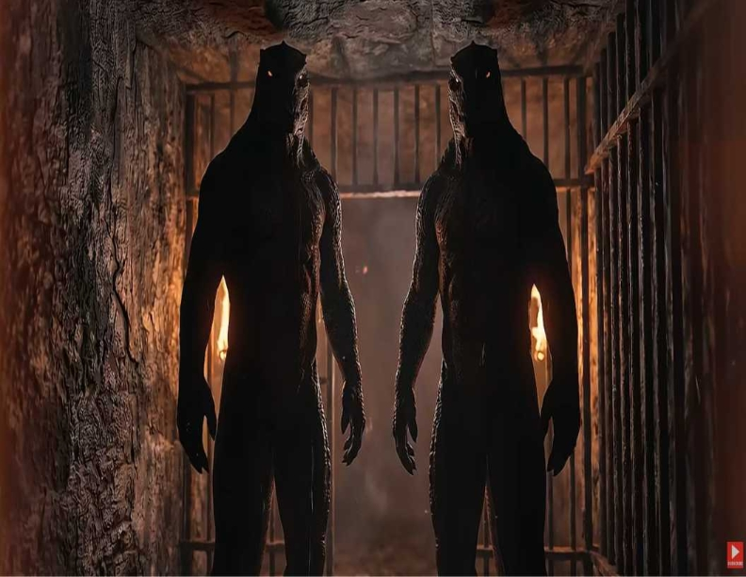
4. Faith, Obedience, and Receiving Healing

Slide 41
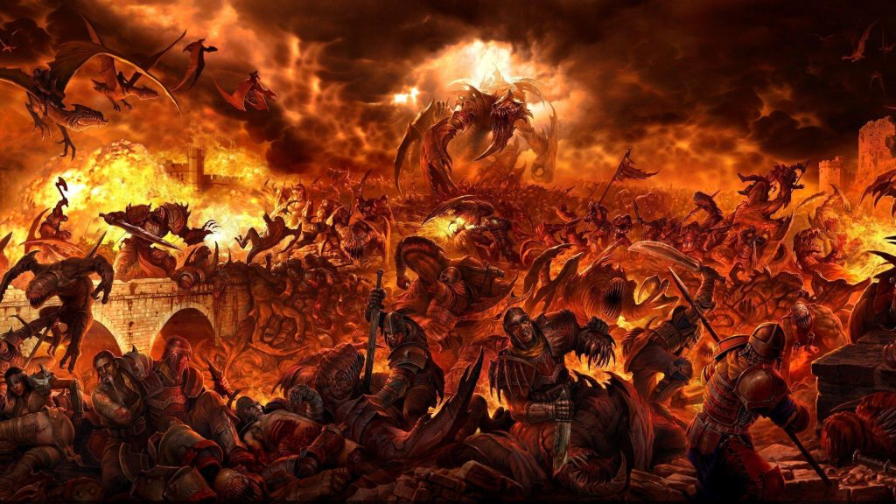
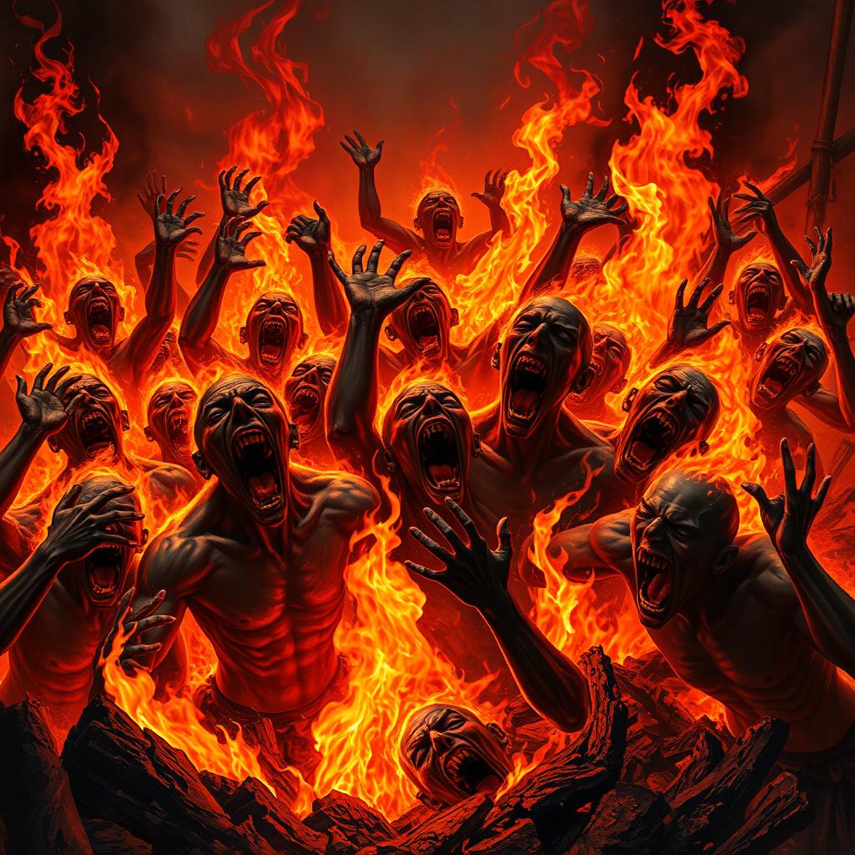
4. Faith, Obedience, and Receiving Healing

Slide 42
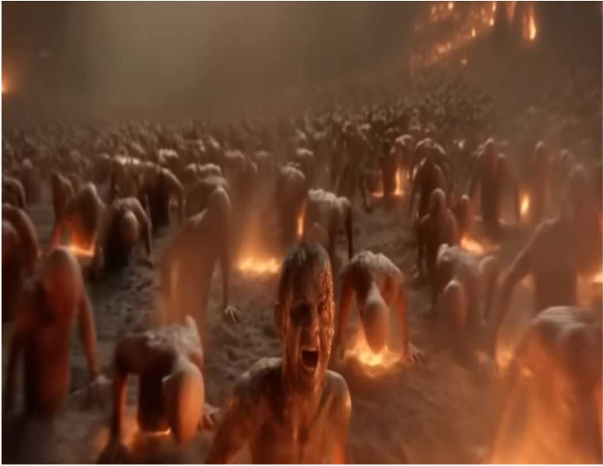
4. Faith, Obedience, and Receiving Healing

Slide 43
Psalms 88:4-5
4 I am counted with those who go down to the pit; I am like a man who has no strength, 5 Adrift among the dead, Like the slain who lie in the grave, Whom You remember no more, And who are cut off from Your hand.

Slide 44
SINCLAIR B. FERGUSON
For hell is viewed by our Lord Jesus Christ not as “made for man,” but “made for the devil and his angels.” Humans as such were made for fellowship with God and for eternal glory. That such creatures should be banished forever into the outer darkness with no escape exit, should fill us with a sense of horror.

Slide 45
Lamentations 3:1-9
I am the man who has seen affliction by the rod of His wrath. 2 He has led me and made me walk In darkness and not in light. 3 Surely He has turned His hand against me Time and time again throughout the day. 4 He has aged my flesh and my skin, And broken my bones. 5 He has besieged me And surrounded me with bitterness and woe.

Slide 46
6 He has set me in dark places Like the dead of long ago. 7 He has hedged me in so that I cannot get out; He has made my chain heavy. 8 Even when I cry and shout, He shuts out my prayer. 9 He has blocked my ways with hewn stone; He has made my paths crooked.

Slide 47
Psalms 116:3
The pains of death surrounded me, And the pangs of Sheol laid hold of me; I found trouble and sorrow.

Slide 48
Mark 5:1-6
1 Then they came to the other side of the sea, to the country of the Gadarenes. 2 And when He had come out of the boat, immediately there met Him out of the tombs a man with an unclean spirit, 3 who had his dwelling among the tombs; and no one could bind him, not even with chains,

Slide 49
4 because he had often been bound with shackles and chains. And the chains had been pulled apart by him, and the shackles broken in pieces; neither could anyone tame him. 5 And always, night and day, he was in the mountains and in the tombs, crying out and cutting himself with stones.

Slide 50
6 When he saw Jesus from afar, he ran and worshiped Him. 7 And he cried out with a loud voice and said, "What have I to do with You, Jesus, Son of the Most High God? I implore You by God that You do not torment me." 8 For He said to him, "Come out of the man, unclean spirit!" 9 Then He asked him, "What is your name?" And he answered, saying, "My name is Legion; for we are many." 10 Also he begged Him earnestly that He would not send them out of the country.

Slide 51
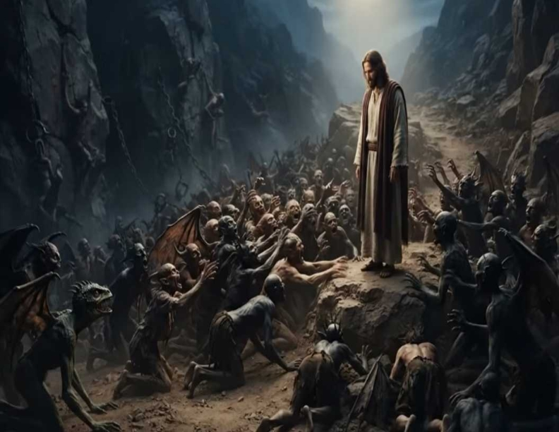
Matthew 8:5-13
5 Now when Jesus had entered Capernaum, a centurion came to Him, pleading with Him, 6 saying, "Lord, my servant is lying at home paralyzed, dreadfully tormented." 7 And Jesus said to him, "I will come and heal him." 8 The centurion answered and said, "Lord, I am not worthy that You should come under my roof. But only speak a word, and my servant will be healed.

Slide 52
A Place of Eternal Torment

Slide 53
Matthew 25:31-46
31 "When the Son of Man comes in His glory, and all the holy angels with Him, then He will sit on the throne of His glory. 32 All the nations will be gathered before Him, and He will separate them one from another, as a shepherd divides his sheep from the goats. 33 And He will set the sheep on His right hand, but the goats on the left.

Slide 54
34 Then the King will say to those on His right hand, 'Come, you blessed of My Father, inherit the kingdom prepared for you from the foundation of the world: 35 for I was hungry and you gave Me food; I was thirsty and you gave Me drink; I was a stranger and you took Me in; 36 I was naked and you clothed Me; I was sick and you visited Me; I was in prison and you came to Me.'

Slide 55
37 "Then the righteous will answer Him, saying, 'Lord, when did we see You hungry and feed You, or thirsty and give You drink? 38 When did we see You a stranger and take You in, or naked and clothe You? 39 Or when did we see You sick, or in prison, and come to You?' 40 "And the King will answer and say to them, 'Assuredly, I say to you, inasmuch as you did it to one of the least of these My brethren, you did it to Me.'

Slide 56
41 "Then He will also say to those on the left hand, 'Depart from Me, you cursed, into the everlasting fire prepared for the devil and his angels: 42 for I was hungry and you gave Me no food; I was thirsty and you gave Me no drink; 43 I was a stranger and you did not take Me in, naked and you did not clothe Me, sick and in prison and you did not visit Me.'

Slide 57
44 "Then they also will answer Him, saying, 'Lord, when did we see You hungry or thirsty or a stranger or naked or sick or in prison, and did not minister to You?' 45 "Then He will answer them, saying, 'Assuredly, I say to you, inasmuch as you did not do it to one of the least of these, you did not do it to Me.' 46 "And these will go away into everlasting punishment, but the righteous into eternal life."

Slide 58
Luke 16:19-31
19 "There was a certain rich man who was clothed in purple and fine linen and fared sumptuously every day. 20 But there was a certain beggar named Lazarus, full of sores, who was laid at his gate, 21 desiring to be fed with the crumbs which fell from the rich man's table. Moreover the dogs came and licked his sores.

Slide 59
22 So it was that the beggar died, and was carried by the angels to Abraham's bosom. The rich man also died and was buried. 23 And being in torments in Hades, he lifted up his eyes and saw Abraham afar off, and Lazarus in his bosom. 24 Then he cried and said, 'Father Abraham, have mercy on me, and send Lazarus that he may dip the tip of his finger in water and cool my tongue; for I am tormented in this flame.'

Slide 60
25 But Abraham said, 'Son, remember that in your lifetime you received your good things, and likewise Lazarus evil things; but now he is comforted and you are tormented. 26 And besides all this, between us and you there is a great gulf fixed, so that those who want to pass from here to you cannot, nor can those from there pass to us.' 27 Then he said, 'I beg you therefore, father, that you would send him to my father's house,

Slide 61
28 for I have five brothers, that he may testify to them, lest they also come to this place of torment.' 29 Abraham said to him, 'They have Moses and the prophets; let them hear them.' 30 And he said, 'No, father Abraham; but if one goes to them from the dead, they will repent.' 31 But he said to him, 'If they do not hear Moses and the prophets, neither will they be persuaded though one rise from the dead.' "

Slide 62
Where is Hell Located?

Slide 63
Sheol (Hebrew):
Often translated as "the grave" or "the pit," it is a general term for the abode of the dead.

Slide 64
Hades (Greek):
Similar to Sheol, it refers to the underworld or the place of the dead.

Slide 65
Gehenna (Greek):
Used by Jesus to depict hell, it draws on the imagery of the Valley of Hinnom, a place of burning refuse.

Slide 66
Tartarus (Greek):
Used in 2 Peter 2:4 to describe a deep abyss where certain angels are imprisoned.

Slide 67
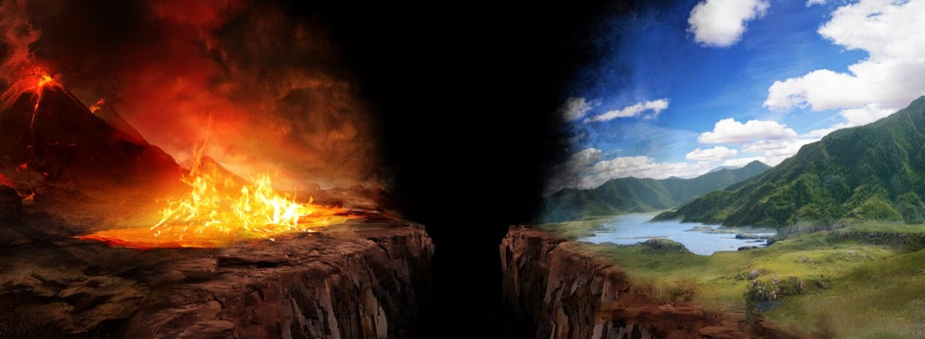
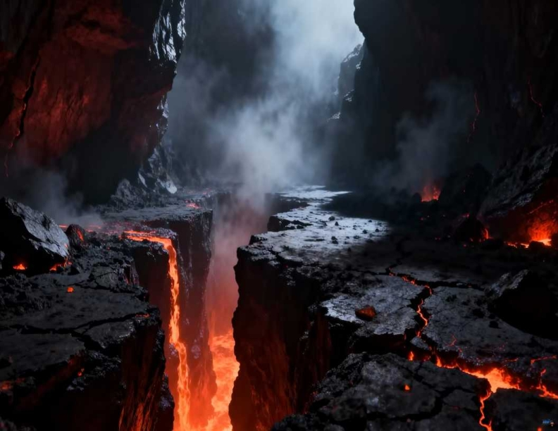
28 for I have five brothers, that he may testify to them, lest they also come to this place of torment.' 29 Abraham said to him, 'They have Moses and the prophets; let them hear them.' 30 And he said, 'No, father Abraham; but if one goes to them from the dead, they will repent.' 31 But he said to him, 'If they do not hear Moses and the prophets, neither will they be persuaded though one rise from the dead.' "

Slide 68
28 for I have five brothers, that he may testify to them, lest they also come to this place of torment.' 29 Abraham said to him, 'They have Moses and the prophets; let them hear them.' 30 And he said, 'No, father Abraham; but if one goes to them from the dead, they will repent.' 31 But he said to him, 'If they do not hear Moses and the prophets, neither will they be persuaded though one rise from the dead.' "

Slide 69
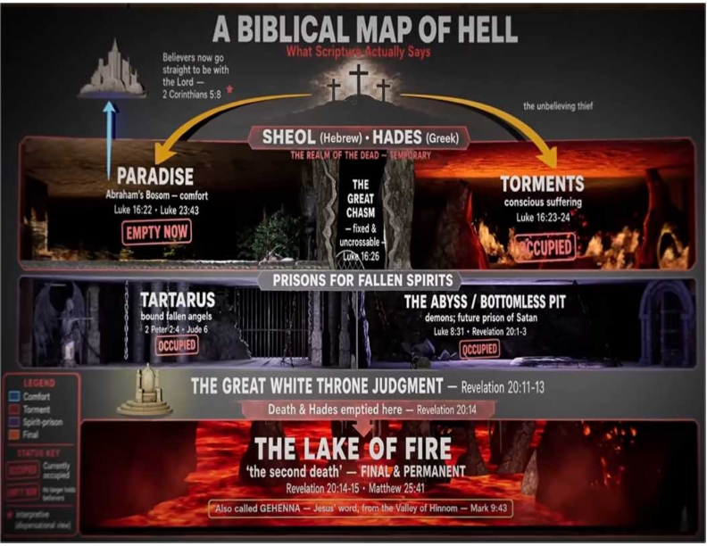
28 for I have five brothers, that he may testify to them, lest they also come to this place of torment.' 29 Abraham said to him, 'They have Moses and the prophets; let them hear them.' 30 And he said, 'No, father Abraham; but if one goes to them from the dead, they will repent.' 31 But he said to him, 'If they do not hear Moses and the prophets, neither will they be persuaded though one rise from the dead.' "

Slide 70
A Place of Eternal Torment

Slide 71
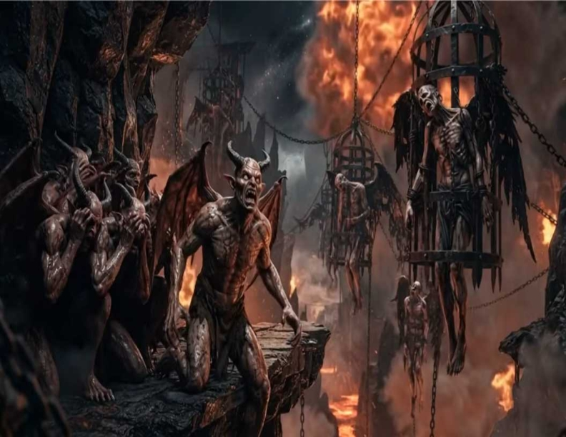
A Place of Eternal Torment

Slide 72
A Place of Eternal Torment

Slide 73
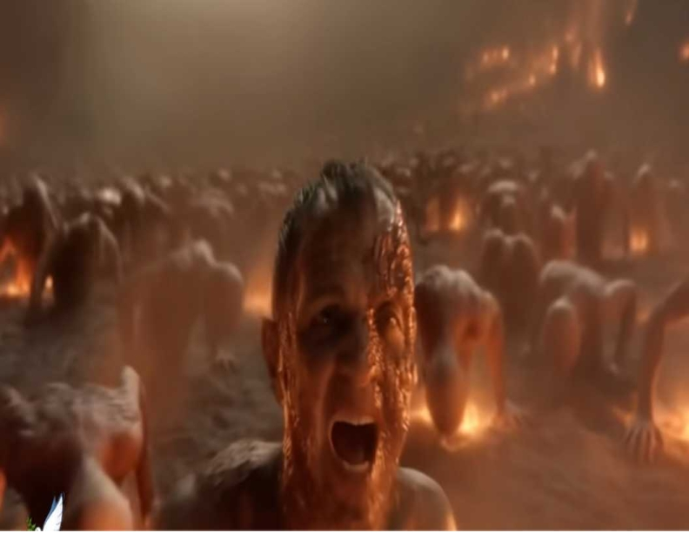
A Place of Eternal Torment

Slide 74
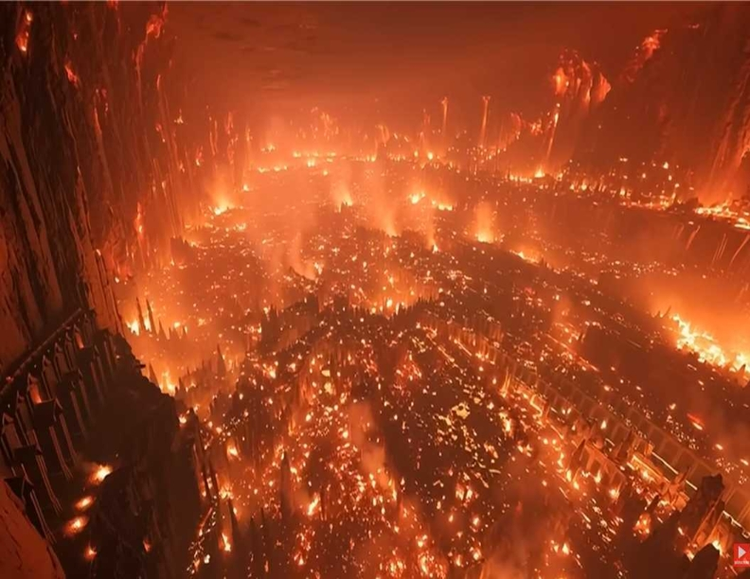
A Place of Eternal Torment

Slide 75
Jesus Will Return to Vindicate us and Judge the Unrighteous

Slide 76
2 Thessalonians 1:5-10
5 which is manifest evidence of the righteous judgment of God, that you may be counted worthy of the kingdom of God, for which you also suffer; 6 since it is a righteous thing with God to repay with tribulation those who trouble you, 7 and to give you who are troubled rest with us when the Lord Jesus is revealed from heaven with His mighty angels,

Slide 77
8 in flaming fire taking vengeance on those who do not know God, and on those who do not obey the gospel of our Lord Jesus Christ. 9 These shall be punished with everlasting destruction from the presence of the Lord and from the glory of His power, 10 when He comes, in that Day, to be glorified in His saints and to be admired among all those who believe, because our testimony among you was believed.

Slide 78
Jude 14-15
14 Now Enoch, the seventh from Adam, prophesied about these men also, saying, "Behold, the Lord comes with ten thousands of His saints, 15 to execute judgment on all, to convict all who are ungodly among them of all their ungodly deeds which they have committed in an ungodly way, and of all the harsh things which ungodly sinners have spoken against Him."

Slide 79
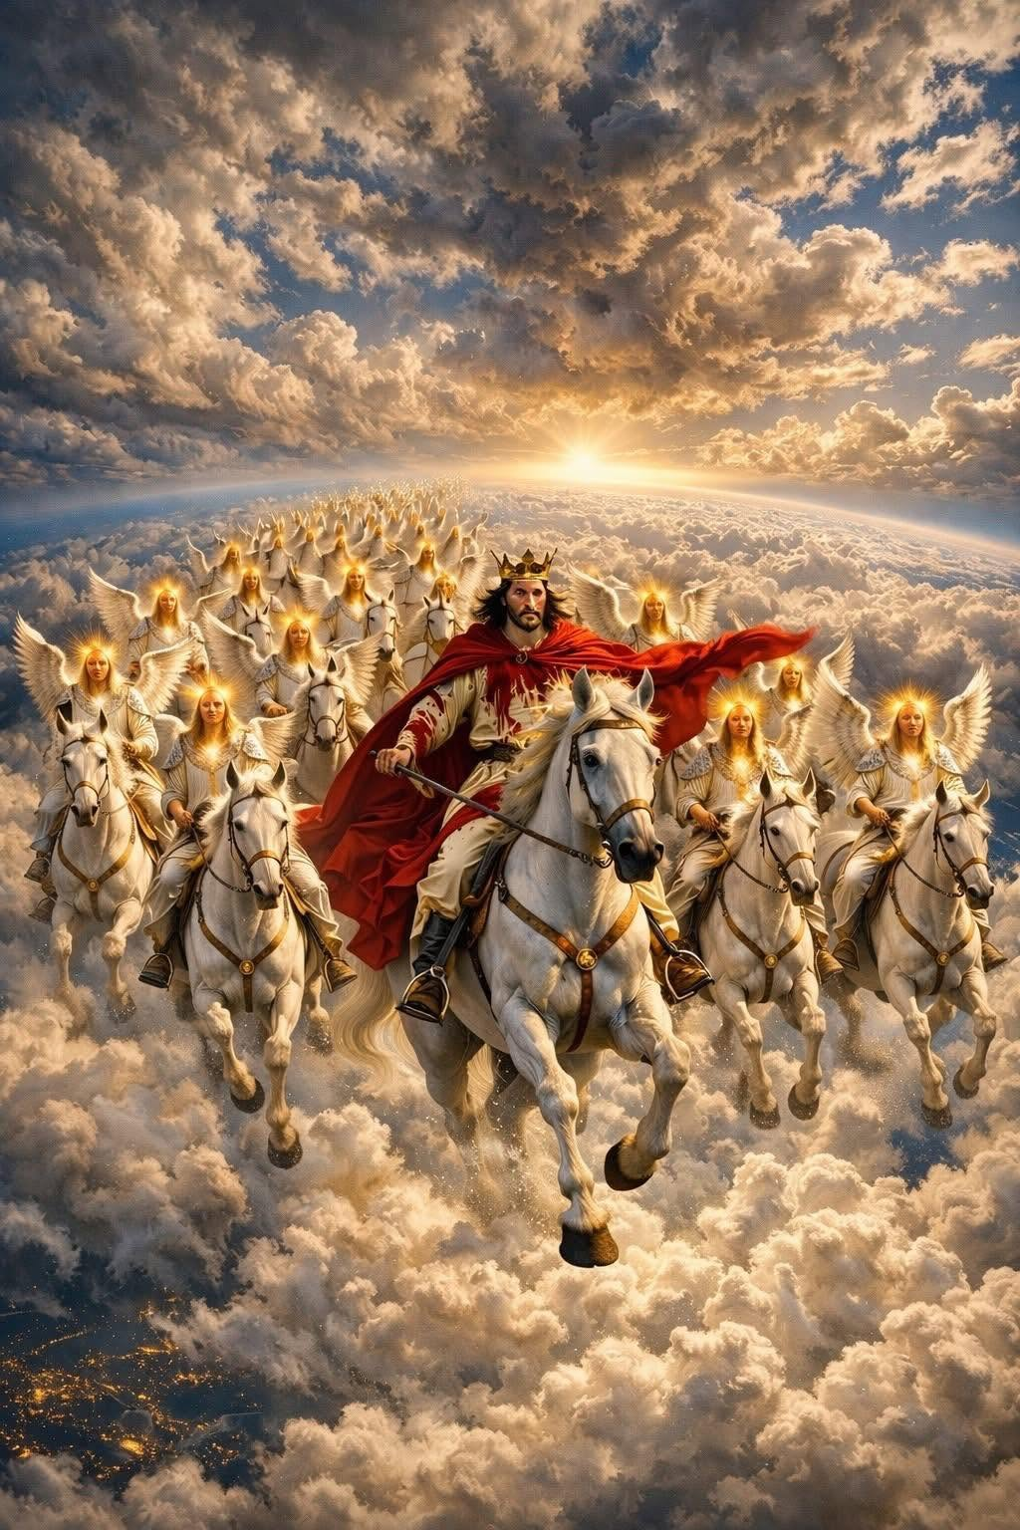

Slide 80
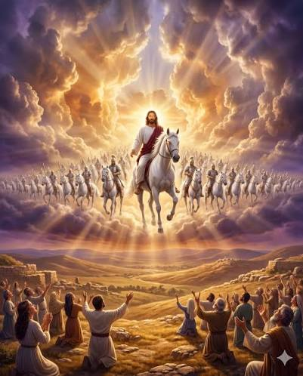

Slide 81
God’s Home for His People!

Slide 82
Revelation 21:1-5
1 Now I saw a new heaven and a new earth, for the first heaven and the first earth had passed away. Also there was no more sea. 2 Then I, John, saw the holy city, New Jerusalem, coming down out of heaven from God, prepared as a bride adorned for her husband.

Slide 83
3 And I heard a loud voice from heaven saying, "Behold, the tabernacle of God is with men, and He will dwell with them, and they shall be His people. God Himself will be with them and be their God.

Slide 84
4 And God will wipe away every tear from their eyes; there shall be no more death, nor sorrow, nor crying. There shall be no more pain, for the former things have passed away." 5 Then He who sat on the throne said, "Behold, I make all things new."

Slide 85
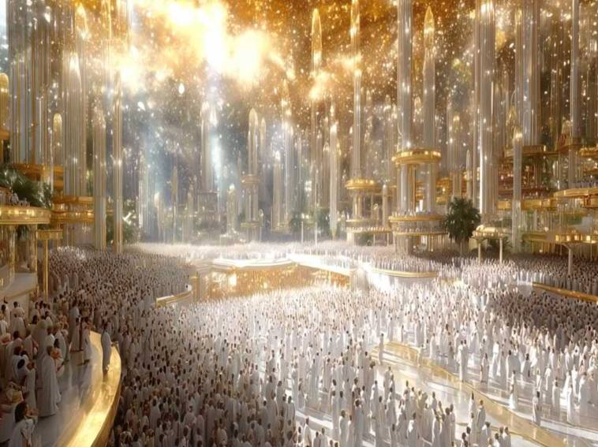
God’s Home for His People!

Slide 86
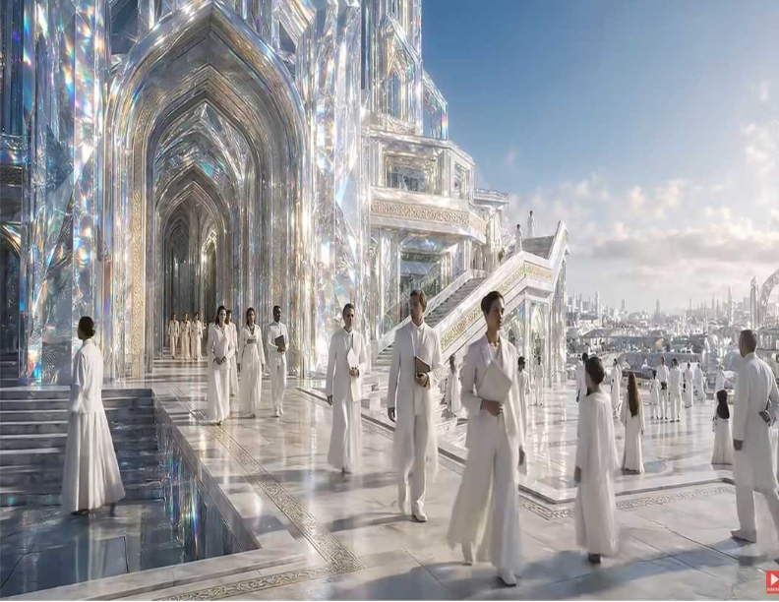
God’s Home for His People!

Slide 87
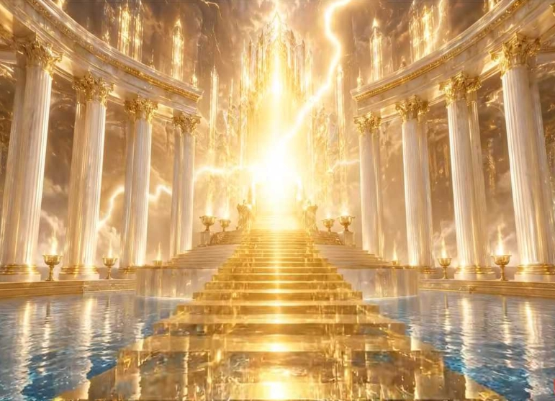
God’s Home for His People!

Slide 88
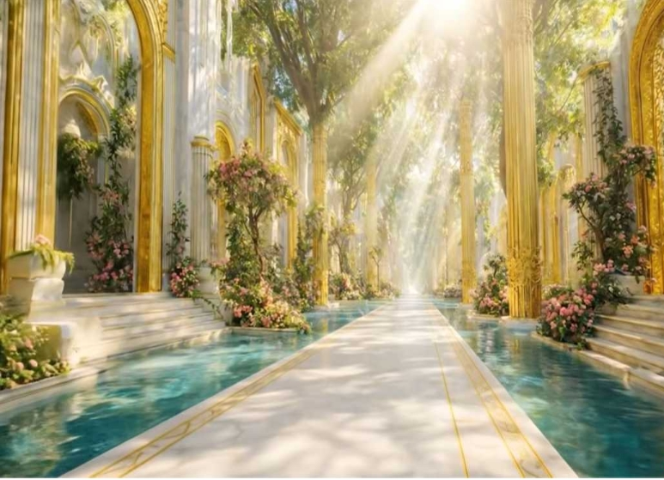
God’s Home for His People!

Slide 89
John 14:1-4
1 "Let not your heart be troubled; you believe in God, believe also in Me. 2 In My Father's house are many mansions; if it were not so, I would have told you. I go to prepare a place for you. 3 And if I go and prepare a place for you, I will come again and receive you to Myself; that where I am, there you may be also. 4 And where I go you know, and the way you know."

Slide 90
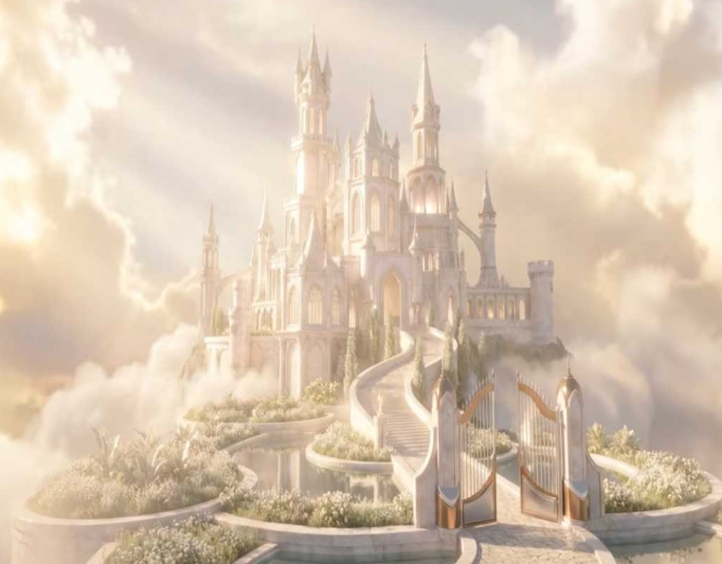
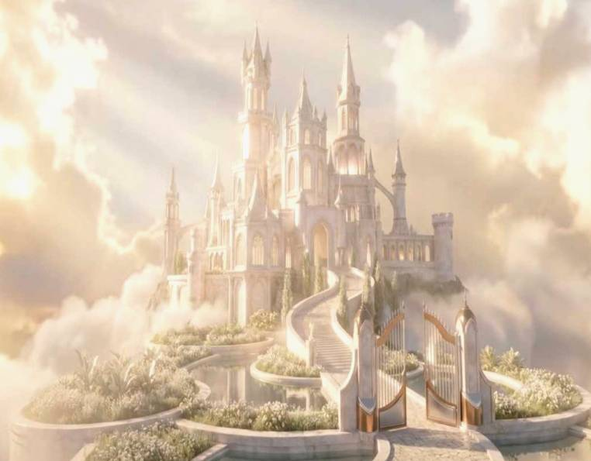
God’s Home for His People!

Slide 91
1 Thessalonians 4:13-18
13 But I do not want you to be ignorant, brethren, concerning those who have fallen asleep, lest you sorrow as others who have no hope. 14 For if we believe that Jesus died and rose again, even so God will bring with Him those who sleep in Jesus.

Slide 92
15 For this we say to you by the word of the Lord, that we who are alive and remain until the coming of the Lord will by no means precede those who are asleep. 16 For the Lord Himself will descend from heaven with a shout, with the voice of an archangel, and with the trumpet of God. And the dead in Christ will rise first.

Slide 93
17 Then we who are alive and remain shall be caught up together with them in the clouds to meet the Lord in the air. And thus we shall always be with the Lord. 18 Therefore comfort one another with these words.

Slide 94
1 Corinthians 15:50-54
50 Now this I say, brethren, that flesh and blood cannot inherit the kingdom of God; nor does corruption inherit incorruption. 51 Behold, I tell you a mystery: We shall not all sleep, but we shall all be changed-- 52 in a moment, in the twinkling of an eye, at the last trumpet. For the trumpet will sound, and the dead will be raised incorruptible, and we shall be changed.

Slide 95
53 For this corruptible must put on incorruption, and this mortal must put on immortality. 54 So when this corruptible has put on incorruption, and this mortal has put on immortality, then shall be brought to pass the saying that is written: "Death is swallowed up in victory."

Slide 96

20 Again, when a righteous man turns from his righteousness and commits iniquity, and I lay a stumbling block before him, he shall die; because you did not give him warning, he shall die in his sin, and his righteousness which he has done shall not be remembered; but his blood I will require at your hand.

Slide 97
Acts 2:38-39
38 Then Peter said to them, "Repent, and let every one of you be baptized in the name of Jesus Christ for the remission of sins; and you shall receive the gift of the Holy Spirit. 39 For the promise is to you and to your children, and to all who are afar off, as many as the Lord our God will call."

Slide 98
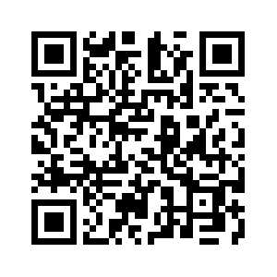
Donate with our QR code app to
Amazing Grace Christian Fellowship
Donations are Deeply Appreciated!

