Slide 1


Slide 2


Slide 3

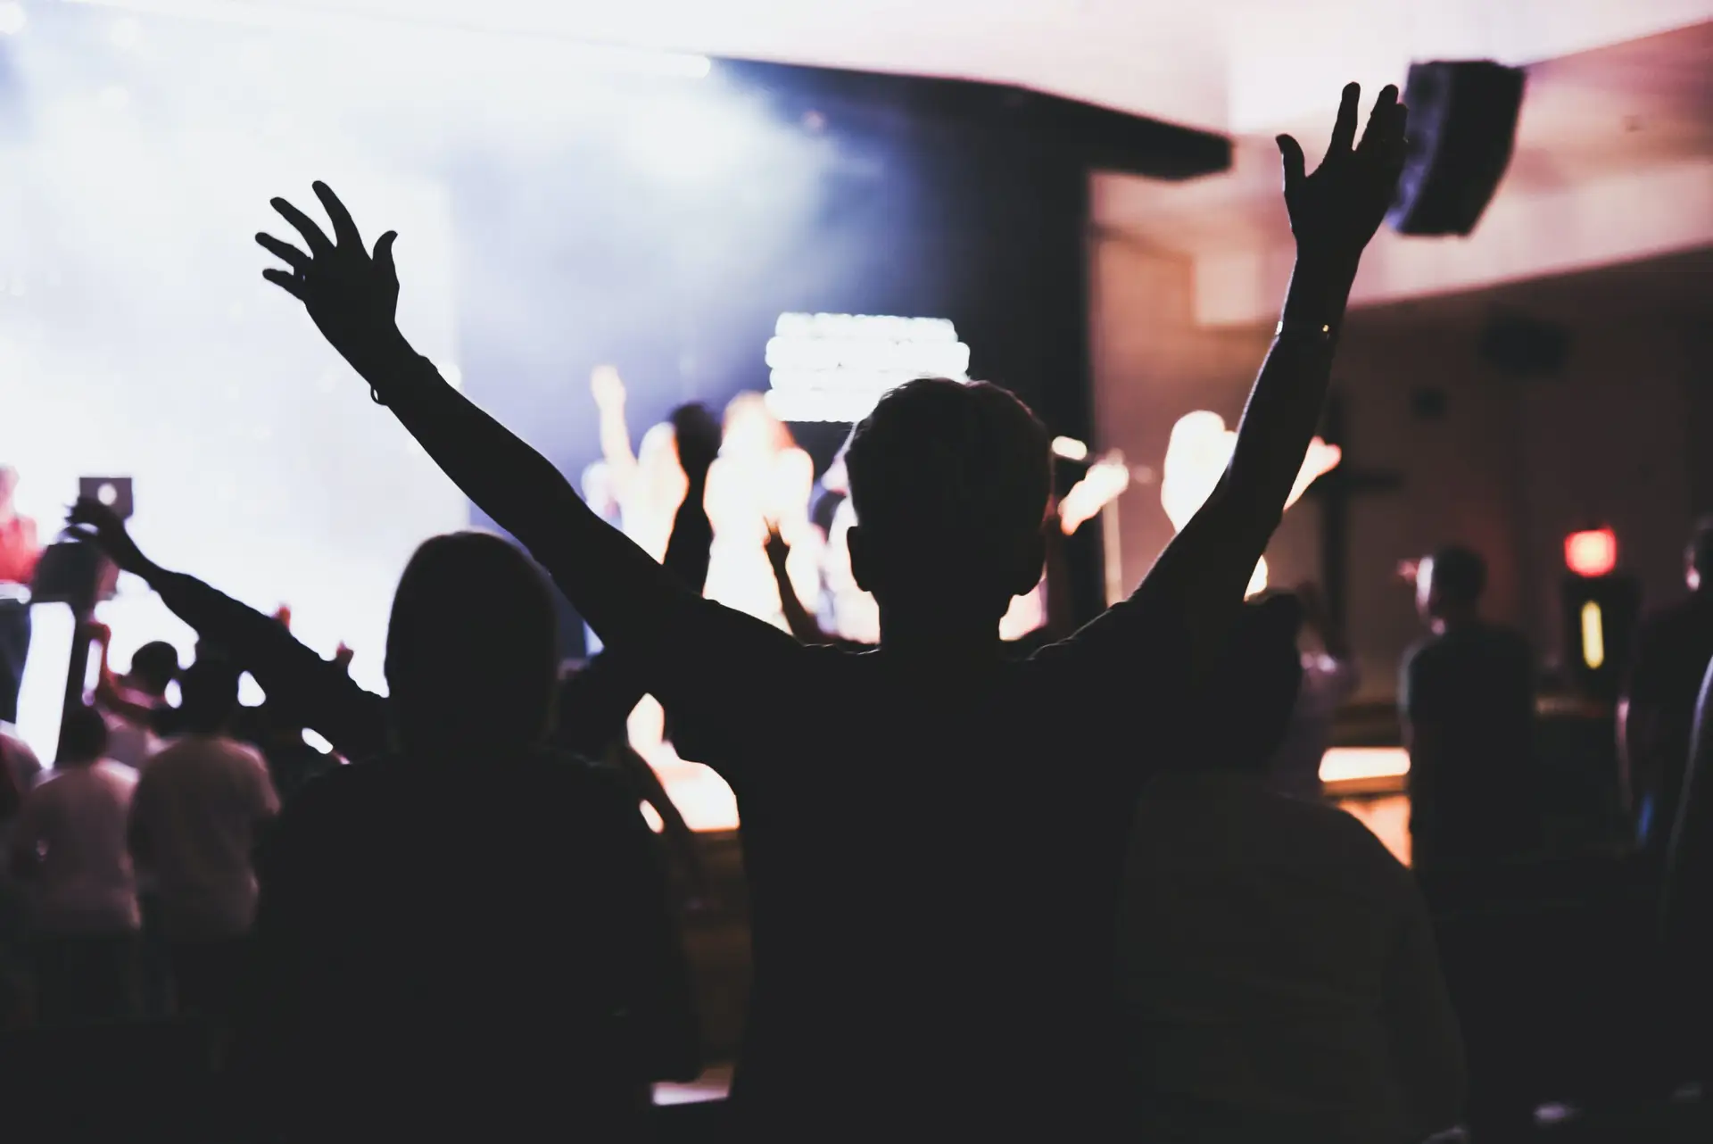
Growing in Jesus-Salvation, Sanctification
& Revival in God’s Timing
by Minister Louie Peraza
Phillippians 1:6
Sunday Morning
September 27, 2026

Slide 4
Philippians 1:6
being confident of this very thing, that He who has begun a good work in you will complete it until the day of Jesus Christ;

Slide 5
•What salvation is
•How God sets us apart (sanctifies us)
•What Jesus revival looks like in our lives
•How we can proclaim Jesus to others

Slide 6
Point 1: What salvation is and
What Salvation is Not

Slide 7
Ephesians 2:8-9
8 For by grace you have been saved through faith, and that not of yourselves; it is the gift of God, 9 not of works, lest anyone should boast.

Slide 8
Romans 10:9-10
9 that if you confess with your mouth the Lord Jesus and believe in your heart that God has raised Him from the dead, you will be saved. 10 For with the heart one believes unto righteousness, and with the mouth confession is made unto salvation.

Slide 9
John 1:12-13
12 But as many as received Him, to them He gave the right to become children of God, to those who believe in His name: 13 who were born, not of blood, nor of the will of the flesh, nor of the will of man, but of God.

Slide 10
Point 2: Spiritual Growth Happens in God’s Timing

Slide 11
2 Peter 3:18
but grow in the grace and knowledge of our Lord and Savior Jesus Christ. To Him be the glory both now and forever. Amen.

Slide 12
Ecclesiastics 3:1
To everything there is a season, A time for every purpose under heaven:

Slide 13
Point 3: How We Are Sanctified-
Set Apart for God

Slide 14
1 Thessalonians 5:23-24
23 Now may the God of peace Himself sanctify you completely; and may your whole spirit, soul, and body be preserved blameless at the coming of our Lord Jesus Christ. 24 He who calls you is faithful, who also will do it.

Slide 15
John 17:17
Sanctify them by Your truth. Your word is truth.

Slide 16
Sanctify: to set them apart for sacred purpose or to make holy. To be separated from common or unclean use and dedicated exclusively to God.

Slide 17
Romans 12:1-2
1 I beseech you therefore, brethren, by the mercies of God, that you present your bodies a living sacrifice, holy, acceptable to God, which is your reasonable service. 2 And do not be conformed to this world, but be transformed by the renewing of your mind, that you may prove what is that good and acceptable and perfect will of God.

Slide 18
Point 4: Jesus Revival & How
to Proclaim Jesus to Others

Slide 19
Acts 1:8
But you shall receive power when the Holy Spirit has come upon you; and you shall be witnesses to Me in Jerusalem, and in all Judea and Samaria, and to the end of the earth."

Slide 20
2 Corinthians 5:17-20
17 Therefore, if anyone is in Christ, he is a new creation; old things have passed away; behold, all things have become new. 18 Now all things are of God, who has reconciled us to Himself through Jesus Christ, and has given us the ministry of reconciliation,

Slide 21
19 that is, that God was in Christ reconciling the world to Himself, not imputing their trespasses to them, and has committed to us the word of reconciliation. 20 Now then, we are ambassadors for Christ, as though God were pleading through us: we implore you on Christ's behalf, be reconciled to God.

Slide 22
Hebrews 12:1-2
1 Therefore we also, since we are surrounded by so great a cloud of witnesses, let us lay aside every weight, and the sin which so easily ensnares us, and let us run with endurance the race that is set before us, 2 looking unto Jesus, the author and finisher of our faith, who for the joy that was set before Him endured the cross, despising the shame, and has sat down at the right hand of the throne of God.

Slide 23
1 Thessalonians 4:13-18
13 But I do not want you to be ignorant, brethren, concerning those who have fallen asleep, lest you sorrow as others who have no hope. 14 For if we believe that Jesus died and rose again, even so God will bring with Him those who sleep in Jesus.

Slide 24
15 For this we say to you by the word of the Lord, that we who are alive and remain until the coming of the Lord will by no means precede those who are asleep. 16 For the Lord Himself will descend from heaven with a shout, with the voice of an archangel, and with the trumpet of God. And the dead in Christ will rise first.

Slide 25
17 Then we who are alive and remain shall be caught up together with them in the clouds to meet the Lord in the air. And thus we shall always be with the Lord. 18 Therefore comfort one another with these words.

Slide 26
1 Corinthians 15:50-54
50 Now this I say, brethren, that flesh and blood cannot inherit the kingdom of God; nor does corruption inherit incorruption. 51 Behold, I tell you a mystery: We shall not all sleep, but we shall all be changed-- 52 in a moment, in the twinkling of an eye, at the last trumpet. For the trumpet will sound, and the dead will be raised incorruptible, and we shall be changed.

Slide 27
53 For this corruptible must put on incorruption, and this mortal must put on immortality. 54 So when this corruptible has put on incorruption, and this mortal has put on immortality, then shall be brought to pass the saying that is written: "Death is swallowed up in victory."

Slide 28

20 Again, when a righteous man turns from his righteousness and commits iniquity, and I lay a stumbling block before him, he shall die; because you did not give him warning, he shall die in his sin, and his righteousness which he has done shall not be remembered; but his blood I will require at your hand.

Slide 29
Acts 2:38-39
38 Then Peter said to them, "Repent, and let every one of you be baptized in the name of Jesus Christ for the remission of sins; and you shall receive the gift of the Holy Spirit. 39 For the promise is to you and to your children, and to all who are afar off, as many as the Lord our God will call."

Slide 30
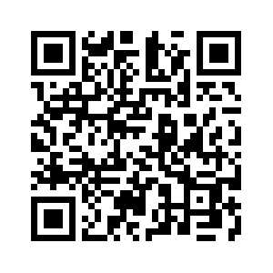
Donate with our QR code app to
Amazing Grace Christian Fellowship
Donations are Deeply Appreciated!

