Slide 1


Slide 2


Slide 3
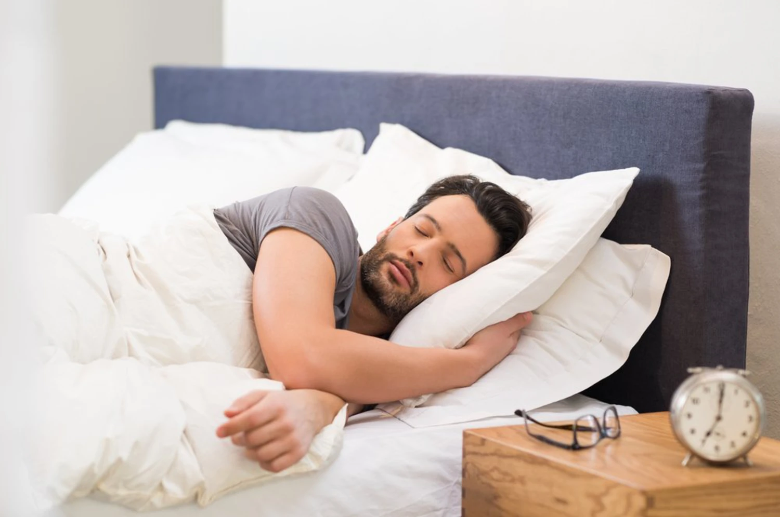

It’s Time to Awake
by Pastor Fee Soliven
Ephesians 5:8-14
Sunday Morning
September 20, 2026

Slide 4
Ephesians 5:8-14
8 For you were once darkness, but now you are light in the Lord. Walk as children of light 9(for the fruit of the Spirit is in all goodness, righteousness, and truth), 10 finding out what is acceptable to the Lord. 11 And have no fellowship with the unfruitful works of darkness, but rather expose them.

Slide 5
12 For it is shameful even to speak of those things which are done by them in secret. 13 But all things that are exposed are made manifest by the light, for whatever makes manifest is light. 14 Therefore He says: "Awake, you who sleep, Arise from the dead, And Christ will give you light."

Slide 6
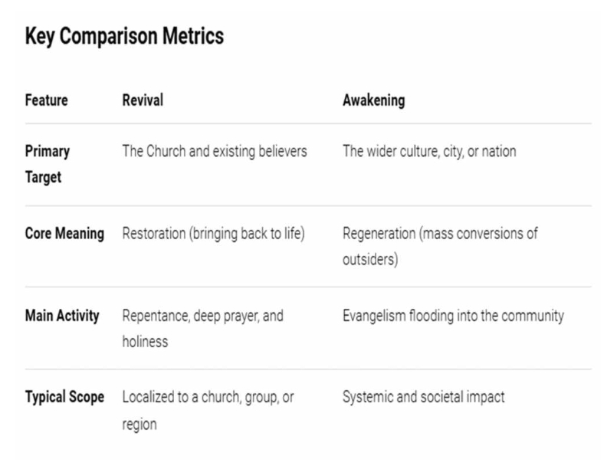
Genesis 1:1
In the beginning God created the heavens and the earth.

Slide 7
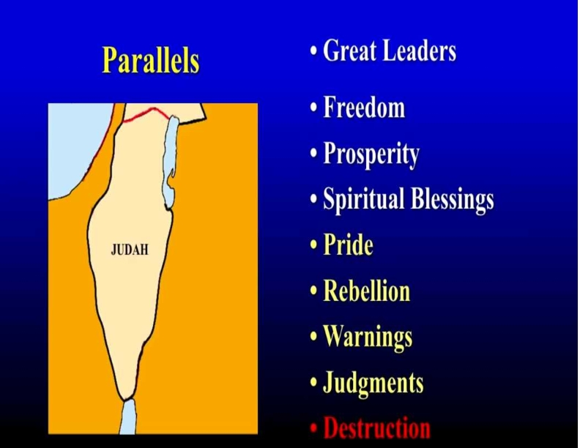
John 1:4-5
4 In Him was life, and the life was the light of men. 5 And the light shines in the darkness, and the darkness did not comprehend it.

Slide 8

Genesis 1:3-4
3 Then God said, "Let there be light"; and there was light. 4 And God saw the light, that it was good; and God divided the light from the darkness.

Slide 9
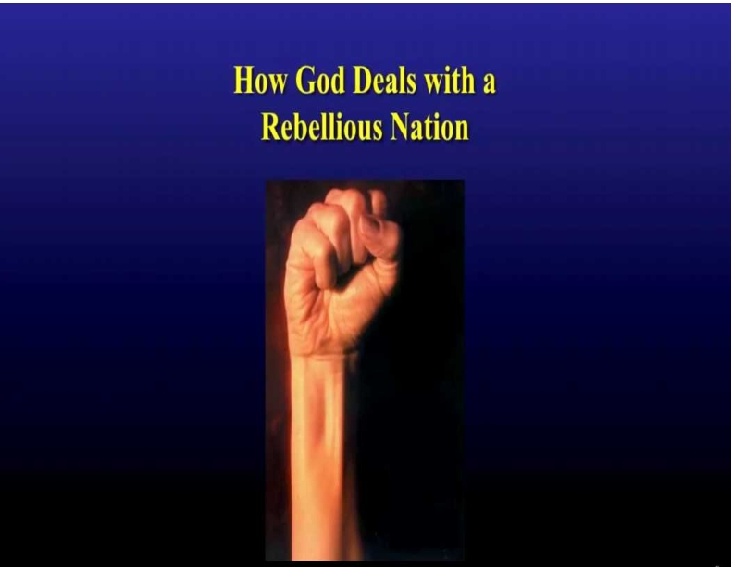
Luke 23:34
Then Jesus said, "Father, forgive them, for they do not know what they do." And they divided His garments and cast lots.

Slide 10
Proverbs 14:34
Righteousness exalts a nation, But sin is a reproach to any people.

Slide 11
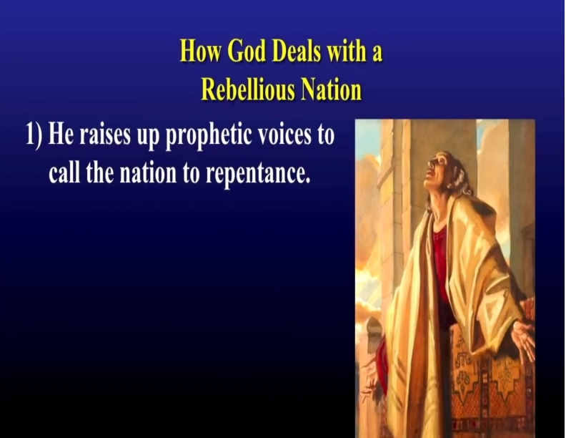
John 9:5
As long as I am in the world, I am the light of the world."

Slide 12
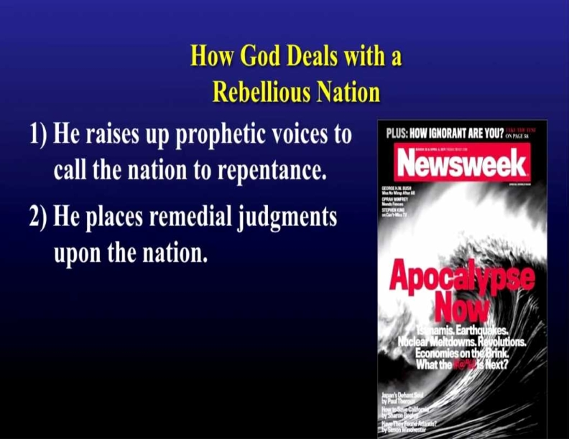
Psalm 36:9
For with You is the fountain of life; In Your light we see light.

Slide 13
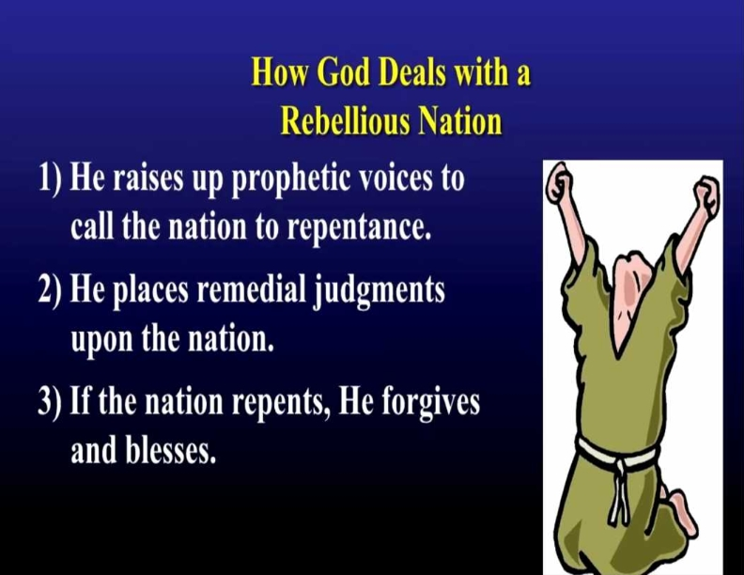
Isaiah 9:2
The people who walked in darkness Have seen a great light; Those who dwelt in the land of the shadow of death, Upon them a light has shined.

Slide 14
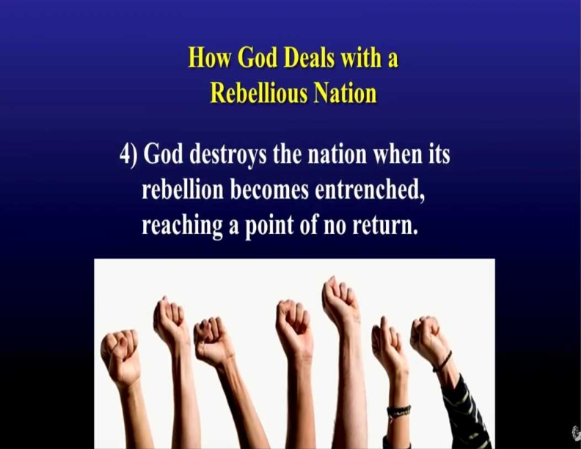
Psalms 23:4
Yea, though I walk through the valley of the shadow of death, I will fear no evil; For You are with me; Your rod and Your staff, they comfort me.

Slide 15
Jeremiah 18:7-8
7 The instant I speak concerning a nation and concerning a kingdom, to pluck up, to pull down, and to destroy it, 8 if that nation against whom I have spoken turns from its evil, I will relent of the disaster that I thought to bring upon it.

Slide 16
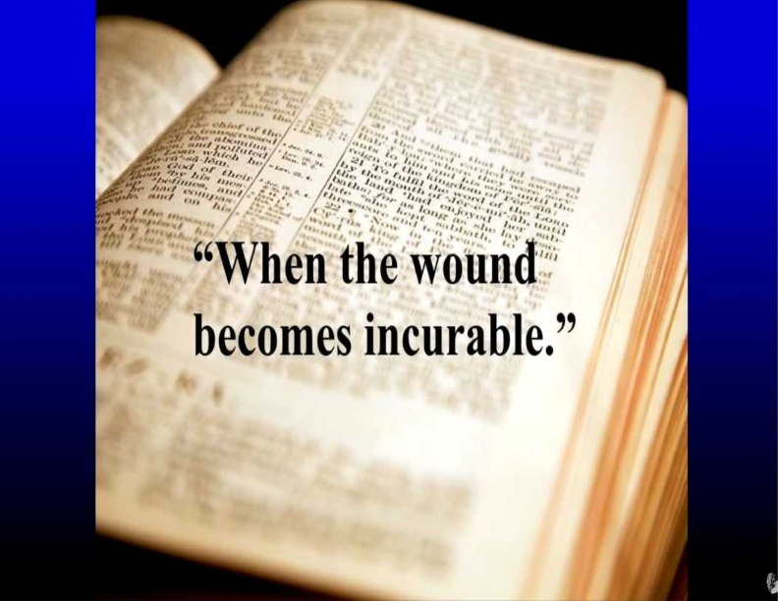
1 Peter 2:9
But you are a chosen generation, a royal priesthood, a holy nation, His own special people, that you may proclaim the praises of Him who called you out of darkness into His marvelous light;

Slide 17
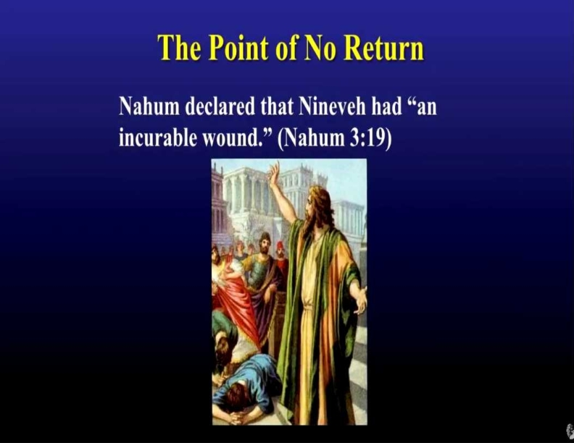
John 1:6-13
6 There was a man sent from God, whose name was John. 7 This man came for a witness, to bear witness of the Light, that all through him might believe. 8 He was not that Light, but was sent to bear witness of that Light. 9 That was the true Light which gives light to every man coming into the world. 10 He was in the world, and the world was made through Him, and the world did not know Him.

Slide 18
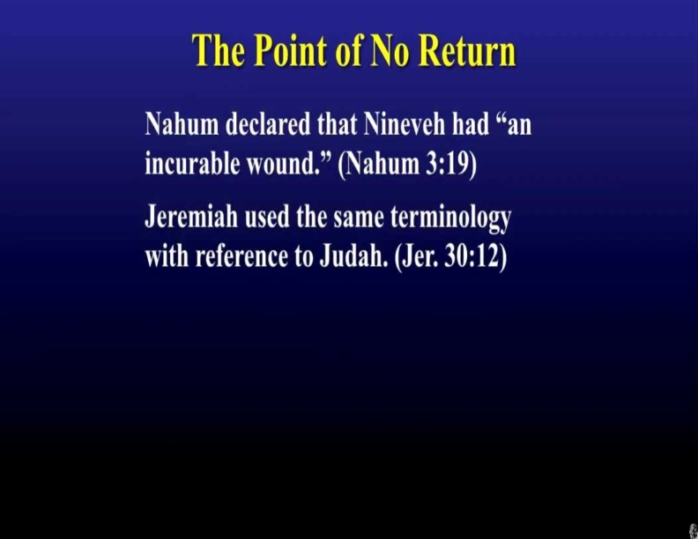
John 8:13-15
13 The Pharisees therefore said to Him, "You bear witness of Yourself; Your witness is not true." 14 Jesus answered and said to them, "Even if I bear witness of Myself, My witness is true, for I know where I came from and where I am going; but you do not know where I come from and where I am going. 15 You judge according to the flesh; I judge no one.

Slide 19
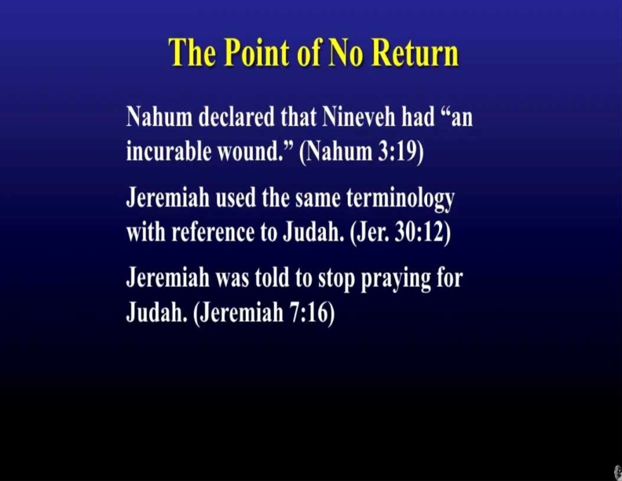
John 12:47
And if anyone hears My words and does not believe, I do not judge him; for I did not come to judge the world but to save the world.

Slide 20
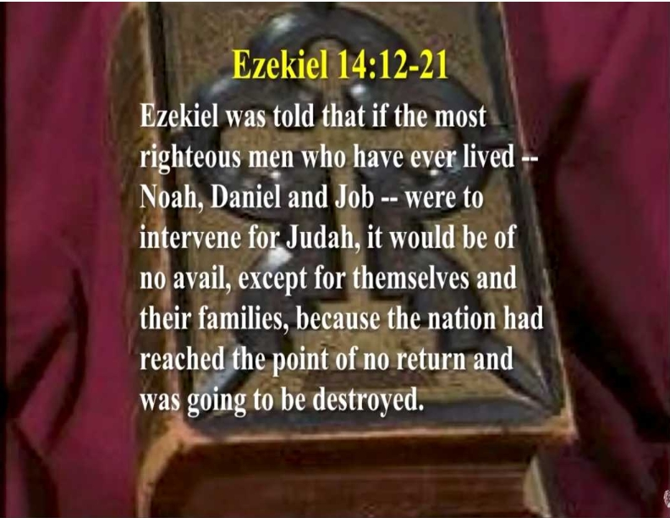
John 3:17
For God did not send His Son into the world to condemn the world, but that the world through Him might be saved.

Slide 21
Nahum 3:19
Your injury has no healing, Your wound is severe. All who hear news of you Will clap their hands over you, For upon whom has not your wickedness passed continually?

Slide 22
Jeremiah 30:12-14
12 "For thus says the LORD: 'Your affliction is incurable, Your wound is severe. 13 There is no one to plead your cause, That you may be bound up; You have no healing medicines. 14 All your lovers have forgotten you; They do not seek you; For I have wounded you with the wound of an enemy, With the chastisement of a cruel one, For the multitude of your iniquities, Because your sins have increased.

Slide 23
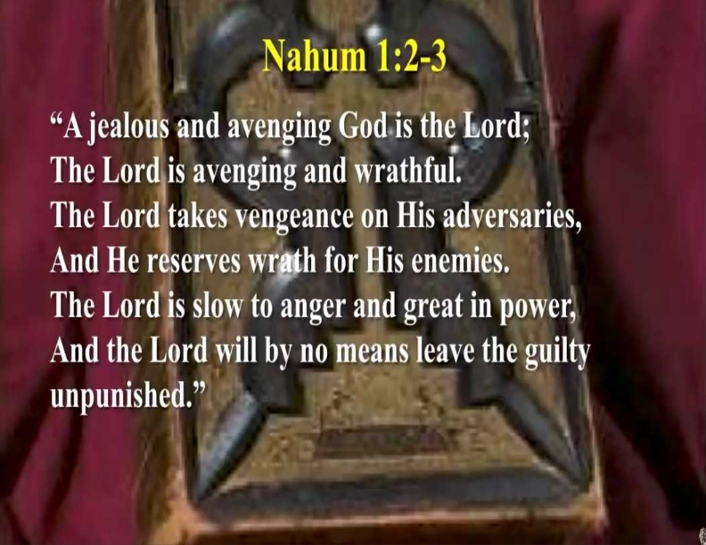
2 Corinthians 4:3-6
3 But even if our gospel is veiled, it is veiled to those who are perishing, 4 whose minds the god of this age has blinded, who do not believe, lest the light of the gospel of the glory of Christ, who is the image of God, should shine on them. 5 For we do not preach ourselves, but Christ Jesus the Lord, and ourselves your bondservants for Jesus' sake.

Slide 24
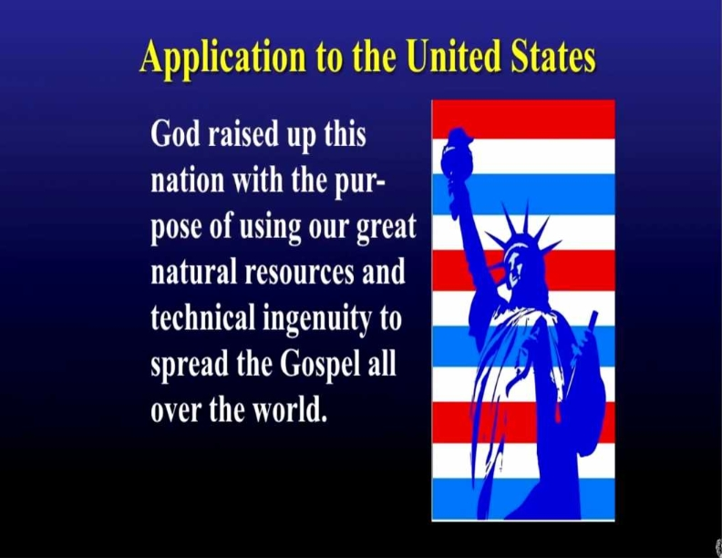
6 For it is the God who commanded light to shine out of darkness, who has shone in our hearts to give the light of the knowledge of the glory of God in the face of Jesus Christ.

Slide 25
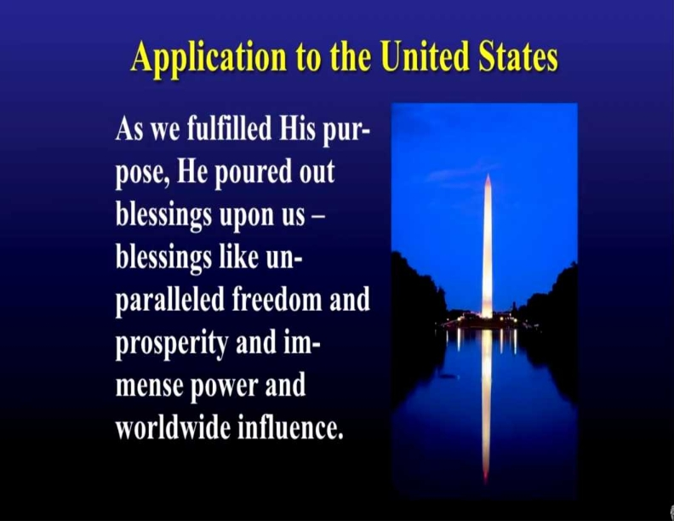
John 8:19-20
19 Then they said to Him, "Where is Your Father?" Jesus answered, "You know neither Me nor My Father. If you had known Me, you would have known My Father also." 20 These words Jesus spoke in the treasury, as He taught in the temple; and no one laid hands on Him, for His hour had not yet come.

Slide 26
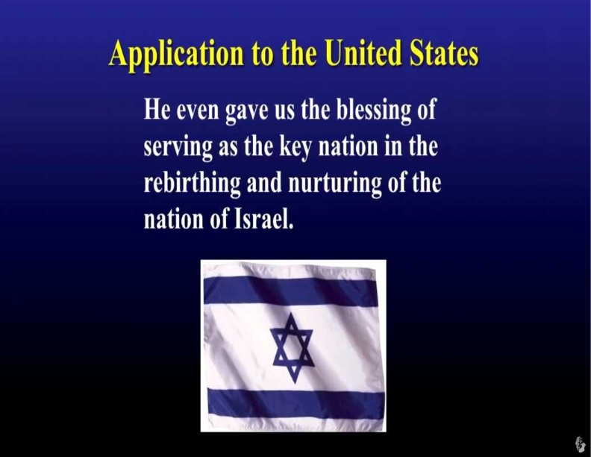
John 8:21-59
21 Then Jesus said to them again, "I am going away, and you will seek Me, and will die in your sin. Where I go you cannot come." 22 So the Jews said, "Will He kill Himself, because He says, 'Where I go you cannot come'?" 23 And He said to them, "You are from beneath; I am from above. You are of this world; I am not of this world.

Slide 27
Proverbs 14:34
Righteousness exalts a nation, But sin is a reproach to any people.

Slide 28
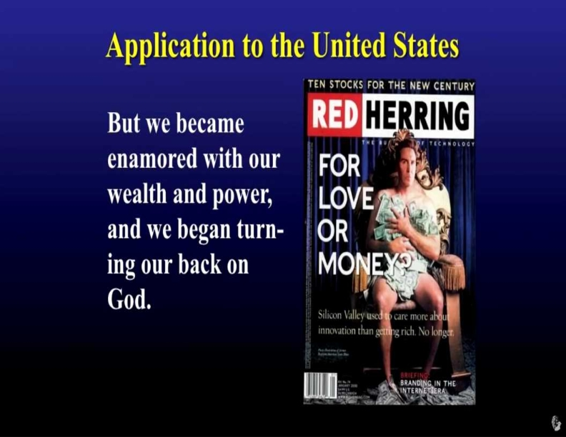
24 Therefore I said to you that you will die in your sins; for if you do not believe that I am He, you will die in your sins." 25 Then they said to Him, "Who are You?" And Jesus said to them, "Just what I have been saying to you from the beginning. 26 I have many things to say and to judge concerning you, but He who sent Me is true; and I speak to the world those things which I heard from Him."

Slide 29
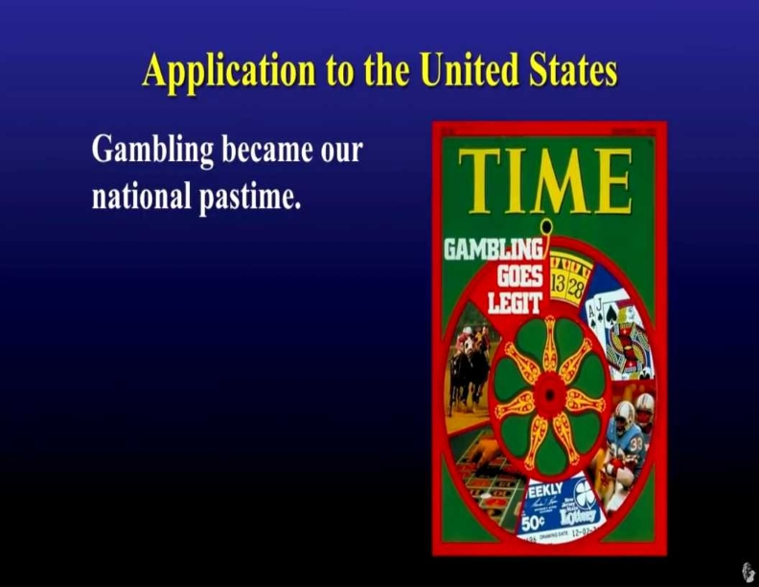
38 I speak what I have seen with My Father, and you do what you have seen with your father." 39 They answered and said to Him, "Abraham is our father." Jesus said to them, "If you were Abraham's children, you would do the works of Abraham. 40 But now you seek to kill Me, a Man who has told you the truth which I heard from God. Abraham did not do this.

Slide 30
Proverbs 13:11
Wealth gained hastily will dwindle, but whoever gathers little by little will increase it.

Slide 31
Proverbs 15:27
Whoever is greedy for unjust gain troubles his own household, but he who hates bribes will live.

Slide 32
Proverbs 20:21
An inheritance gained hastily in the beginning will not be blessed in the end.

Slide 33
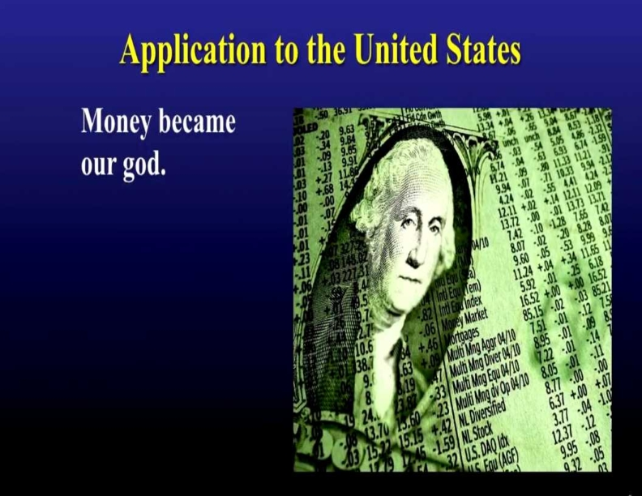
30 As He spoke these words, many believed in Him. 31 Then Jesus said to those Jews who believed Him, "If you abide in My word, you are My disciples indeed. 32 And you shall know the truth, and the truth shall make you free." 33 They answered Him, "We are Abraham's descendants, and have never been in bondage to anyone. How can you say, 'You will be made free'?"

Slide 34
1 Timothy 6:10
For the love of money is a root of all kinds of evil, for which some have strayed from the faith in their greediness, and pierced themselves through with many sorrows.

Slide 35
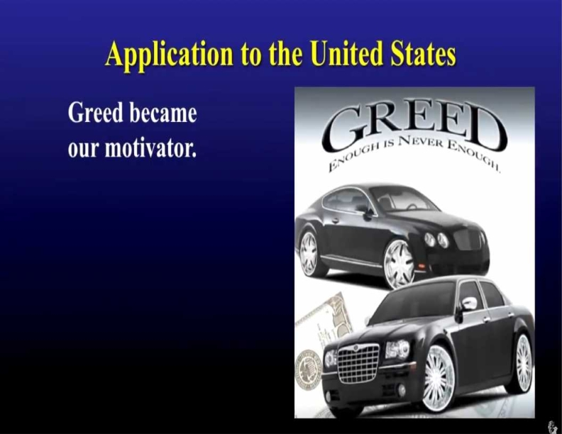
34 Jesus answered them, "Most assuredly, I say to you, whoever commits sin is a slave of sin. 35 And a slave does not abide in the house forever, but a son abides forever. 36 Therefore if the Son makes you free, you shall be free indeed. 37 "I know that you are Abraham's descendants, but you seek to kill Me, because My word has no place in you.

Slide 36
Colossians 3:5-7
5 Therefore put to death your members which are on the earth: fornication, uncleanness, passion, evil desire, and covetousness, which is idolatry. 6 Because of these things the wrath of God is coming upon the sons of disobedience, 7 in which you yourselves once walked when you lived in them

Slide 37
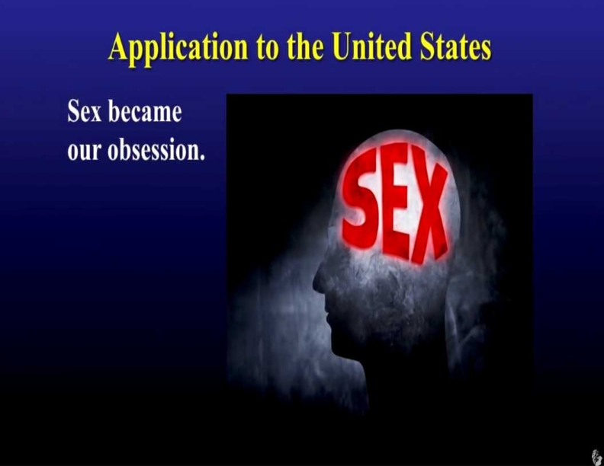
41 You do the deeds of your father." Then they said to Him, "We were not born of fornication; we have one Father--God." 42 Jesus said to them, "If God were your Father, you would love Me, for I proceeded forth and came from God; nor have I come of Myself, but He sent Me. 43 Why do you not understand My speech? Because you are not able to listen to My word.

Slide 38
1 Corinthians 6:18-20
18 Flee sexual immorality. Every sin that a man does is outside the body, but he who commits sexual immorality sins against his own body. 19 Or do you not know that your body is the temple of the Holy Spirit who is in you, whom you have from God, and you are not your own? 20 For you were bought at a price; therefore glorify God in your body and in your spirit, which are God's.

Slide 39
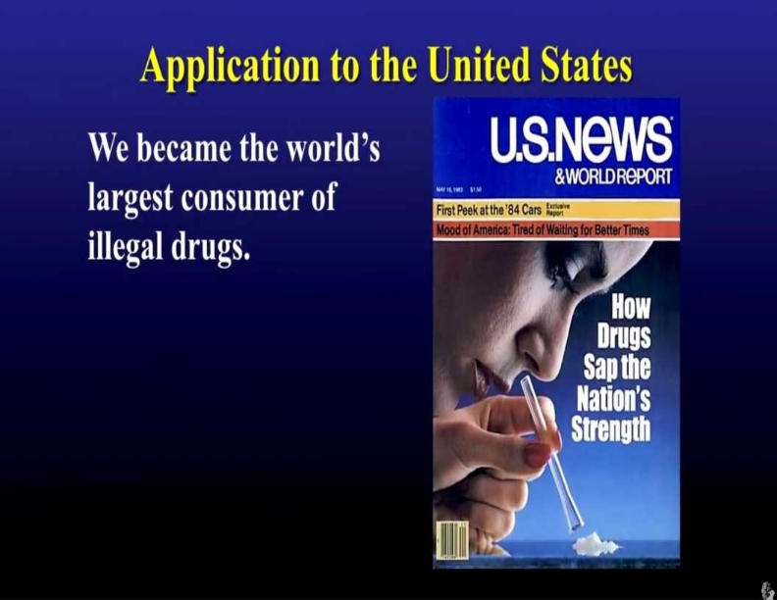
47 He who is of God hears God's words; therefore you do not hear, because you are not of God." 48 Then the Jews answered and said to Him, "Do we not say rightly that You are a Samaritan and have a demon?" 49 Jesus answered, "I do not have a demon; but I honor My Father, and you dishonor Me. 50 And I do not seek My own glory; there is One who seeks and judges.

Slide 40
1 Corinthians 10:13
No temptation has overtaken you except such as is common to man; but God is faithful, who will not allow you to be tempted beyond what you are able, but with the temptation will also make the way of escape, that you may be able to bear it.

Slide 41
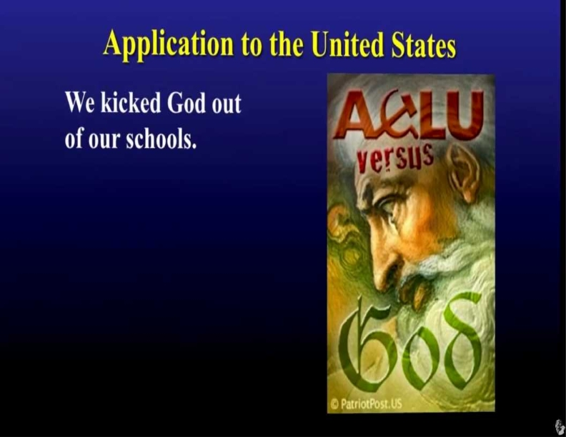
54 Jesus answered, "If I honor Myself, My honor is nothing. It is My Father who honors Me, of whom you say that He is your God. 55 Yet you have not known Him, but I know Him. And if I say, 'I do not know Him,' I shall be a liar like you; but I do know Him and keep His word. 56 Your father Abraham rejoiced to see My day, and he saw it and was glad." 57 Then the Jews said to Him, "You are not yet fifty years old, and have You seen Abraham?"

Slide 42
Psalms 9:17
The wicked shall be turned into hell, And all the nations that forget God.

Slide 43
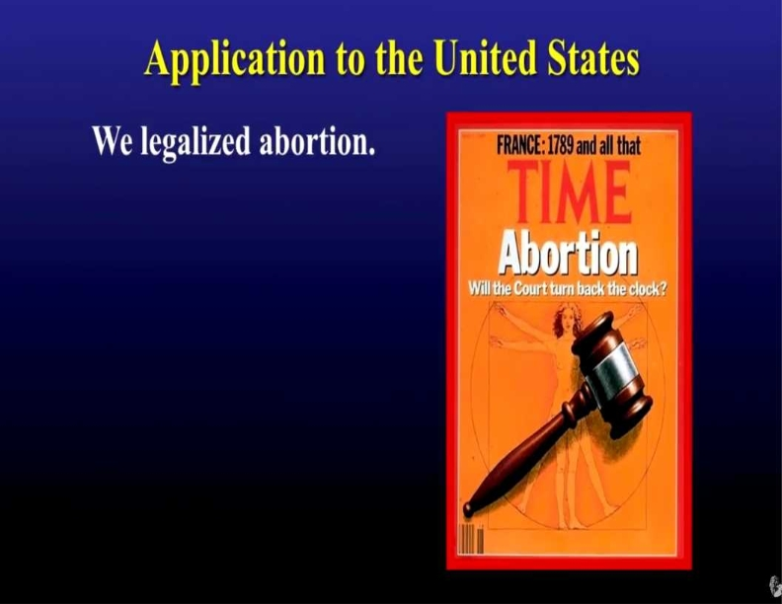
Psalms 9:17
The wicked shall be turned into hell, And all the nations that forget God.

Slide 44
Proverbs 6:16-19
16 These six things the LORD hates, Yes, seven are an abomination to Him: 17 A proud look, A lying tongue, Hands that shed innocent blood, 18 A heart that devises wicked plans, Feet that are swift in running to evil, 19 A false witness who speaks lies, And one who sows discord among brethren.

Slide 45
Exodus 20:13
"You shall not murder."

Slide 46
Genesis 9:6
"Whoever sheds the blood of man, by man shall his blood be shed, for God made man in his own image

Slide 47

Planned Parenthood
They have (Murdered) aborted over 70 Million Babies since Roe V. Wade passed on January 22, 1973

Slide 48
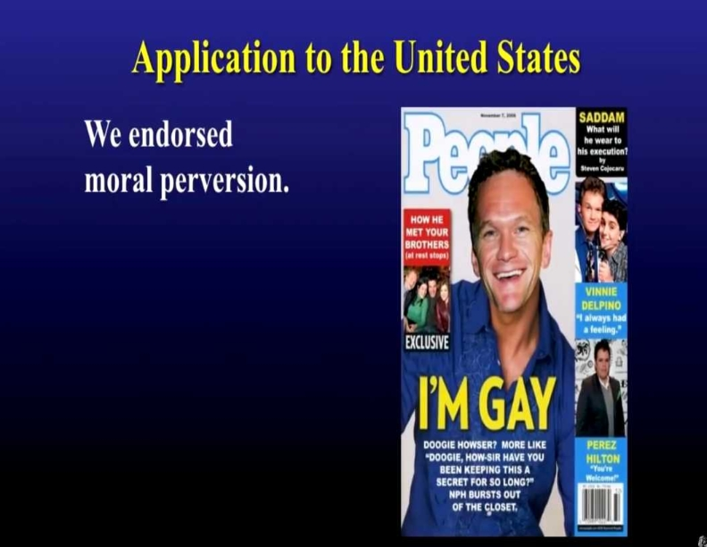
Psalms 9:17
The wicked shall be turned into hell, And all the nations that forget God.

Slide 49
Leviticus 20:13
If a man lies with a male as he lies with a woman, both of them have committed an abomination. They shall surely be put to death. Their blood shall be upon them.

Slide 50
Romans 1:26-27
26 For this reason God gave them up to vile passions. For even their women exchanged the natural use for what is against nature. 27 Likewise also the men, leaving the natural use of the woman, burned in their lust for one another, men with men committing what is shameful, and receiving in themselves the penalty of their error which was due.

Slide 51
Malachi 3:6
"For I am the LORD, I do not change; Therefore you are not consumed, O sons of Jacob.

Slide 52
Hebrews 13:8
Jesus Christ is the same yesterday, today, and forever.

Slide 53
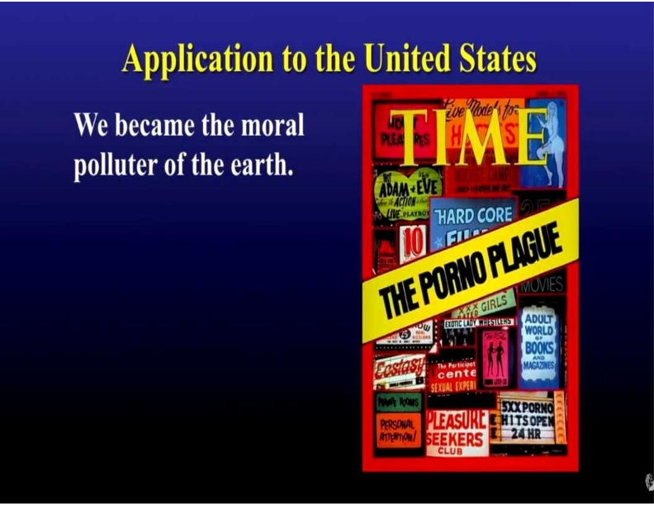
Psalms 9:17
The wicked shall be turned into hell, And all the nations that forget God.

Slide 54
Galatians 5:19-21
19 Now the works of the flesh are evident, which are: adultery, fornication, uncleanness, lewdness, 20 idolatry, sorcery, hatred, contentions, jealousies, outbursts of wrath, selfish ambitions, dissensions, heresies, 21 envy, murders, drunkenness, revelries, and the like; of which I tell you beforehand, just as I also told you in time past, that those who practice such things will not inherit the kingdom of God.

Slide 55
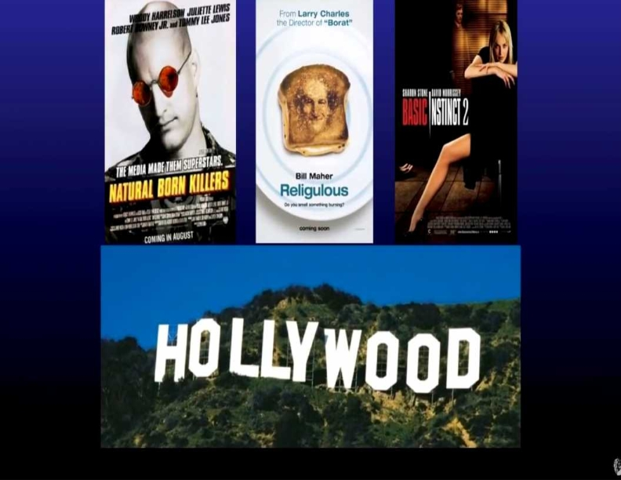


Psalms 9:17
The wicked shall be turned into hell, And all the nations that forget God.

Slide 56
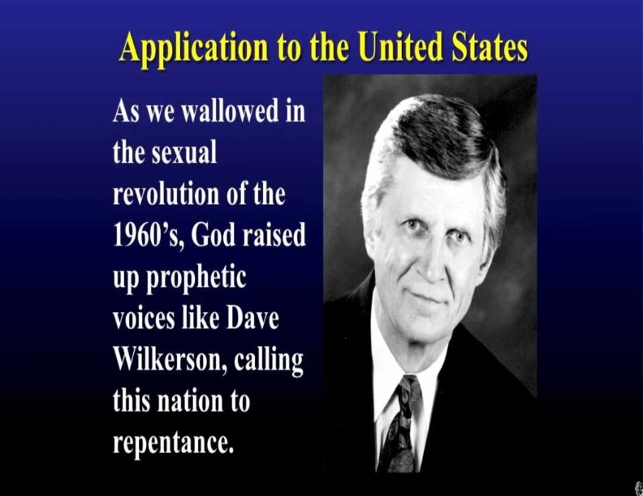
Psalms 9:17
The wicked shall be turned into hell, And all the nations that forget God.

Slide 57
2 Chronicles 7:14
If My people who are called by My name will humble themselves, and pray and seek My face, and turn from their wicked ways, then I will hear from heaven, and will forgive their sin and heal their land.

Slide 58
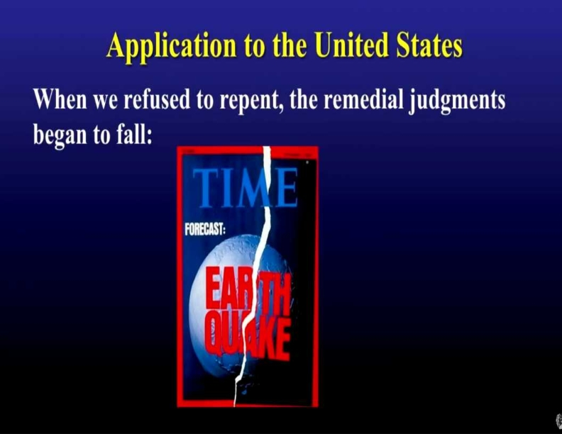
Psalms 9:17
The wicked shall be turned into hell, And all the nations that forget God.

Slide 59
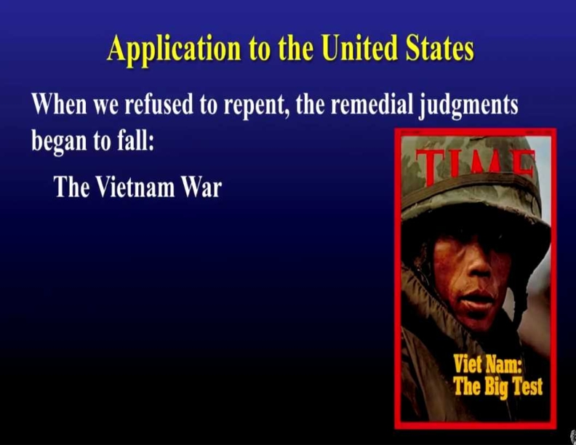
Psalms 9:17
The wicked shall be turned into hell, And all the nations that forget God.

Slide 60
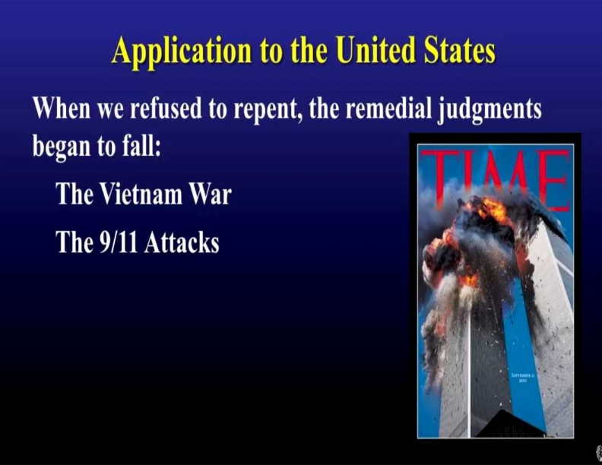
Psalms 9:17
The wicked shall be turned into hell, And all the nations that forget God.

Slide 61
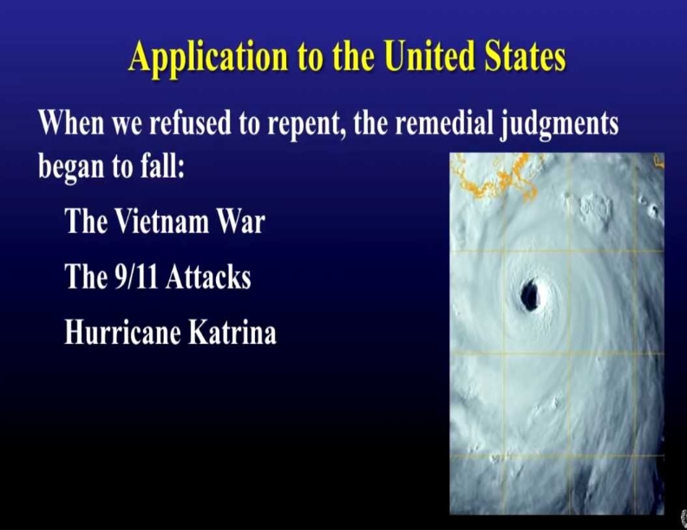
Psalms 9:17
The wicked shall be turned into hell, And all the nations that forget God.

Slide 62
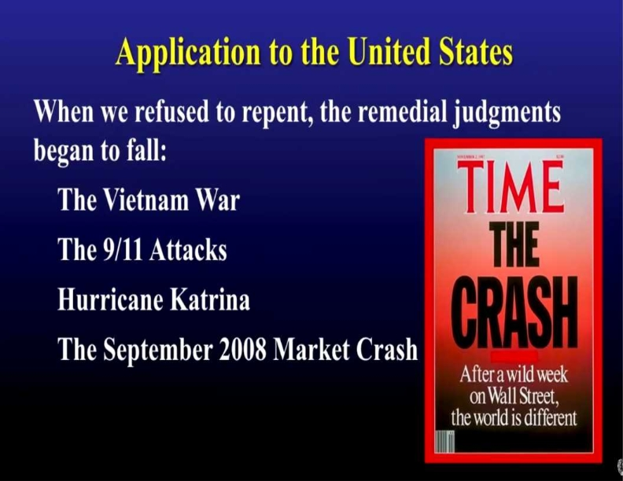
Psalms 9:17
The wicked shall be turned into hell, And all the nations that forget God.

Slide 63
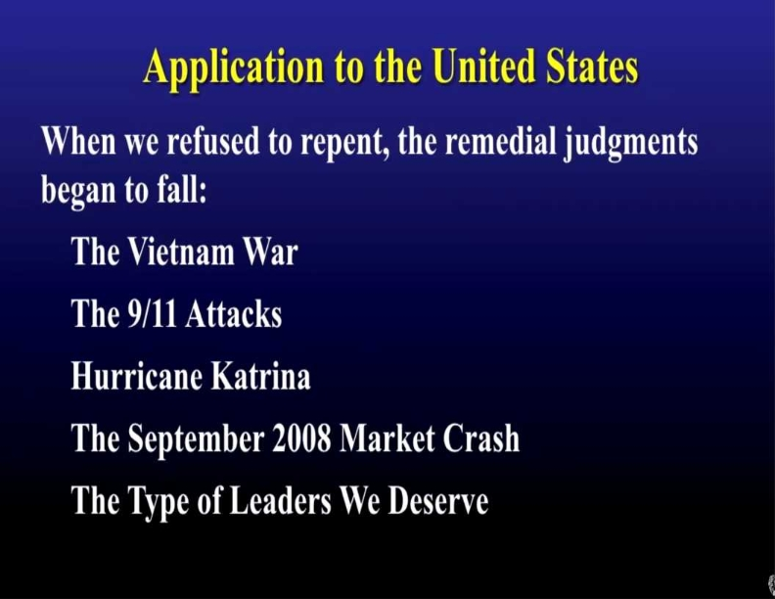
Psalms 9:17
The wicked shall be turned into hell, And all the nations that forget God.

Slide 64
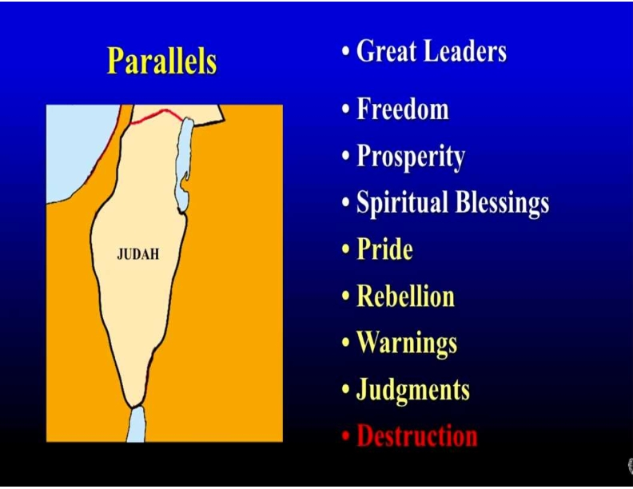
Psalms 9:17
The wicked shall be turned into hell, And all the nations that forget God.

Slide 65
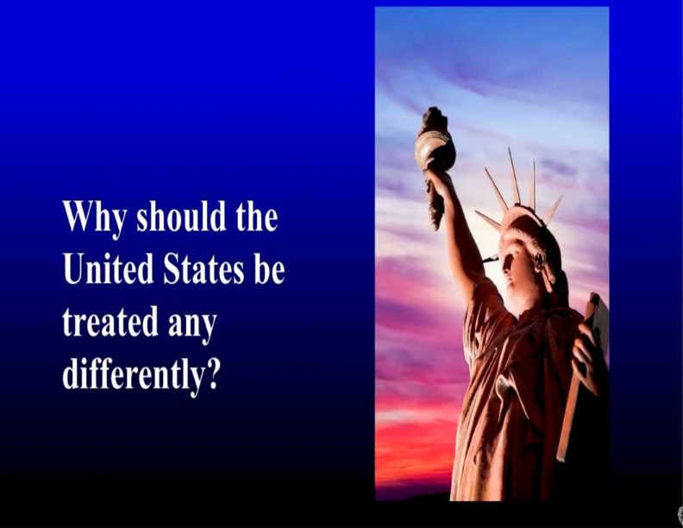
Psalms 9:17
The wicked shall be turned into hell, And all the nations that forget God.

Slide 66
Psalms 9:17
The wicked shall be turned into hell, And all the nations that forget God.

Slide 67
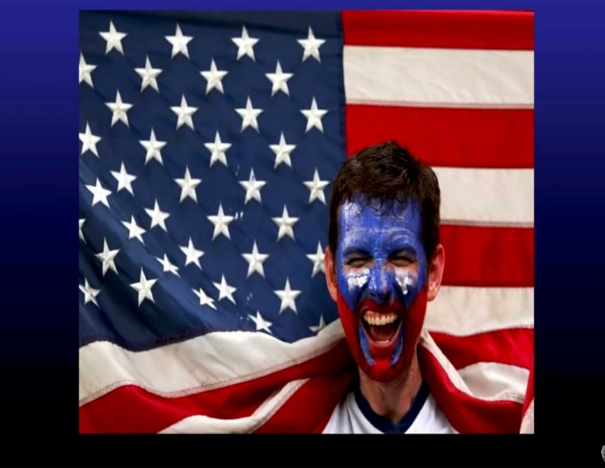
Psalms 9:17
The wicked shall be turned into hell, And all the nations that forget God.

Slide 68
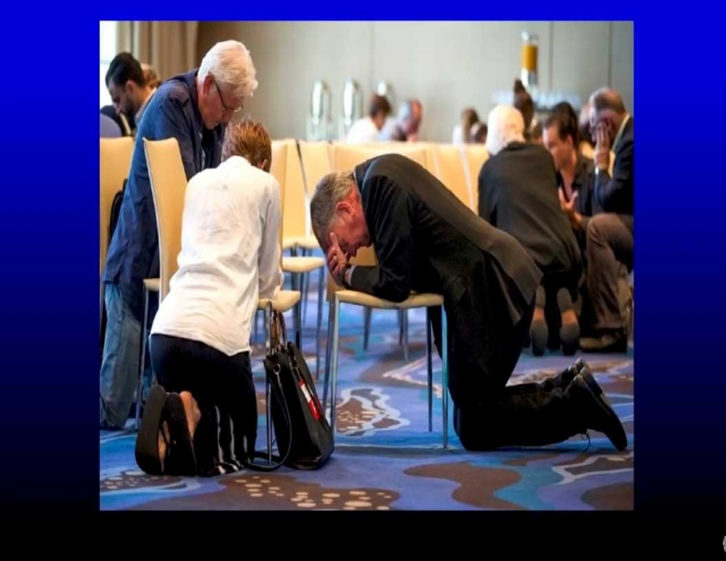
Psalms 9:17
The wicked shall be turned into hell, And all the nations that forget God.

Slide 69

Psalms 9:17
The wicked shall be turned into hell, And all the nations that forget God.

Slide 70

Psalms 9:17
The wicked shall be turned into hell, And all the nations that forget God.

Slide 71
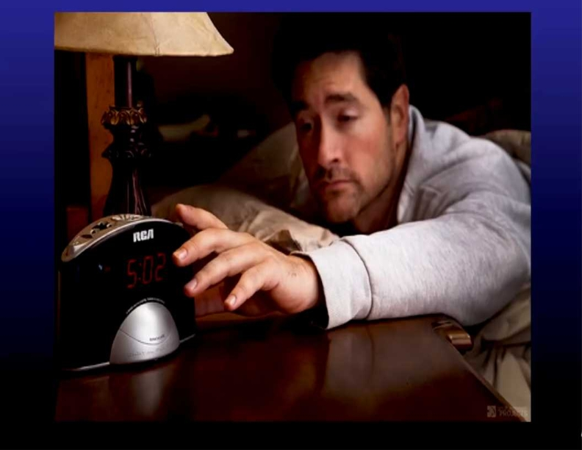
Psalms 9:17
The wicked shall be turned into hell, And all the nations that forget God.

Slide 72
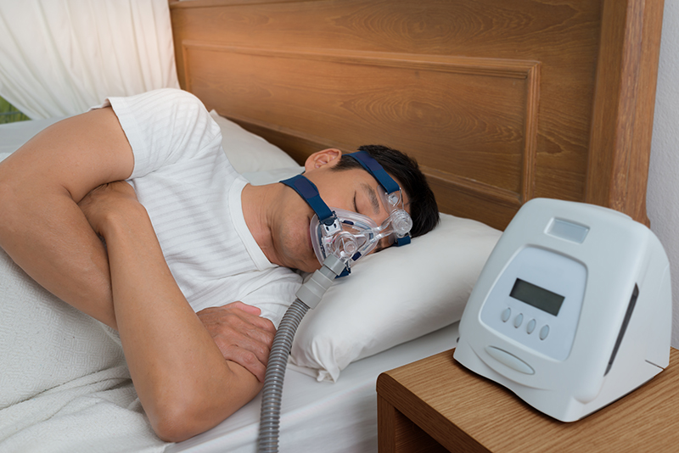
Psalms 9:17
The wicked shall be turned into hell, And all the nations that forget God.

Slide 73

Psalms 9:17
The wicked shall be turned into hell, And all the nations that forget God.

Slide 74

Psalms 9:17
The wicked shall be turned into hell, And all the nations that forget God.

Slide 75
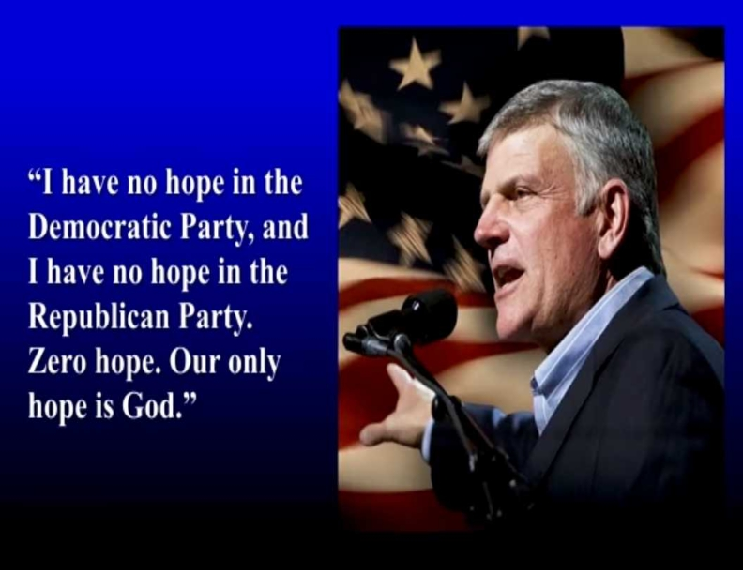
Psalms 9:17
The wicked shall be turned into hell, And all the nations that forget God.

Slide 76
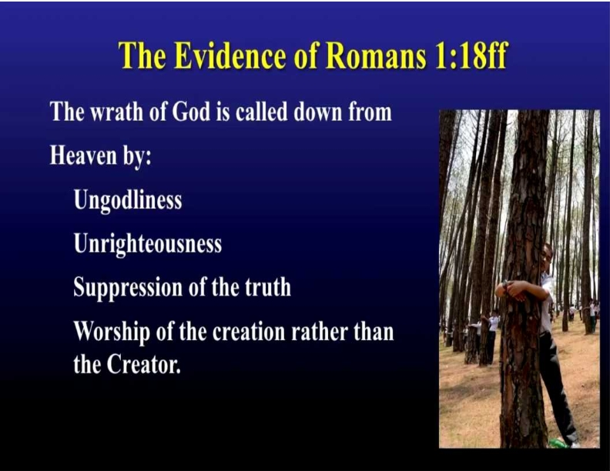
Psalms 9:17
The wicked shall be turned into hell, And all the nations that forget God.

Slide 77
Romans 1:18-20
18 For the wrath of God is revealed from heaven against all ungodliness and unrighteousness of men, who suppress the truth in unrighteousness, 19 because what may be known of God is manifest in them, for God has shown it to them. 20 For since the creation of the world His invisible attributes are clearly seen, being understood by the things that are made, even His eternal power and Godhead, so that they are without excuse…

Slide 78
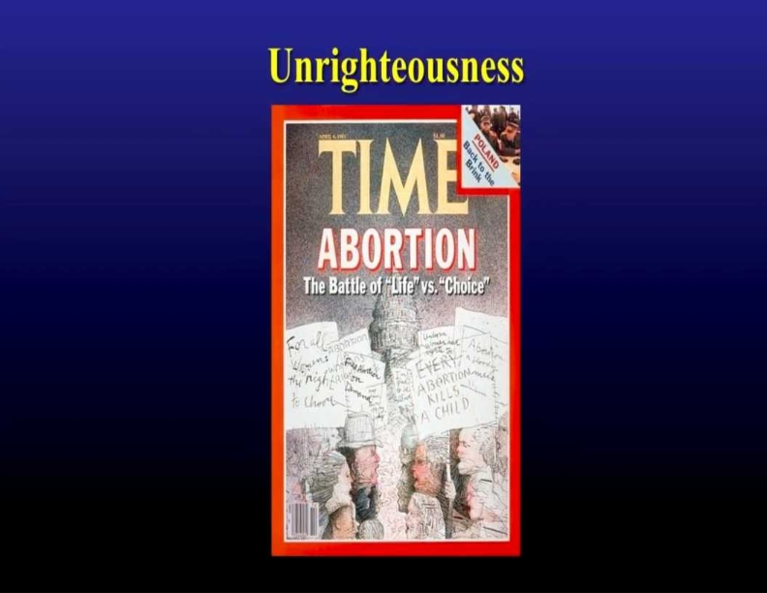
Psalms 9:17
The wicked shall be turned into hell, And all the nations that forget God.

Slide 79
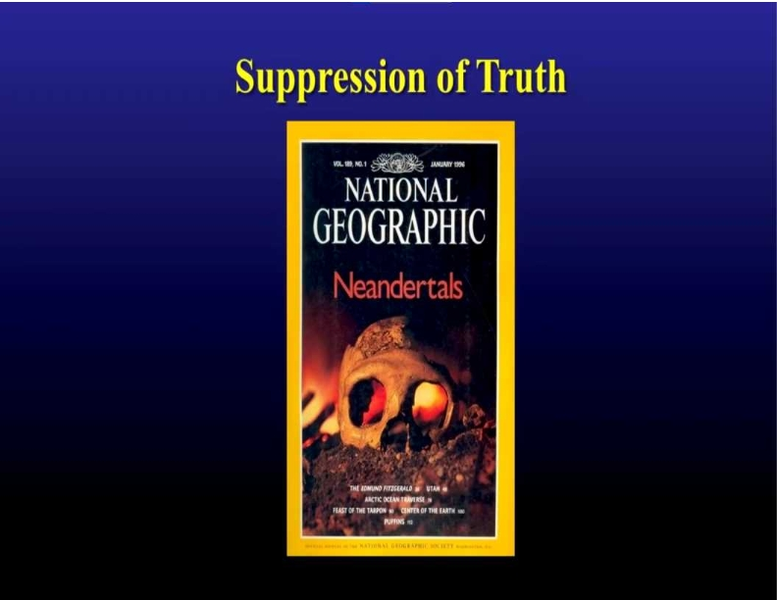
Psalms 9:17
The wicked shall be turned into hell, And all the nations that forget God.

Slide 80
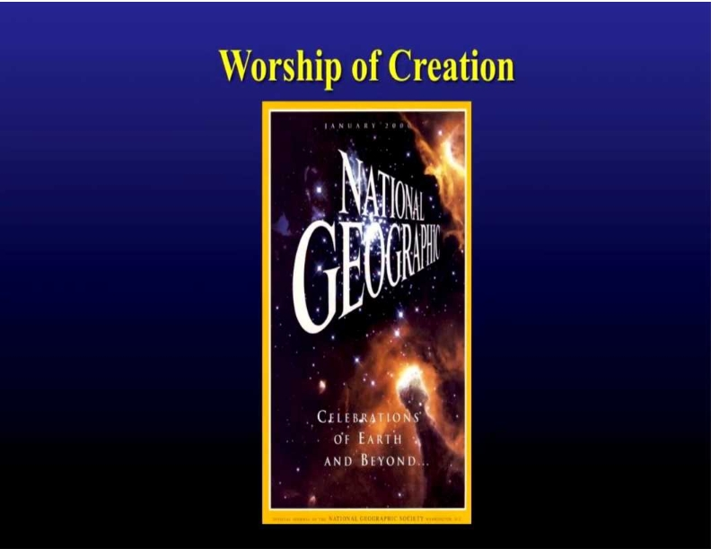
Psalms 9:17
The wicked shall be turned into hell, And all the nations that forget God.

Slide 81
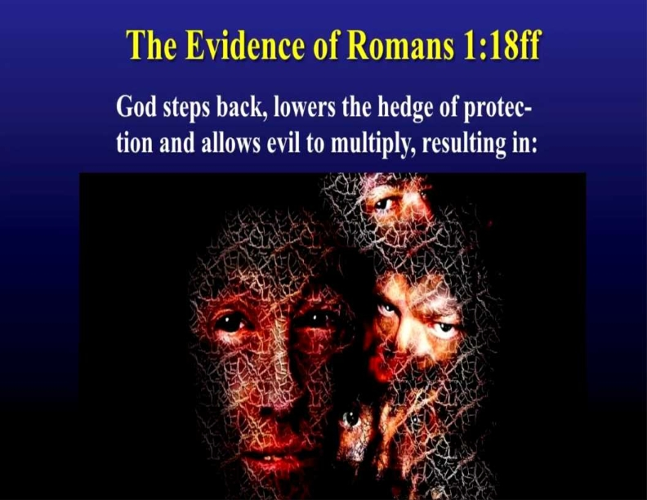
Psalms 9:17
The wicked shall be turned into hell, And all the nations that forget God.

Slide 82
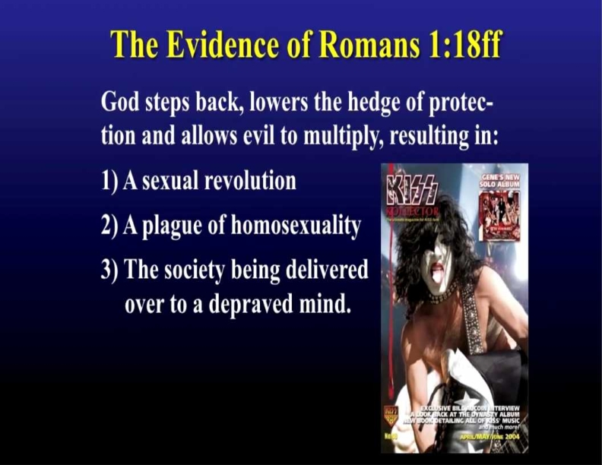
Psalms 9:17
The wicked shall be turned into hell, And all the nations that forget God.

Slide 83

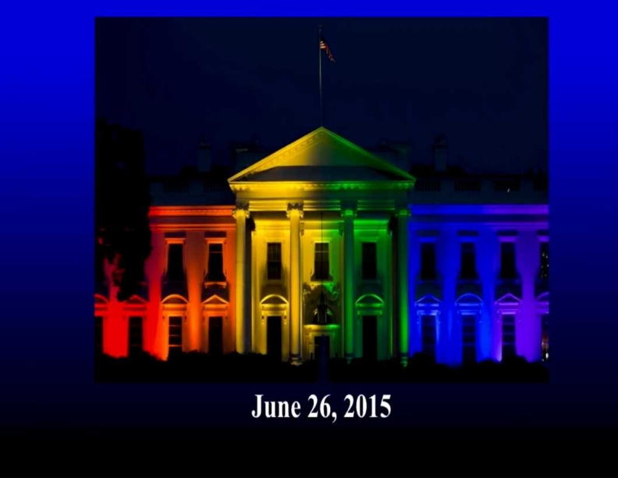
Psalms 9:17
The wicked shall be turned into hell, And all the nations that forget God.

Slide 84
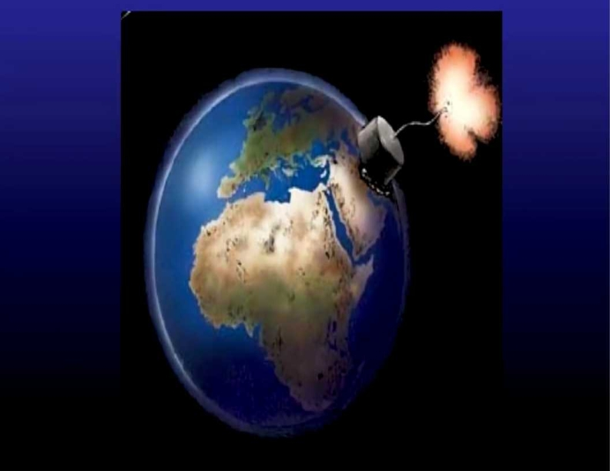
Psalms 9:17
The wicked shall be turned into hell, And all the nations that forget God.

Slide 85

Psalms 9:17
The wicked shall be turned into hell, And all the nations that forget God.

Slide 86

Psalms 9:17
The wicked shall be turned into hell, And all the nations that forget God.

Slide 87

Psalms 9:17
The wicked shall be turned into hell, And all the nations that forget God.

Slide 88

Psalms 9:17
The wicked shall be turned into hell, And all the nations that forget God.

Slide 89

Psalms 9:17
The wicked shall be turned into hell, And all the nations that forget God.

Slide 90
1 Thessalonians 5:9-11
9 For God did not appoint us to wrath, but to obtain salvation through our Lord Jesus Christ, 10 who died for us, that whether we wake or sleep, we should live together with Him. 11 Therefore comfort each other and edify one another, just as you also are doing.

Slide 91

1 Thessalonians 4:16-17
16 For the Lord himself shall descend from heaven with a shout, with the voice of the archangel, and with the trump of God: and the dead in Christ shall rise first: 17 Then we which are alive and remain shall be caught up together with them in the clouds, to meet the Lord in the air: and so shall we ever be with the Lord.

Slide 92
Awaken To:
Share the Gospel
2. Witness and Testify what God has done in your life
3. Pray and Fast for Family, Friends and Country
4. Be Steadfast in Your Faith in Christ

Slide 93
John 14:1-4
1 "Let not your heart be troubled; you believe in God, believe also in Me. 2 In My Father's house are many mansions; if it were not so, I would have told you. I go to prepare a place for you. 3 And if I go and prepare a place for you, I will come again and receive you to Myself; that where I am, there you may be also. 4 And where I go you know, and the way you know."

Slide 94


Our Blessed Hope
By Pastor Fee Soliven
1 John 3:1-3
Sunday Morning
September 6, 2026

Slide 95



Philippians 3:20-21
20 For our citizenship is in heaven, from which we also eagerly wait for the Savior, the Lord Jesus Christ, 21 who will transform our lowly body that it may be conformed to His glorious body, according to the working by which He is able even to subdue all things to Himself.

Slide 96
1 Thessalonians 4:13-18
13 But I do not want you to be ignorant, brethren, concerning those who have fallen asleep, lest you sorrow as others who have no hope. 14 For if we believe that Jesus died and rose again, even so God will bring with Him those who sleep in Jesus.

Slide 97
15 For this we say to you by the word of the Lord, that we who are alive and remain until the coming of the Lord will by no means precede those who are asleep. 16 For the Lord Himself will descend from heaven with a shout, with the voice of an archangel, and with the trumpet of God. And the dead in Christ will rise first.

Slide 98
17 Then we who are alive and remain shall be caught up together with them in the clouds to meet the Lord in the air. And thus we shall always be with the Lord. 18 Therefore comfort one another with these words.

Slide 99
1 Corinthians 15:50-54
50 Now this I say, brethren, that flesh and blood cannot inherit the kingdom of God; nor does corruption inherit incorruption. 51 Behold, I tell you a mystery: We shall not all sleep, but we shall all be changed-- 52 in a moment, in the twinkling of an eye, at the last trumpet. For the trumpet will sound, and the dead will be raised incorruptible, and we shall be changed.

Slide 100
53 For this corruptible must put on incorruption, and this mortal must put on immortality. 54 So when this corruptible has put on incorruption, and this mortal has put on immortality, then shall be brought to pass the saying that is written: "Death is swallowed up in victory."

Slide 101

20 Again, when a righteous man turns from his righteousness and commits iniquity, and I lay a stumbling block before him, he shall die; because you did not give him warning, he shall die in his sin, and his righteousness which he has done shall not be remembered; but his blood I will require at your hand.

Slide 102
Acts 2:38-39
38 Then Peter said to them, "Repent, and let every one of you be baptized in the name of Jesus Christ for the remission of sins; and you shall receive the gift of the Holy Spirit. 39 For the promise is to you and to your children, and to all who are afar off, as many as the Lord our God will call."

Slide 103

Donate with our QR code app to
Amazing Grace Christian Fellowship
Donations are Deeply Appreciated!

