Slide 1


Slide 2


Slide 3

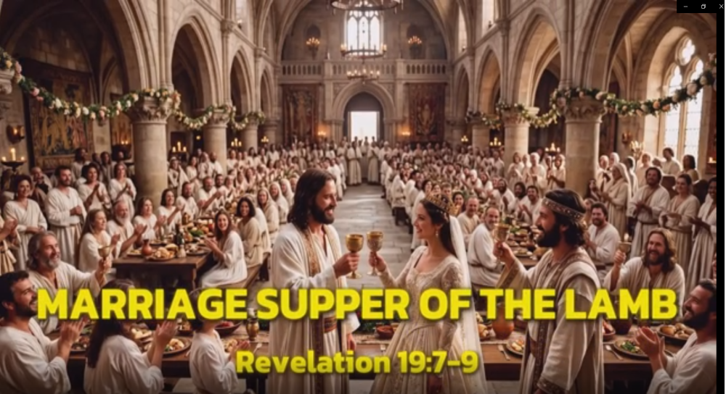
Our Blessed Hope
By Pastor Fee Soliven
Revelation 19:7-9
Sunday Morning
September 6, 2026

Slide 4
Revelation 19:7-9
7 Let us be glad and rejoice and give Him glory, for the marriage of the Lamb has come, and His wife has made herself ready." 8 And to her it was granted to be arrayed in fine linen, clean and bright, for the fine linen is the righteous acts of the saints. 9 Then he said to me, "Write: 'Blessed are those who are called to the marriage supper of the Lamb!' "

Slide 5
1 John 3:1-3
1 Behold what manner of love the Father has bestowed on us, that we should be called children of God! Therefore the world does not know us, because it did not know Him. 2 Beloved, now we are children of God; and it has not yet been revealed what we shall be, but we know that when He is revealed, we shall be like Him, for we shall see Him as He is. 3 And everyone who has this hope in Him purifies himself, just as He is pure.

Slide 6
Titus 2:11-15
11 For the grace of God that brings salvation has appeared to all men, 12 teaching us that, denying ungodliness and worldly lusts, we should live soberly, righteously, and godly in the present age, 13 looking for the blessed hope and glorious appearing of our great God and Savior Jesus Christ,

Slide 7
14 who gave Himself for us, that He might redeem us from every lawless deed and purify for Himself His own special people, zealous for good works. 15 Speak these things, exhort, and rebuke with all authority. Let no one despise you.

Slide 8
Romans 8:22-25
22 For we know that the whole creation groans and labors with birth pangs together until now. 23 Not only that, but we also who have the firstfruits of the Spirit, even we ourselves groan within ourselves, eagerly waiting for the adoption, the redemption of our body. 24 For we were saved in this hope, but hope that is seen is not hope; for why does one still hope for what he sees? 25 But if we hope for what we do not see, we eagerly wait for it with perseverance.

Slide 9
1 Peter 1:3-5
3 Blessed be the God and Father of our Lord Jesus Christ, who according to His abundant mercy has begotten us again to a living hope through the resurrection of Jesus Christ from the dead, 4 to an inheritance incorruptible and undefiled and that does not fade away, reserved in heaven for you, 5 who are kept by the power of God through faith for salvation ready to be revealed in the last time.

Slide 10
Why do we need to be changed and to be like Him?

Slide 11
John 14:1-5
1 "Let not your heart be troubled; you believe in God, believe also in Me. 2 In My Father's house are many mansions; if it were not so, I would have told you. I go to prepare a place for you. 3 And if I go and prepare a place for you, I will come again and receive you to Myself; that where I am, there you may be also. 4 And where I go you know, and the way you know."
The Marriage Supper of the Lamb

Slide 12
The Marriage Supper of the Lamb

Slide 13
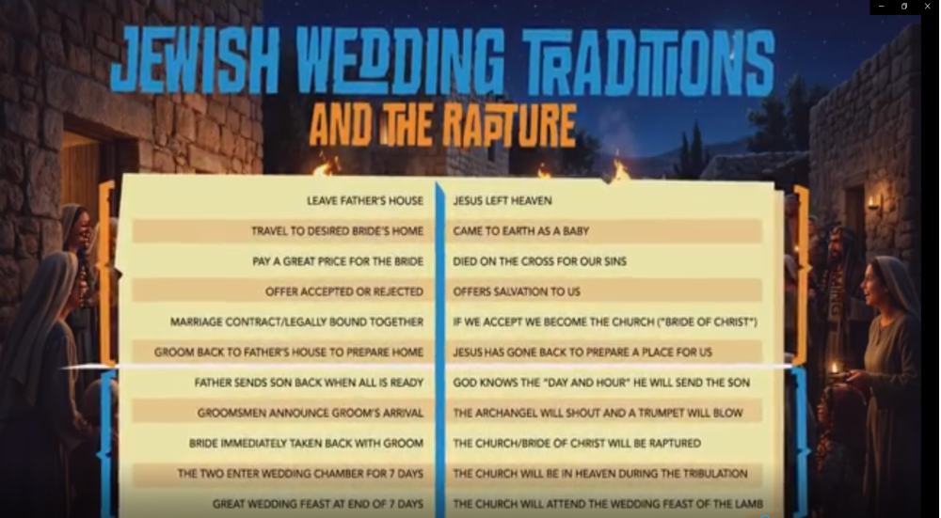
Our Blessed Hope
By Pastor Fee Soliven
1 John 3:1-3
Sunday Morning
September 6, 2026

Slide 14
Our Blessed Hope
By Pastor Fee Soliven
1 John 3:1-3
Sunday Morning
September 6, 2026

Slide 15
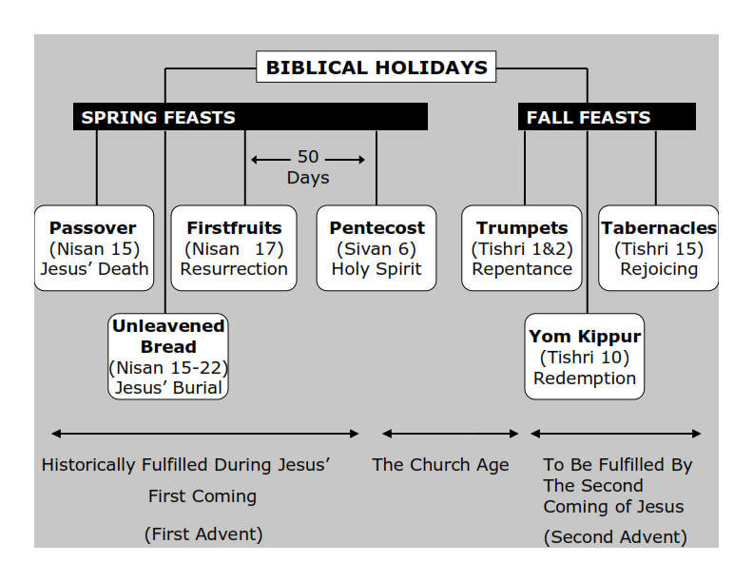
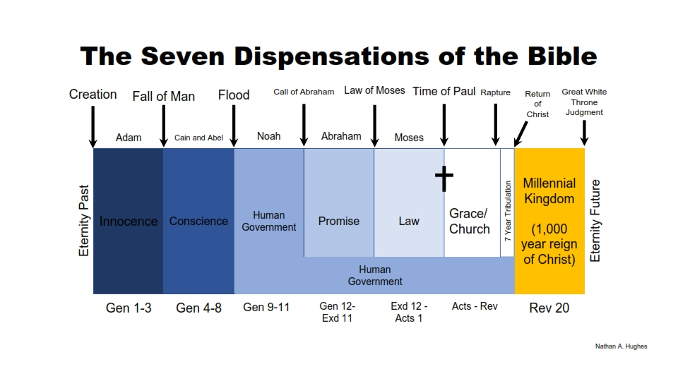
Philippians 3:20-21
20 For our citizenship is in heaven, from which we also eagerly wait for the Savior, the Lord Jesus Christ, 21 who will transform our lowly body that it may be conformed to His glorious body, according to the working by which He is able even to subdue all things to Himself.

Slide 16
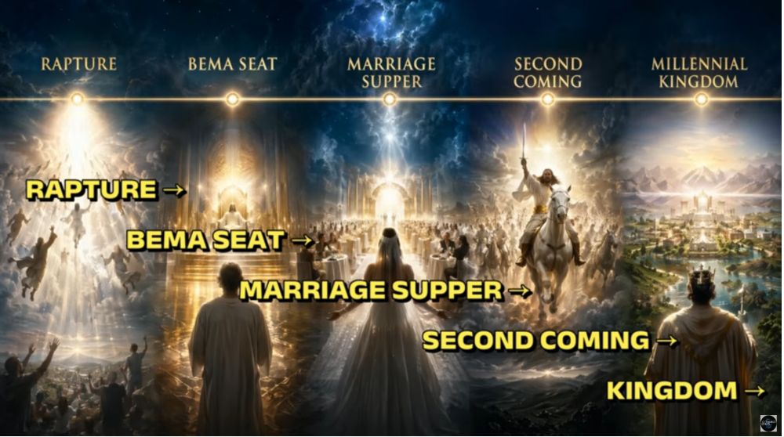
Philippians 3:20-21
20 For our citizenship is in heaven, from which we also eagerly wait for the Savior, the Lord Jesus Christ, 21 who will transform our lowly body that it may be conformed to His glorious body, according to the working by which He is able even to subdue all things to Himself.

Slide 17
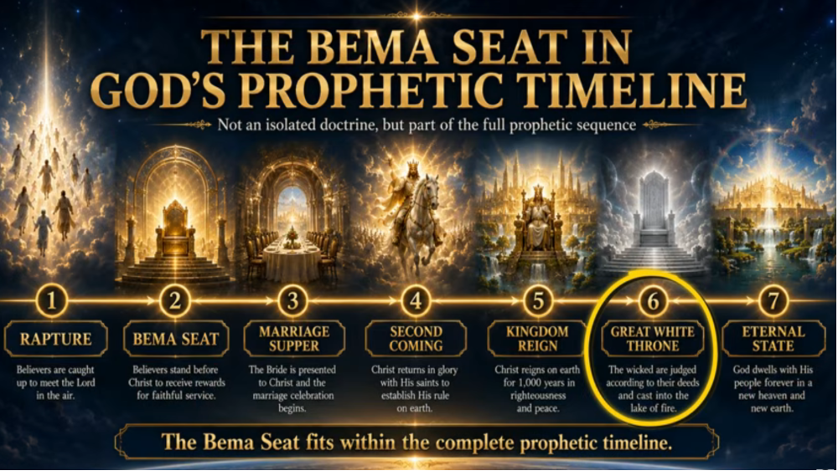
Leviticus 23:2
And the LORD spoke to Moses, saying, Speak to the children of Israel, and say to them, Concerning the Feasts of the LORD, which you shall proclaim to be holy convocations, even these are my feasts.

Slide 18
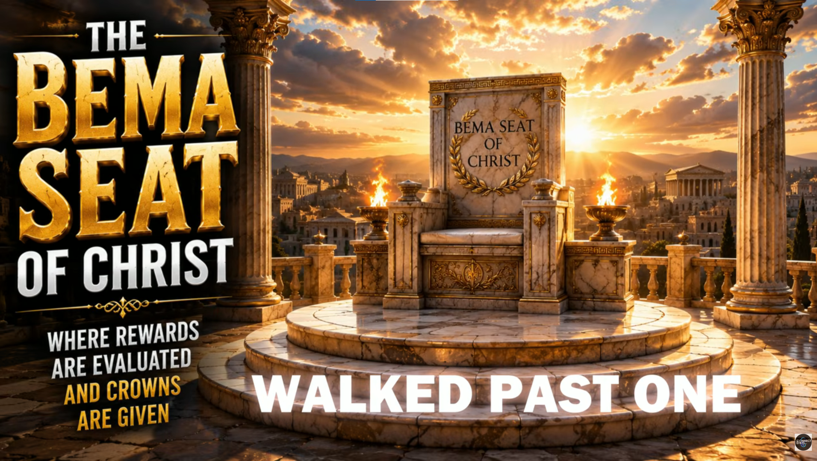
Leviticus 23:2
And the LORD spoke to Moses, saying, Speak to the children of Israel, and say to them, Concerning the Feasts of the LORD, which you shall proclaim to be holy convocations, even these are my feasts.

Slide 19
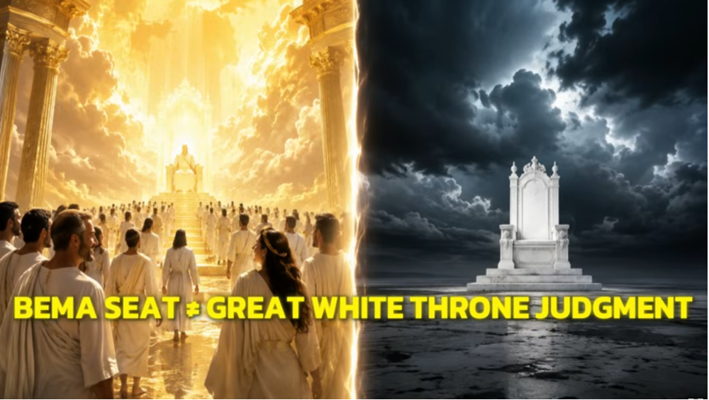
Leviticus 23:2
And the LORD spoke to Moses, saying, Speak to the children of Israel, and say to them, Concerning the Feasts of the LORD, which you shall proclaim to be holy convocations, even these are my feasts.

Slide 20
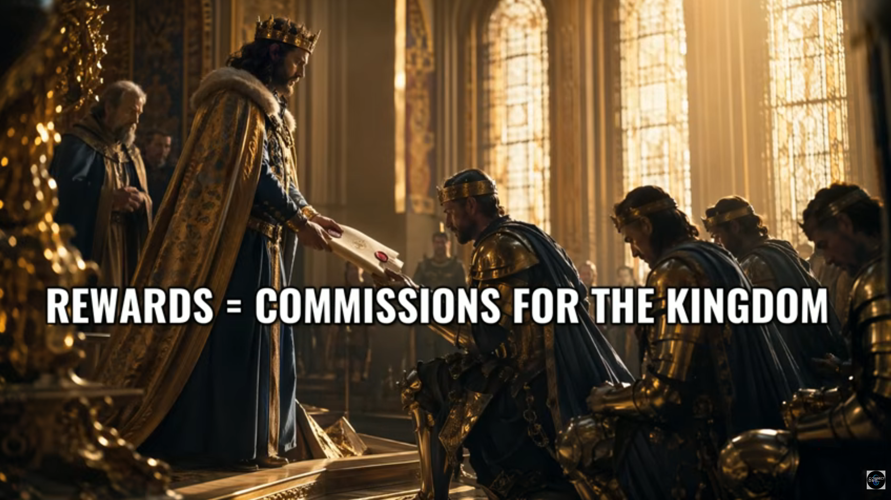
Leviticus 23:2
And the LORD spoke to Moses, saying, Speak to the children of Israel, and say to them, Concerning the Feasts of the LORD, which you shall proclaim to be holy convocations, even these are my feasts.

Slide 21
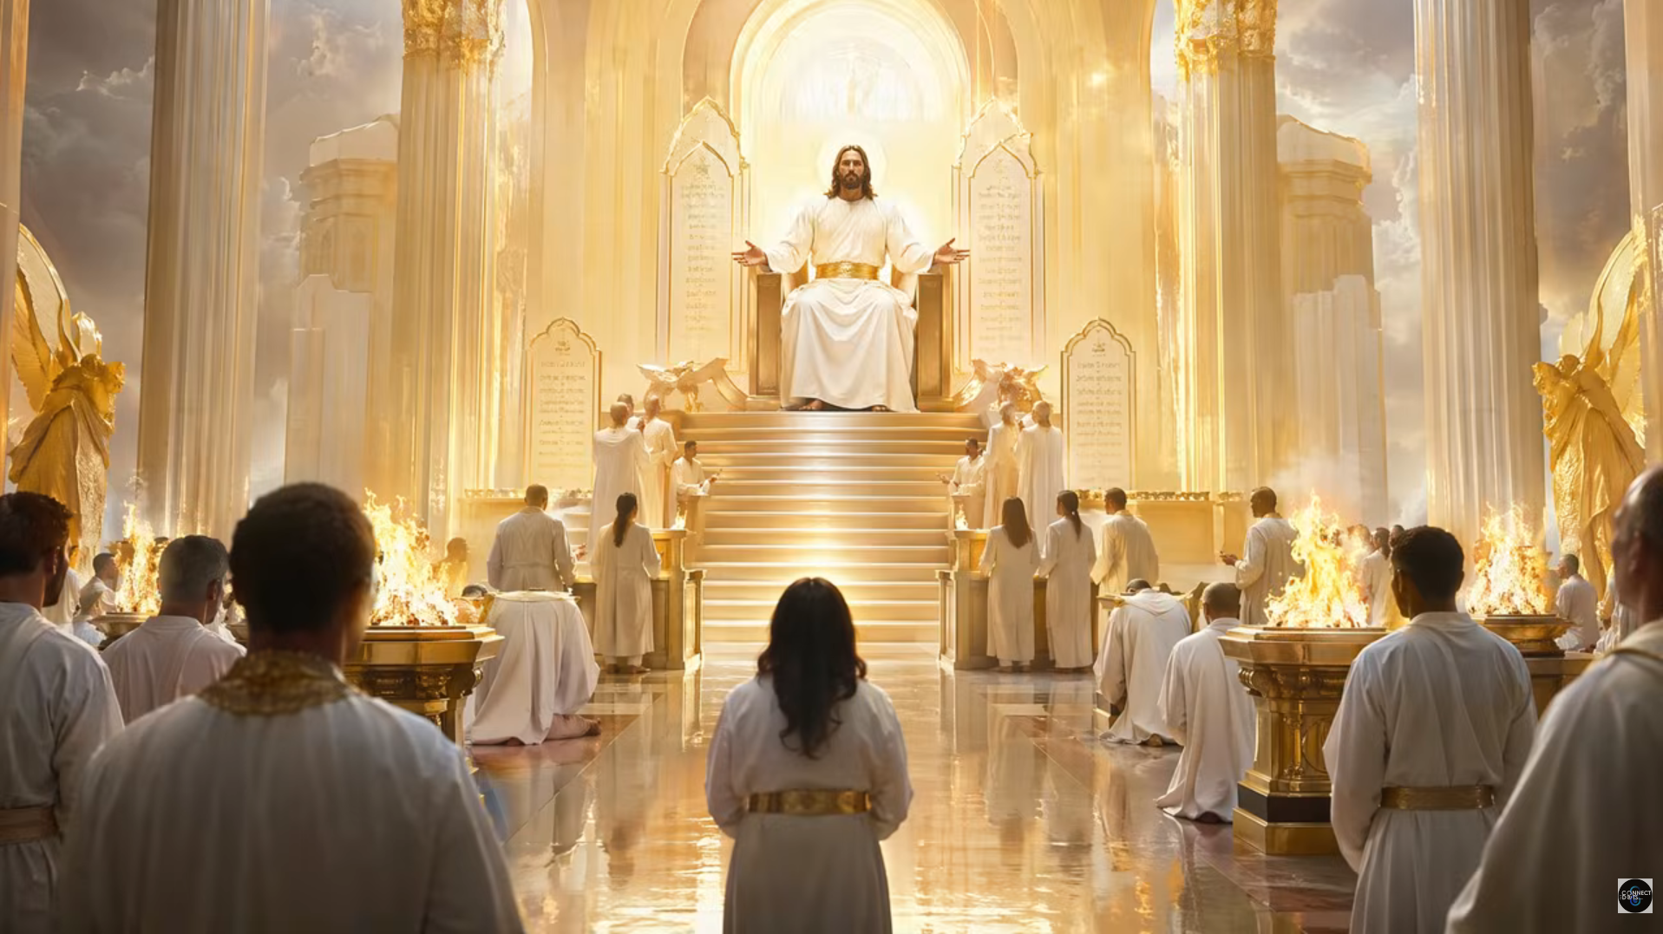
Leviticus 23:2
And the LORD spoke to Moses, saying, Speak to the children of Israel, and say to them, Concerning the Feasts of the LORD, which you shall proclaim to be holy convocations, even these are my feasts.

Slide 22
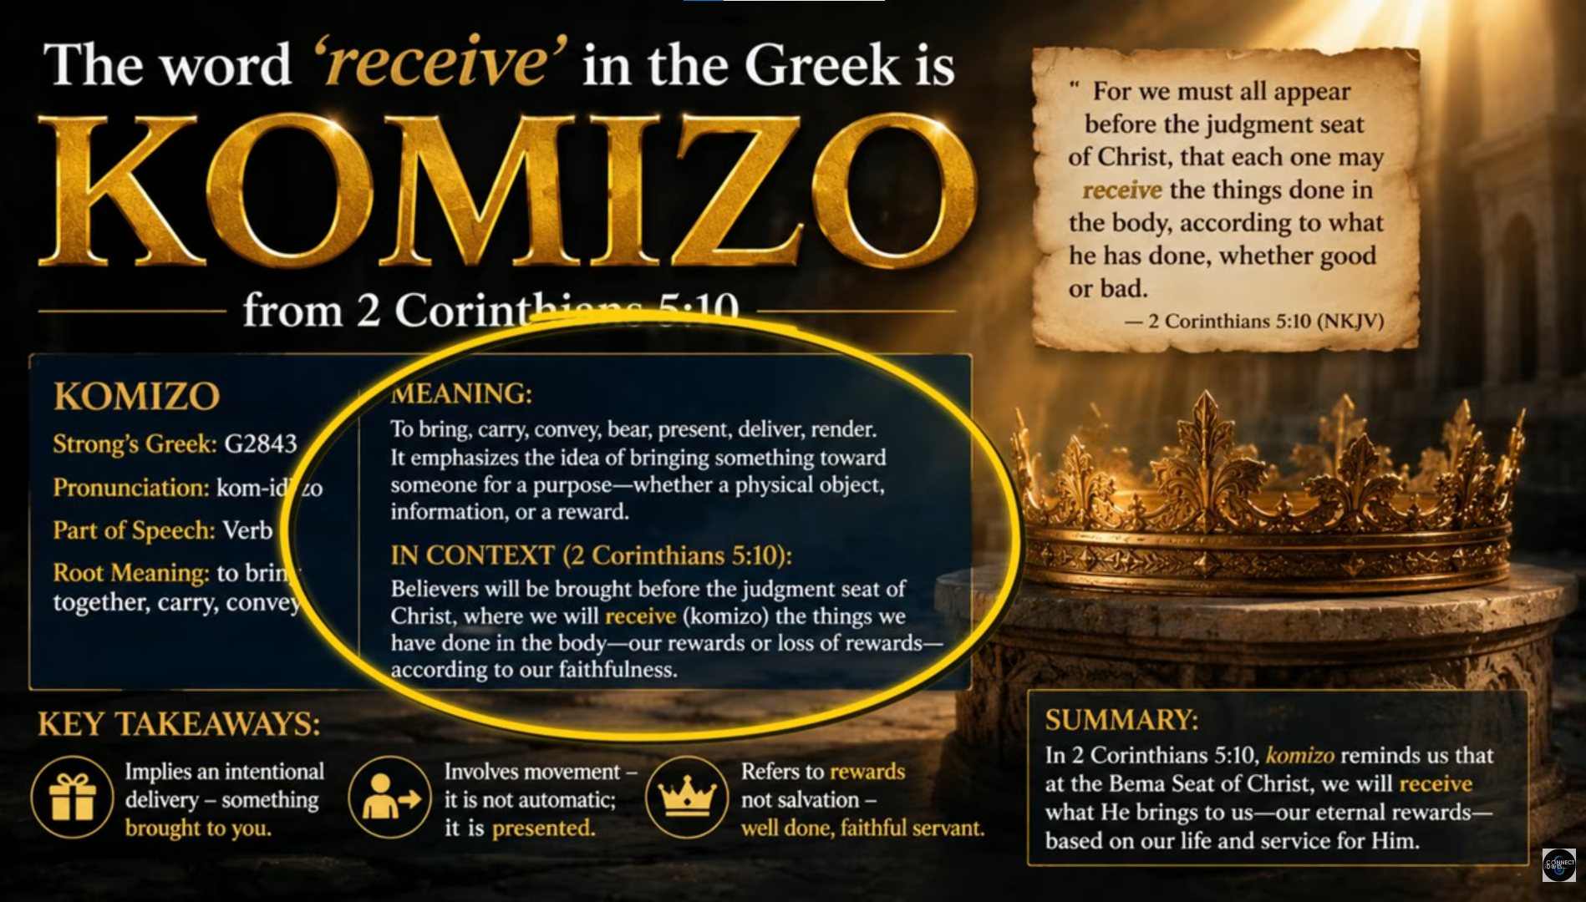
Leviticus 23:2
And the LORD spoke to Moses, saying, Speak to the children of Israel, and say to them, Concerning the Feasts of the LORD, which you shall proclaim to be holy convocations, even these are my feasts.

Slide 23
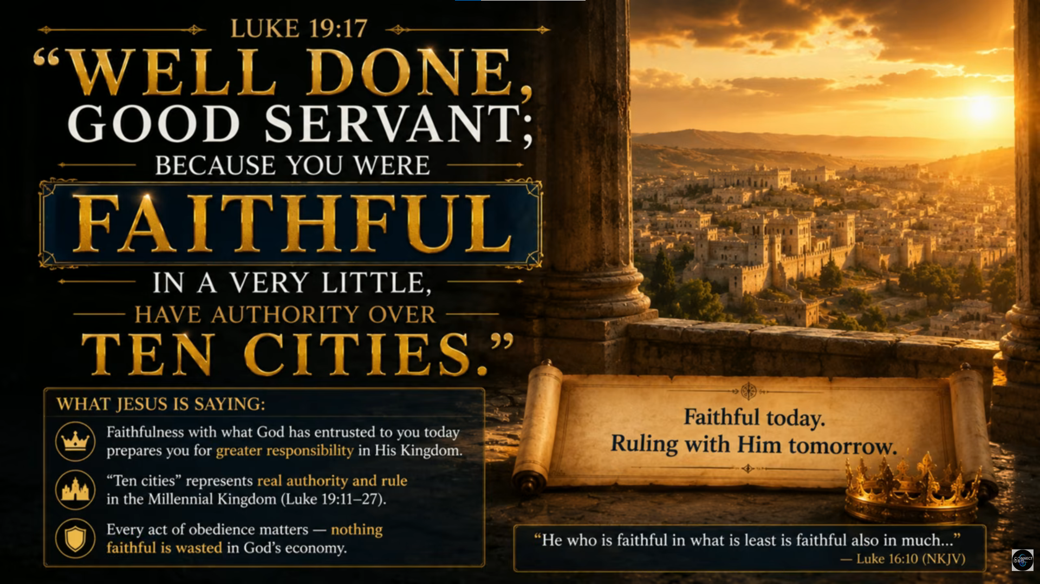
Leviticus 23:2
And the LORD spoke to Moses, saying, Speak to the children of Israel, and say to them, Concerning the Feasts of the LORD, which you shall proclaim to be holy convocations, even these are my feasts.

Slide 24
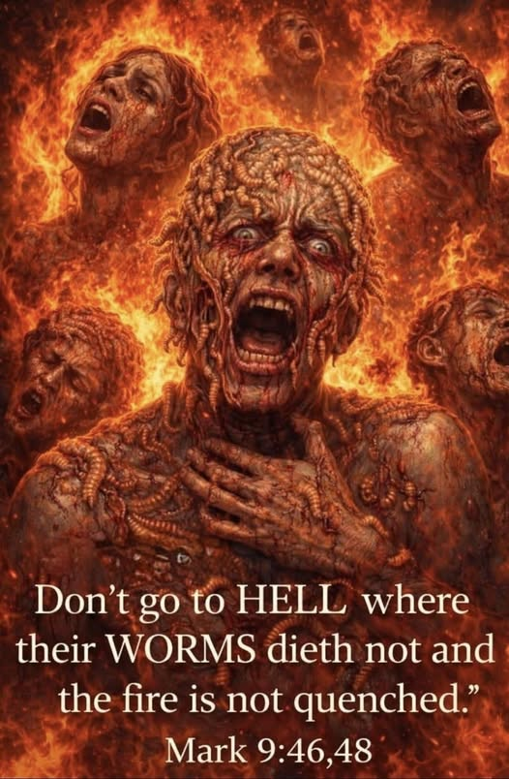

Slide 25
Philippians 3:20-21
20 For our citizenship is in heaven, from which we also eagerly wait for the Savior, the Lord Jesus Christ, 21 who will transform our lowly body that it may be conformed to His glorious body, according to the working by which He is able even to subdue all things to Himself.

Slide 26
Leviticus 23:2
And the LORD spoke to Moses, saying, Speak to the children of Israel, and say to them, Concerning the Feasts of the LORD, which you shall proclaim to be holy convocations, even these are my feasts.

Slide 27
The Hebrew word for Feasts is also MOED meaning appointed times. The Hebrew word for convocation is MIQRA meaning a dress rehearsal.

Slide 28
Philippians 3:20-21
20 For our citizenship is in heaven, from which we also eagerly wait for the Savior, the Lord Jesus Christ, 21 who will transform our lowly body that it may be conformed to His glorious body, according to the working by which He is able even to subdue all things to Himself.

Slide 29
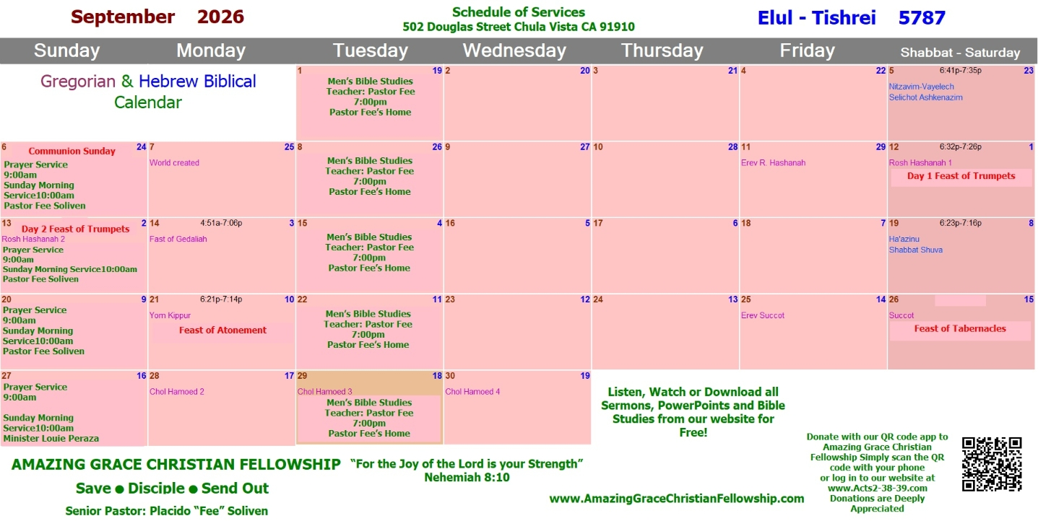
Philippians 3:20-21
20 For our citizenship is in heaven, from which we also eagerly wait for the Savior, the Lord Jesus Christ, 21 who will transform our lowly body that it may be conformed to His glorious body, according to the working by which He is able even to subdue all things to Himself.

Slide 30
Feast of Trumpets : REPENTANCE
Feast of Yom Kippur: REDEMPTION
Feast of Tabernacles: REJOICING

Slide 31
Idioms for the Feast of Yom Teruah:
(The Feast of Trumpets)

Slide 32
(Idioms: Webster Definition)
A construction or expression of one language whose parts correspond to elements in another language but whose total structure is matched in an indirect way.

Slide 33
1. The Time of Jacobs trouble
The 7 Year Tribulation. It will be the beginning of a new 7 year Shemitah cycle.

Slide 34
2. The Day of the Awakening Blast. The Rapture of the Church!

Slide 35
3. Yom HaDin: Day of Judgment, The Opening of the Books, Opening of the Gates

Slide 36
4. Yom HaKeseh: The Hidden Day

Slide 37
5. Ha Kiddushin Nesuin:
Wedding of the Messiah

Slide 38
1. The Time of Jacobs trouble

Slide 39
The 7 Year Tribulation. It will be the beginning of a new 7 year Shemitah cycle.

Slide 40
Jeremiah 30:6-7
6 Ask now, and see, Whether a man is ever in labor with child? So why do I see every man with his hands on his loins Like a woman in labor, And all faces turned pale? 7 Alas! For that day is great, So that none is like it; And it is the time of Jacob's trouble, But he shall be saved out of it.

Slide 41
Daniel 12:1-3
1 "At that time Michael shall stand up, The great prince who stands watch over the sons of your people; And there shall be a time of trouble, Such as never was since there was a nation, Even to that time. And at that time your people shall be delivered, Every one who is found written in the book.

Slide 42
2 And many of those who sleep in the dust of the earth shall awake, Some to everlasting life, Some to shame and everlasting contempt. 3 Those who are wise shall shine Like the brightness of the firmament, And those who turn many to righteousness Like the stars forever and ever.

Slide 43
Matthew 24:21-22
21 For then there will be great tribulation, such as has not been since the beginning of the world until this time, no, nor ever shall be. 22 And unless those days were shortened, no flesh would be saved; but for the elect's sake those days will be shortened.

Slide 44
2. The Day of the Awakening Blast
The Rapture of the Church!

Slide 45
On the Feast of Trumpets the Shofar is blown 100 times. There are three sounds made with the shofar:

Slide 46
Tekiah - One long straight blast.
Shevarim - Three shorter blasts.
Teruah – 9 quick blasts in short succession
This series is blown 11 times for a total of 99 blasts and the final blast is known as
“The Last Trump” !

Slide 47
1 Corinthians 15:51-54
51 Behold, I shew you a mystery; We shall not all sleep, but we shall all be changed, 52 In a moment, in the twinkling of an eye, at the last trump: for the trumpet shall sound, and the dead shall be raised incorruptible, and we shall be changed.

Slide 48
53 For this corruptible must put on incorruption, and this mortal must put on immortality. 54 So when this corruptible shall have put on incorruption, and this mortal shall have put on immortality, then shall be brought to pass the saying that is written, Death is swallowed up in victory.

Slide 49
1 Thessalonians 4:16-17
16 For the Lord himself shall descend from heaven with a shout, with the voice of the archangel, and with the trump of God: and the dead in Christ shall rise first: 17 Then we which are alive and remain shall be caught up together with them in the clouds, to meet the Lord in the air: and so shall we ever be with the Lord.

Slide 50
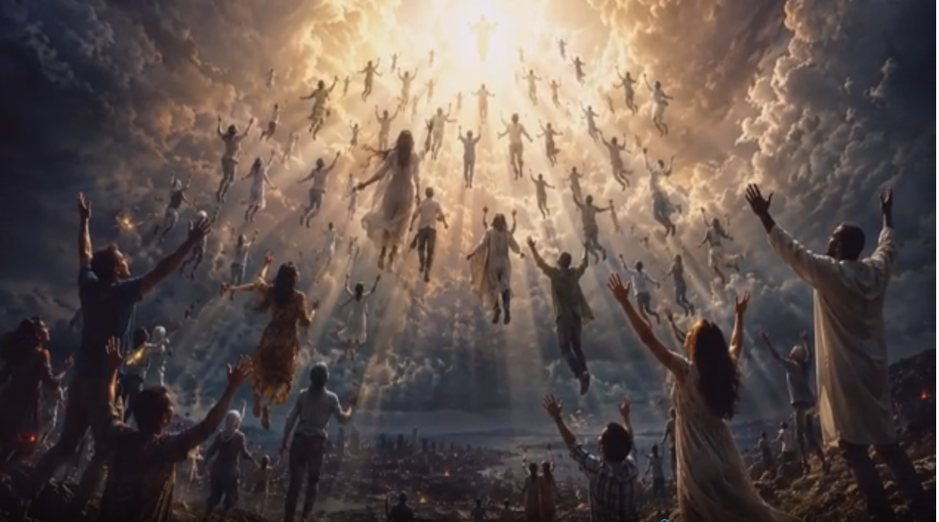
1 Thessalonians 4:16-17
16 For the Lord himself shall descend from heaven with a shout, with the voice of the archangel, and with the trump of God: and the dead in Christ shall rise first: 17 Then we which are alive and remain shall be caught up together with them in the clouds, to meet the Lord in the air: and so shall we ever be with the Lord.

Slide 51
3. Yom HaDin/Day of Judgment/The Opening of the Books/
Opening of the Gates

Slide 52
1 Corinthians 3:13-15
13 each one's work will become clear; for the Day will declare it, because it will be revealed by fire; and the fire will test each one's work, of what sort it is. 14 If anyone's work which he has built on it endures, he will receive a reward. 15 If anyone's work is burned, he will suffer loss; but he himself will be saved, yet so as through fire.

Slide 53
2 Corinthians 5:10-11
10 For we must all appear before the judgment seat of Christ, that each one may receive the things done in the body, according to what he has done, whether good or bad. 11 Knowing, therefore, the terror of the Lord, we persuade men; but we are well known to God, and I also trust are well known in your consciences.

Slide 54
Revelation 20:11-15
11 Then I saw a great white throne and Him who sat on it, from whose face the earth and the heaven fled away. And there was found no place for them. 12 And I saw the dead, small and great, standing before God, and books were opened. And another book was opened, which is the Book of Life. And the dead were judged according to their works, by the things which were written in the books.

Slide 55
13 The sea gave up the dead who were in it, and Death and Hades delivered up the dead who were in them. And they were judged, each one according to his works. 14 Then Death and Hades were cast into the lake of fire. This is the second death. 15 And anyone not found written in the Book of Life was cast into the lake of fire.

Slide 56
Psalm 24:7-10
7 Lift up your heads, O you gates! And be lifted up, you everlasting doors! And the King of glory shall come in. 8 Who is this King of glory? The LORD strong and mighty, The LORD mighty in battle. 9 Lift up your heads, O you gates! Lift up, you everlasting doors! And the King of glory shall come in. 10 Who is this King of glory? The LORD of hosts, He is the King of glory.

Slide 57
Psalm 118:19-21
19 Open to me the gates of righteousness; I will go through them, And I will praise the LORD. 20 This is the gate of the LORD, Through which the righteous shall enter. 21 I will praise You, For You have answered me, And have become my salvation.

Slide 58
4. Yom HaKeseh (The Hidden Day)

Slide 59
Zephaniah 2:1-3
1 Gather yourselves together, yes, gather together, O undesirable nation, 2 Before the decree is issued, Or the day passes like chaff, Before the LORD's fierce anger comes upon you, Before the day of the LORD's anger comes upon you!

Slide 60
3 Seek the LORD, all you meek of the earth, Who have upheld His justice. Seek righteousness, seek humility. It may be that you will be hidden In the day of the LORD's anger.

Slide 61
1 Thessalonians 5:9-11
9 For God did not appoint us to wrath, but to obtain salvation through our Lord Jesus Christ, 10 who died for us, that whether we wake or sleep, we should live together with Him. 11 Therefore comfort each other and edify one another, just as you also are doing.

Slide 62
Psalm 27:5
5 For in the time of trouble He shall hide me in His pavilion; In the secret place of His tabernacle He shall hide me; He shall set me high upon a rock.

Slide 63
Isaiah 26:20-21
20 Come, my people, enter your chambers, And shut your doors behind you; Hide yourself, as it were, for a little moment, Until the indignation is past. 21 For behold, the LORD comes out of His place To punish the inhabitants of the earth for their iniquity; The earth will also disclose her blood, And will no more cover her slain.

Slide 64
Matthew 24:36
"But of that day and hour no one knows, not even the angels of heaven, but My Father only.

Slide 65
So here is the big clue for us:

Slide 66
1 Thessalonians 5:1-9
1 But concerning the times and the seasons, brethren, you have no need that I should write to you. 2 For you yourselves know perfectly that the day of the Lord so comes as a thief in the night. 3 For when they say, "Peace and safety!" then sudden destruction comes upon them, as labor pains upon a pregnant woman. And they shall not escape.

Slide 67
4 But you, brethren, are not in darkness, so that this Day should overtake you as a thief. 5 You are all sons of light and sons of the day. We are not of the night nor of darkness. 6 Therefore let us not sleep, as others do, but let us watch and be sober. 7 For those who sleep, sleep at night, and those who get drunk are drunk at night.

Slide 68
8 But let us who are of the day be sober, putting on the breastplate of faith and love, and as a helmet the hope of salvation. 9 For God did not appoint us to wrath, but to obtain salvation through our Lord Jesus Christ

Slide 69
The Feast of Trumpets is on Tishri 1&2 it's a 2 day feast and no one knew when the sighting of the new moon would be. So when they saw the new moon the feast began!

Slide 70
Philippians 3:20-21
20 For our citizenship is in heaven, from which we also eagerly wait for the Savior, the Lord Jesus Christ, 21 who will transform our lowly body that it may be conformed to His glorious body, according to the working by which He is able even to subdue all things to Himself.

Slide 71
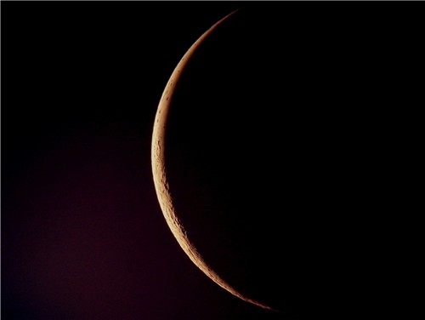
The Great tribulation is going to be a time of horrific trouble this world has never seen nor will it ever see it like that again!

Slide 72
5. Ha Kiddushin/Nesuin
(Wedding of the Messiah)

Slide 73
1. Marriages were arranged by the parents (Abraham for Isaac)
Typically the young man would go to the house of the “bride to be” carrying 3 items
Large sum of Money
B. Betrothal Contract
C. Skin of wine.
Anyone arriving at a house with these 3 items was definitely considered a prospect.

Slide 74
If the bridal price was approved a glass of wine was poured. If she approved, the betrothal contract became a legal document between the two. Their status was betrothed rather than fully married even though they would be called husband and wife.

Slide 75
Ezekiel 16:8-10
8 When I passed by you again and looked upon you, indeed your time was the time of love; so I spread My wing over you and covered your nakedness. Yes, I swore an oath to you and entered into a covenant with you, and you became Mine," says the Lord GOD. 9 Then I washed you in water; yes, I thoroughly washed off your blood, and I anointed you with oil.

Slide 76
In Jewish tradition The Bridegroom would make the statement “He would go to his Father’s house and prepare a place for her”. This place was known as the chamber.

Slide 77
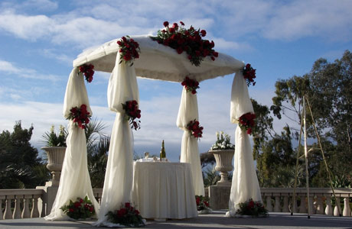
creation." 5 For this they willfully forget: that by the word of God the heavens were of old, and the earth standing out of water and in the water, 6 by which the world that then existed perished, being flooded with water. 7 But the heavens and the earth which are

Slide 78
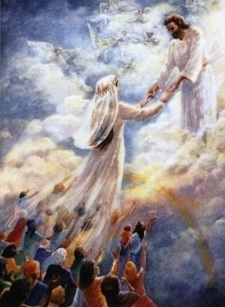

Slide 79
John 14:1-4
1 "Let not your heart be troubled; you believe in God, believe also in Me. 2 In My Father's house are many mansions; if it were not so, I would have told you. I go to prepare a place for you. 3 And if I go and prepare a place for you, I will come again and receive you to Myself; that where I am, there you may be also. 4 And where I go you know, and the way you know."

Slide 80
The Bride has been bought with a price and is to spend her time preparing to live as a wife and mother in Israel. Spending her days learning how to please her husband and waiting for his return.

Slide 81
2. The Bridal price was established for the Bride

Slide 82
1 Peter 1:18-19
18 knowing that you were not redeemed with corruptible things, like silver or gold, from your aimless conduct received by tradition from your fathers, 19 but with the precious blood of Christ, as of a lamb without blemish and without spot.

Slide 83
1 Corinthians 6:19-20
19 Or do you not know that your body is the temple of the Holy Spirit who is in you, whom you have from God, and you are not your own? 20 For you were bought at a price; therefore glorify God in your body and in your spirit, which are God's.

Slide 84
3. Bride and Groom are Betrothed

Slide 85
This legally binds the two together but they don’t live together.

Slide 86
Hosea 2:19-23
9 "I will betroth you to Me forever; Yes, I will betroth you to Me In righteousness and justice, In lovingkindness and mercy; 20 I will betroth you to Me in faithfulness, And you shall know the LORD. 21 "It shall come to pass in that day That I will answer," says the LORD; "I will answer the heavens, And they shall answer the earth.

Slide 87
22 The earth shall answer With grain, With new wine, And with oil; They shall answer Jezreel. 23 Then I will sow her for Myself in the earth, And I will have mercy on her who had not obtained mercy; Then I will say to those who were not My people, 'You are My people!' And they shall say, 'You are my God!' "

Slide 88
4. Written document drawn up called the Ketubah which states the bride price, promises of the groom, and the rights of the bride. The Bible is our Ketubah!

Slide 89
2 Corinthians 1:20-22
20 For all the promises of God in Him are Yes, and in Him Amen, to the glory of God through us. 21 Now He who establishes us with you in Christ and has anointed us is God, 22 who also has sealed us and given us the Spirit in our hearts as a guarantee.

Slide 90
5. The Bride must give her consent
“I do”

Slide 91
Romans 10:9-13
9 that if you confess with your mouth the Lord Jesus and believe in your heart that God has raised Him from the dead, you will be saved. 10 For with the heart one believes unto righteousness, and with the mouth confession is made unto salvation.

Slide 92
11 For the Scripture says, "Whoever believes on Him will not be put to shame." 12 For there is no distinction between Jew and Greek, for the same Lord over all is rich to all who call upon Him. 13 For "whoever calls on the name of the LORD shall be saved."

Slide 93
4. The marriage Supper of the Lamb

Slide 94
Revelation 19:7-9
7 Let us be glad and rejoice and give Him glory, for the marriage of the Lamb has come, and His wife has made herself ready." 8 And to her it was granted to be arrayed in fine linen, clean and bright, for the fine linen is the righteous acts of the saints. 9 Then he said to me, "Write: 'Blessed are those who are called to the marriage supper of the Lamb!' " And he said to me, "These are the true sayings of God."

Slide 95
Our Blessed Hope
By Pastor Fee Soliven
1 John 3:1-3
Sunday Morning
September 6, 2026

Slide 96
1 Thessalonians 4:13-18
13 But I do not want you to be ignorant, brethren, concerning those who have fallen asleep, lest you sorrow as others who have no hope. 14 For if we believe that Jesus died and rose again, even so God will bring with Him those who sleep in Jesus.

Slide 97
15 For this we say to you by the word of the Lord, that we who are alive and remain until the coming of the Lord will by no means precede those who are asleep. 16 For the Lord Himself will descend from heaven with a shout, with the voice of an archangel, and with the trumpet of God. And the dead in Christ will rise first.

Slide 98
17 Then we who are alive and remain shall be caught up together with them in the clouds to meet the Lord in the air. And thus we shall always be with the Lord. 18 Therefore comfort one another with these words.

Slide 99
1 Corinthians 15:50-54
50 Now this I say, brethren, that flesh and blood cannot inherit the kingdom of God; nor does corruption inherit incorruption. 51 Behold, I tell you a mystery: We shall not all sleep, but we shall all be changed-- 52 in a moment, in the twinkling of an eye, at the last trumpet. For the trumpet will sound, and the dead will be raised incorruptible, and we shall be changed.

Slide 100
53 For this corruptible must put on incorruption, and this mortal must put on immortality. 54 So when this corruptible has put on incorruption, and this mortal has put on immortality, then shall be brought to pass the saying that is written: "Death is swallowed up in victory."

Slide 101

20 Again, when a righteous man turns from his righteousness and commits iniquity, and I lay a stumbling block before him, he shall die; because you did not give him warning, he shall die in his sin, and his righteousness which he has done shall not be remembered; but his blood I will require at your hand.

Slide 102
Acts 2:38-39
38 Then Peter said to them, "Repent, and let every one of you be baptized in the name of Jesus Christ for the remission of sins; and you shall receive the gift of the Holy Spirit. 39 For the promise is to you and to your children, and to all who are afar off, as many as the Lord our God will call."

