Slide 1


Slide 2


Slide 3
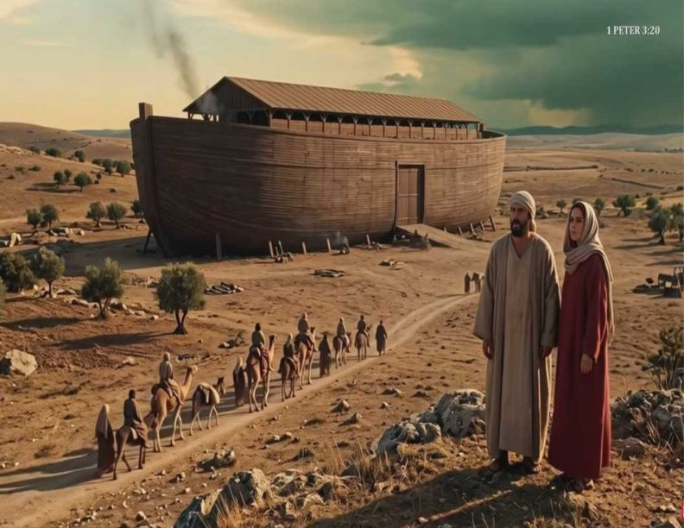

As in the Days of Noah
by Pastor Fee Soliven
Matthew 24:37-39
Sunday Morning
October 4, 2026

Slide 4
Matthew 24:37-39
37 But as the days of Noah were, so also will the coming of the Son of Man be. 38 For as in the days before the flood, they were eating and drinking, marrying and giving in marriage, until the day that Noah entered the ark, 39 and did not know until the flood came and took them all away, so also will the coming of the Son of Man be.

Slide 5
Genises 6:1-13
1 Now it came to pass, when men began to multiply on the face of the earth, and daughters were born to them, 2 that the sons of God saw the daughters of men, that they were beautiful; and they took wives for themselves of all whom they chose. 3 And the LORD said, "My Spirit shall not strive with man forever, for he is indeed flesh; yet his days shall be one hundred and twenty years."

Slide 6
4 There were giants on the earth in those days, and also afterward, when the sons of God came in to the daughters of men and they bore children to them. Those were the mighty men who were of old, men of renown. 5 Then the LORD saw that the wickedness of man was great in the earth, and that every intent of the thoughts of his heart was only evil continually.

Slide 7
6 And the LORD was sorry that He had made man on the earth, and He was grieved in His heart. 7 So the LORD said, "I will destroy man whom I have created from the face of the earth, both man and beast, creeping thing and birds of the air, for I am sorry that I have made them." 8 But Noah found grace in the eyes of the LORD. 9 This is the genealogy of Noah. Noah was a just man, perfect in his generations. Noah walked with God.

Slide 8
10 And Noah begot three sons: Shem, Ham, and Japheth. 11 The earth also was corrupt before God, and the earth was filled with violence. 12 So God looked upon the earth, and indeed it was corrupt; for all flesh had corrupted their way on the earth. 13 And God said to Noah, "The end of all flesh has come before Me, for the earth is filled with violence through them; and behold, I will destroy them with the earth.

Slide 9
Let’s Look at Noah’s Day

Slide 10
Marrying and Giving in Marriage

Slide 11
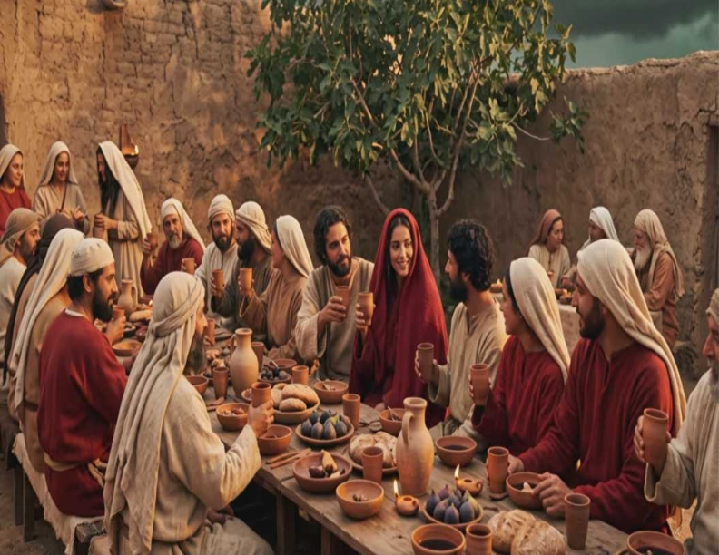
1.

Slide 12
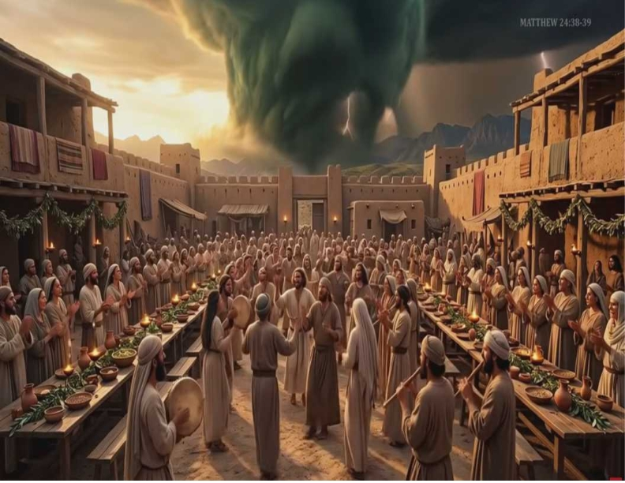
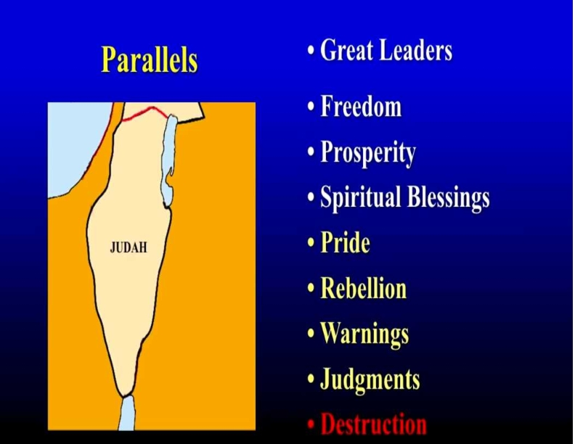
John 1:4-5
4 In Him was life, and the life was the light of men. 5 And the light shines in the darkness, and the darkness did not comprehend it.

Slide 13
Working, Commerce and
Business as Usual

Slide 14
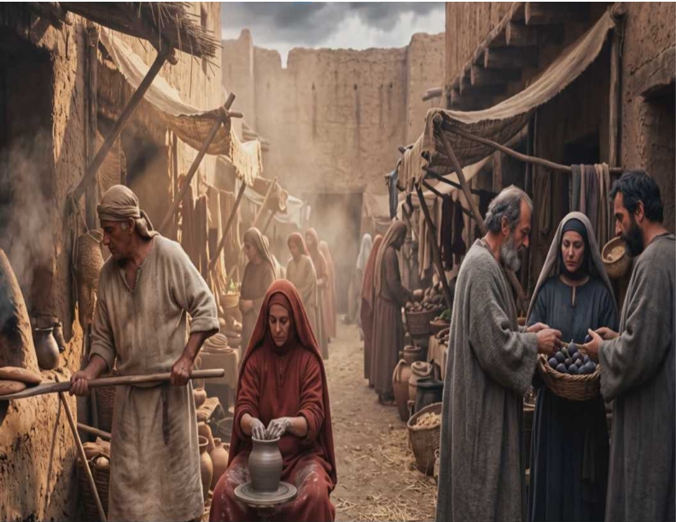

Genesis 1:3-4
3 Then God said, "Let there be light"; and there was light. 4 And God saw the light, that it was good; and God divided the light from the darkness.

Slide 15
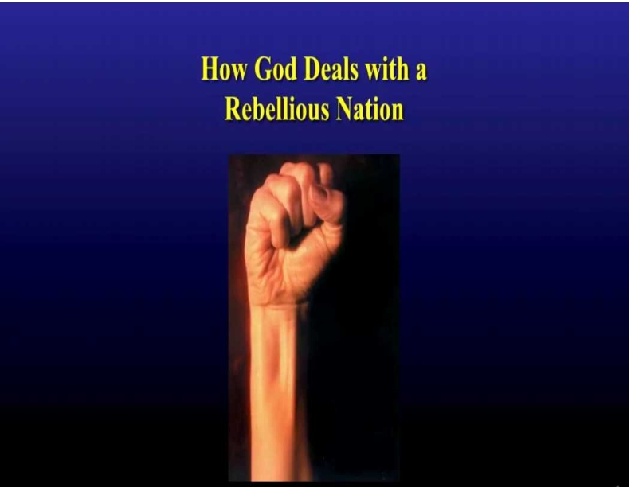
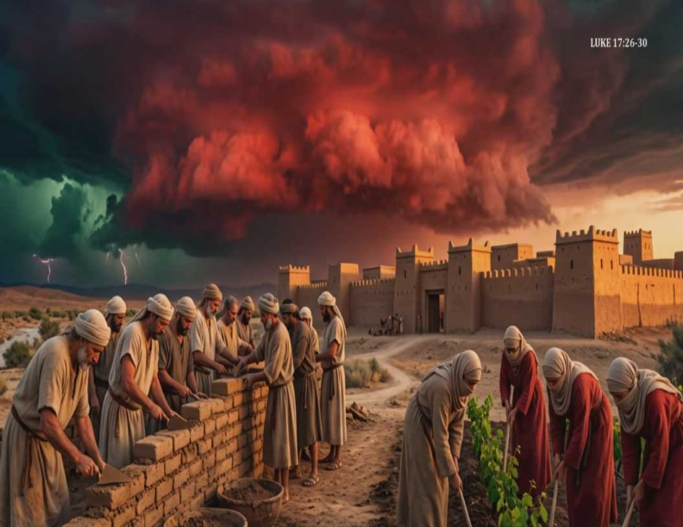
Luke 23:34
Then Jesus said, "Father, forgive them, for they do not know what they do." And they divided His garments and cast lots.

Slide 16
Evil Fallen Angels
took Human Wives

Slide 17
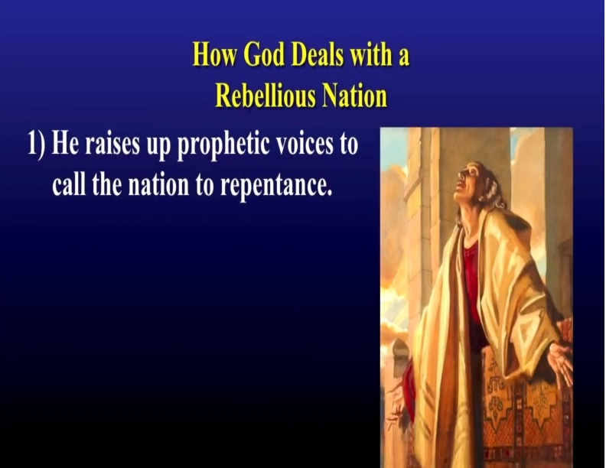
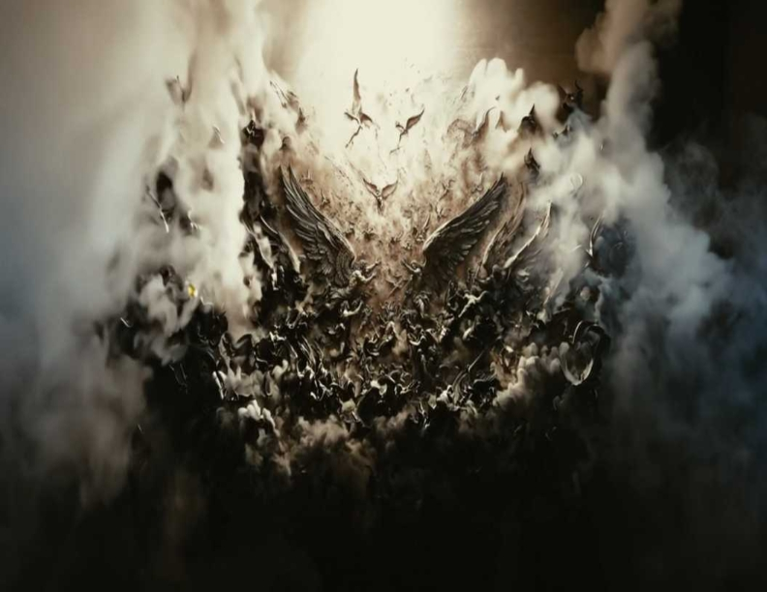
John 9:5
As long as I am in the world, I am the light of the world."

Slide 18
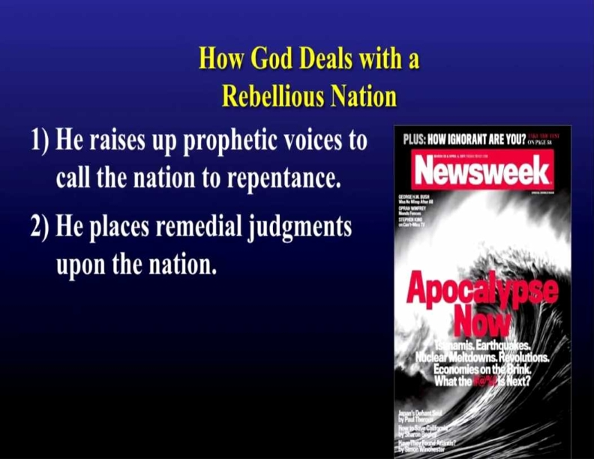
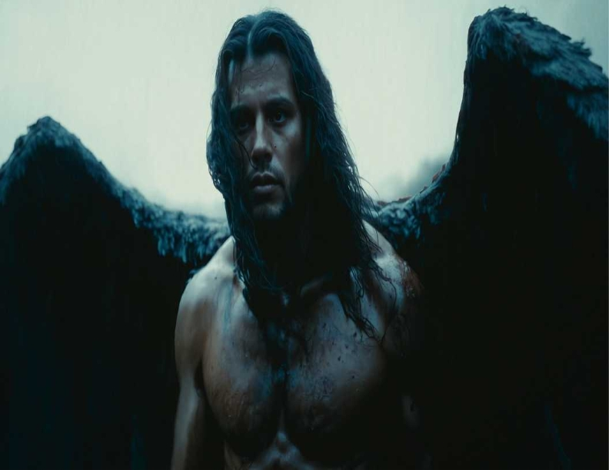
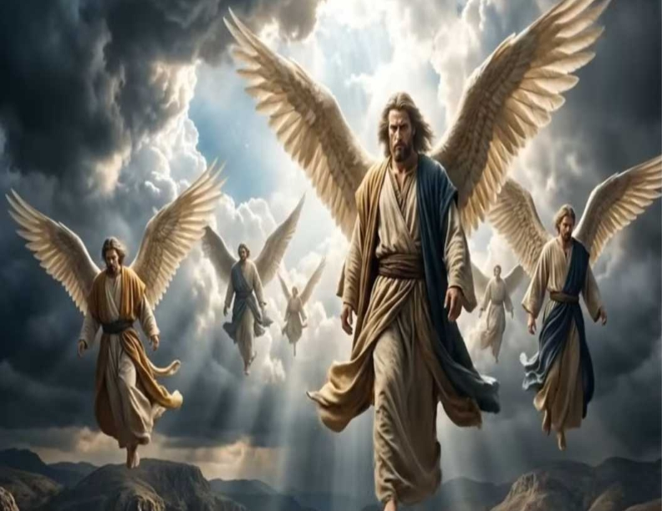
Psalm 36:9
For with You is the fountain of life; In Your light we see light.

Slide 19
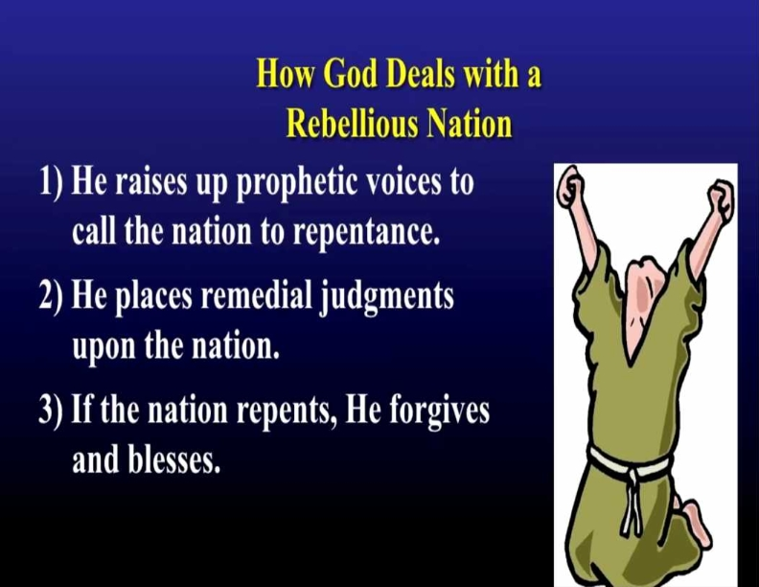
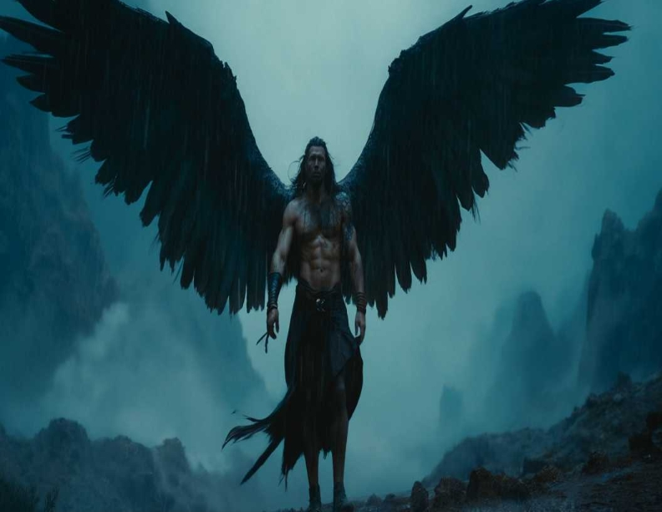
Isaiah 9:2
The people who walked in darkness Have seen a great light; Those who dwelt in the land of the shadow of death, Upon them a light has shined.

Slide 20
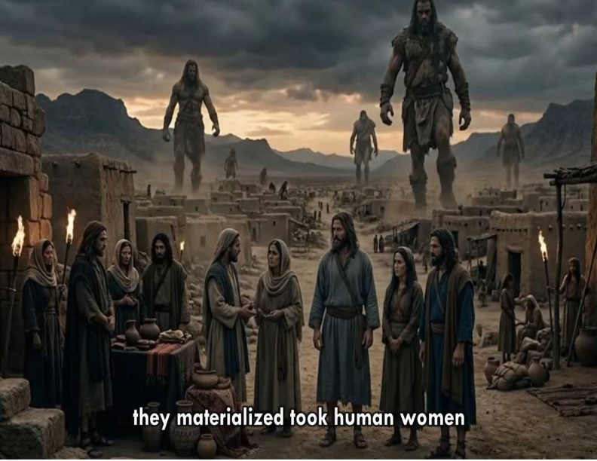
Isaiah 9:2
The people who walked in darkness Have seen a great light; Those who dwelt in the land of the shadow of death, Upon them a light has shined.

Slide 21
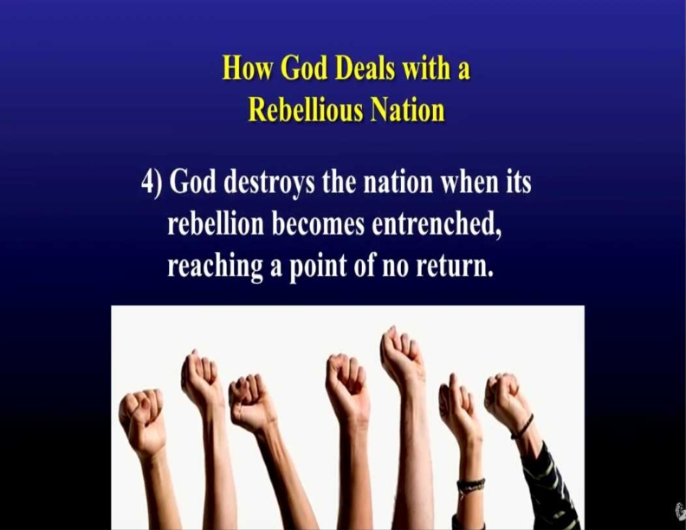
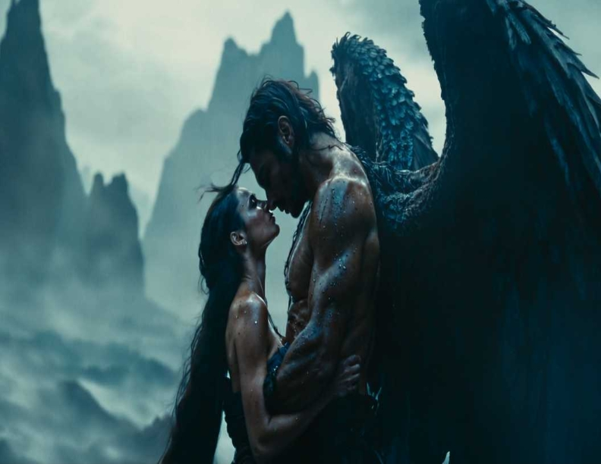
Psalms 23:4
Yea, though I walk through the valley of the shadow of death, I will fear no evil; For You are with me; Your rod and Your staff, they comfort me.

Slide 22
2 Peter 2:4
For if God did not spare the angels who sinned, but cast them down to hell and delivered them into chains of darkness, to be reserved for judgment;

Slide 23
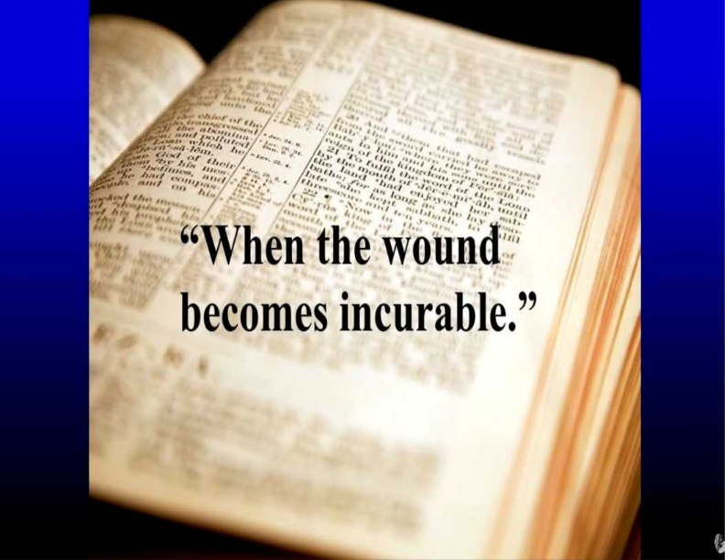
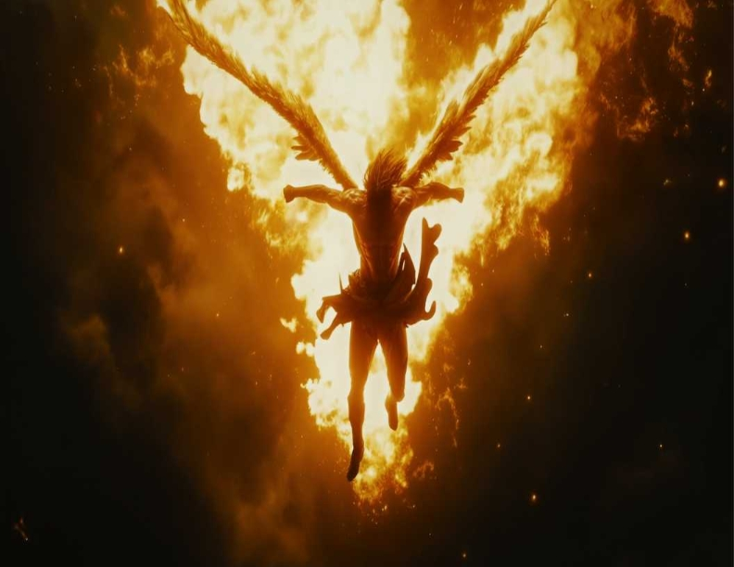
1 Peter 2:9
But you are a chosen generation, a royal priesthood, a holy nation, His own special people, that you may proclaim the praises of Him who called you out of darkness into His marvelous light;

Slide 24
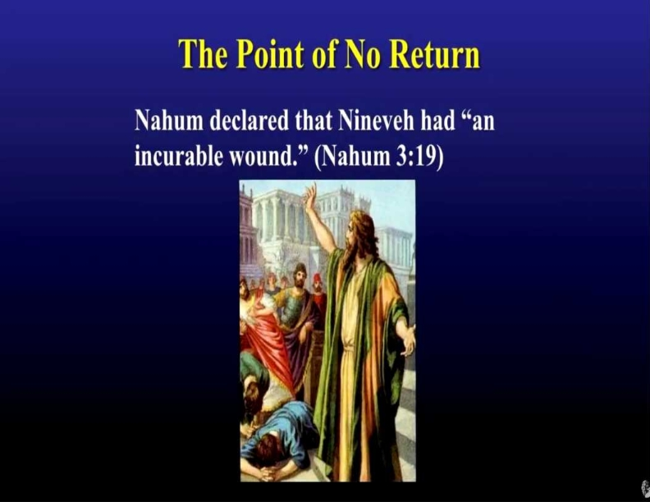
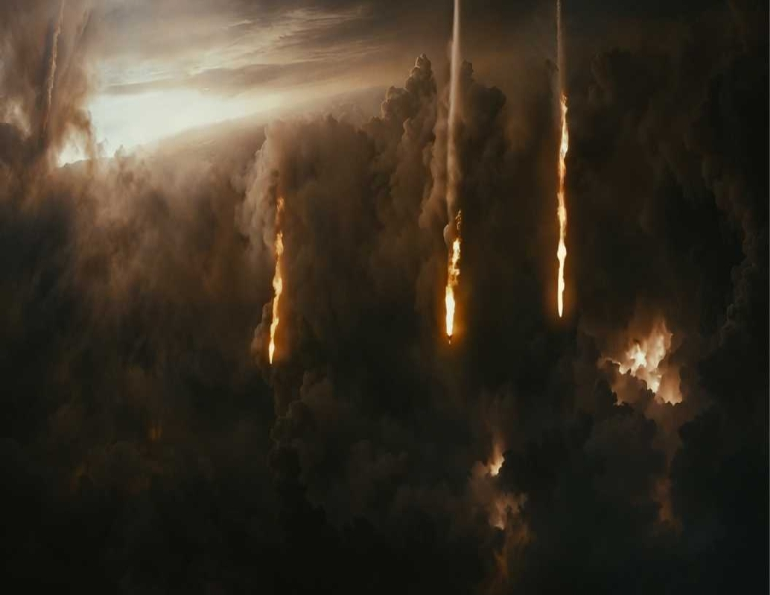
John 1:6-13
6 There was a man sent from God, whose name was John. 7 This man came for a witness, to bear witness of the Light, that all through him might believe. 8 He was not that Light, but was sent to bear witness of that Light. 9 That was the true Light which gives light to every man coming into the world. 10 He was in the world, and the world was made through Him, and the world did not know Him.

Slide 25
The Ungodly Union Created the Giants
on the Earth. Their offsprings were
Called “The Nephilim”

Slide 26
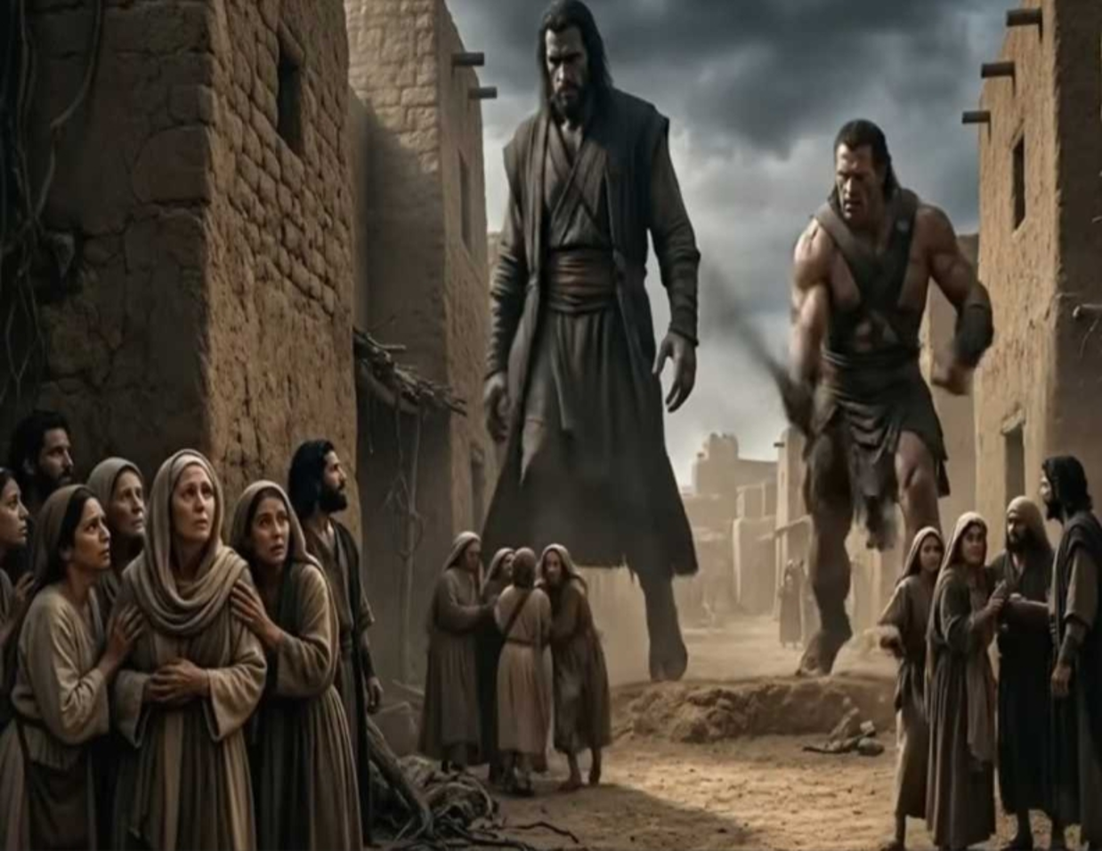
Psalm 36:9
For with You is the fountain of life; In Your light we see light.

Slide 27
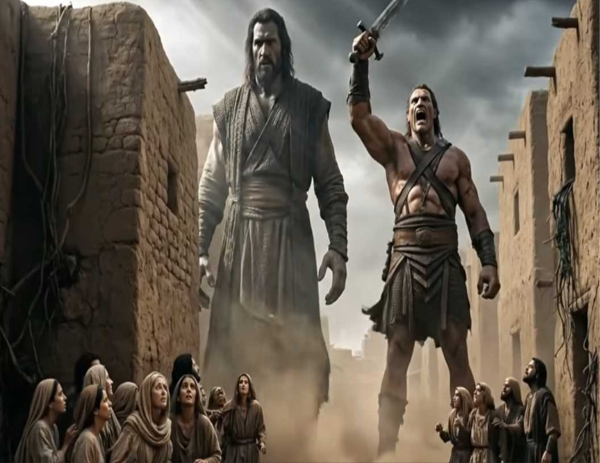
Isaiah 9:2
The people who walked in darkness Have seen a great light; Those who dwelt in the land of the shadow of death, Upon them a light has shined.

Slide 28
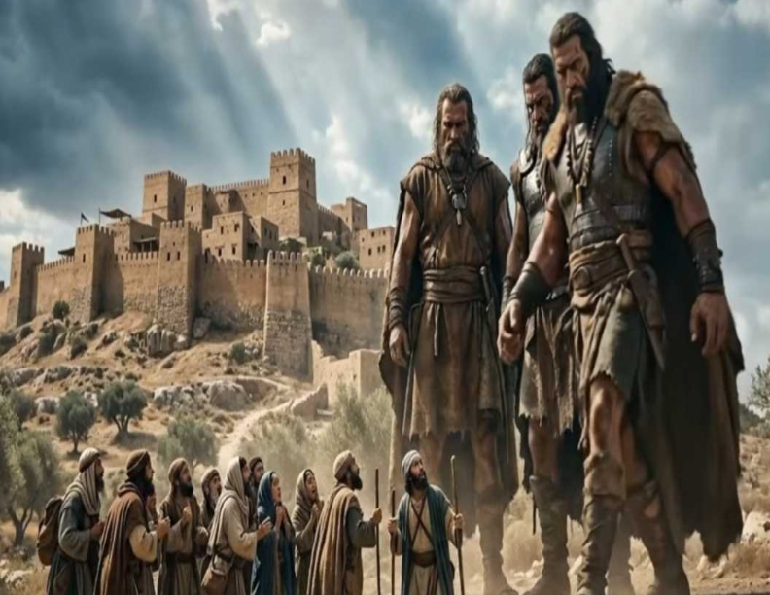
2 Peter 2:4
For if God did not spare the angels who sinned, but cast them down to hell and delivered them into chains of darkness, to be reserved for judgment;

Slide 29
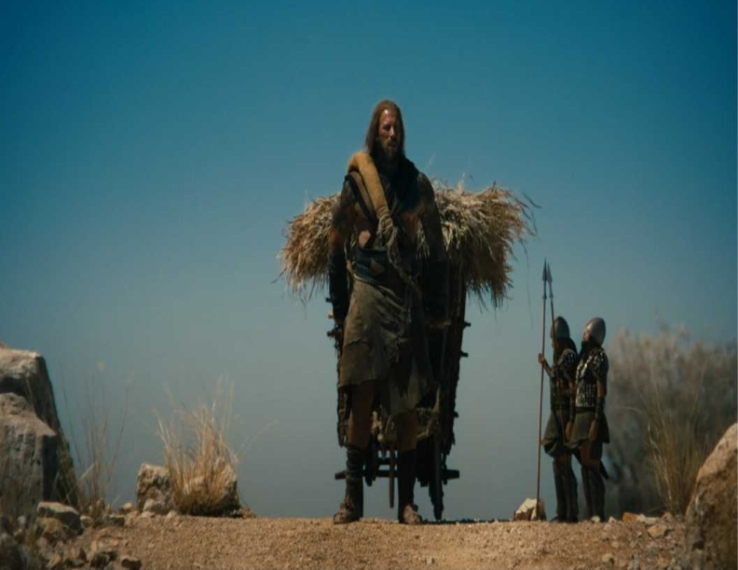
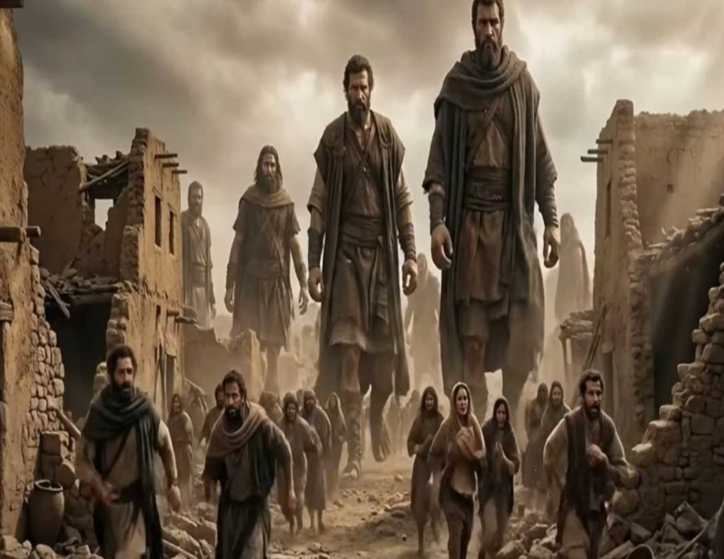
Nahum 3:19
Your injury has no healing, Your wound is severe. All who hear news of you Will clap their hands over you, For upon whom has not your wickedness passed continually?

Slide 30
Continual Violence

Slide 31
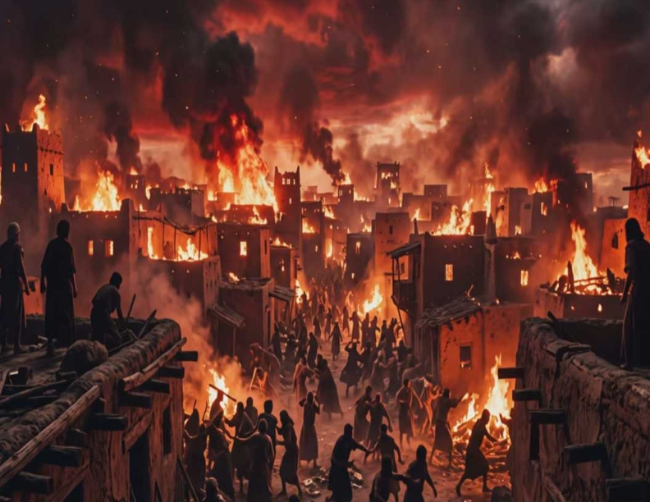
Continual Violence

Slide 32
Who was Noah?

Slide 33
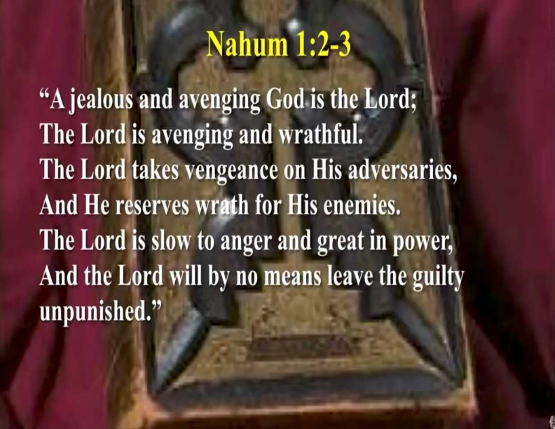
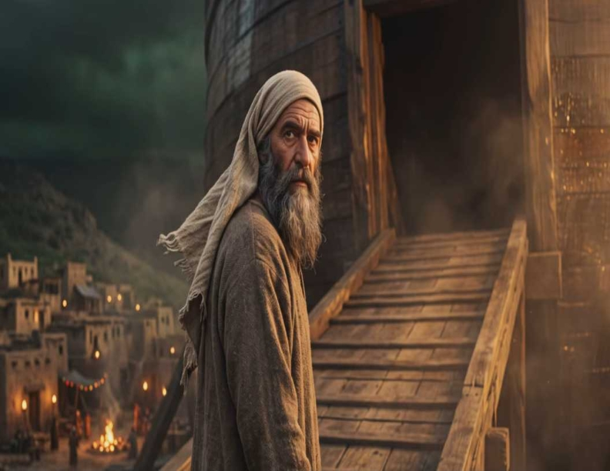
2 Corinthians 4:3-6
3 But even if our gospel is veiled, it is veiled to those who are perishing, 4 whose minds the god of this age has blinded, who do not believe, lest the light of the gospel of the glory of Christ, who is the image of God, should shine on them. 5 For we do not preach ourselves, but Christ Jesus the Lord, and ourselves your bondservants for Jesus' sake.

Slide 34
Genesis 6:8-9
8 But Noah found grace in the eyes of the LORD. 9 This is the genealogy of Noah. Noah was a just man, perfect in his generations. Noah walked with God.

Slide 35
Genesis 7:1
Then the LORD said to Noah, "Come into the ark, you and all your household, because I have seen that you are righteous before Me in this generation.

Slide 36
2 Peter 2:5
and did not spare the ancient world, but saved Noah, one of eight people, a preacher of righteousness, bringing in the flood on the world of the ungodly…

Slide 37
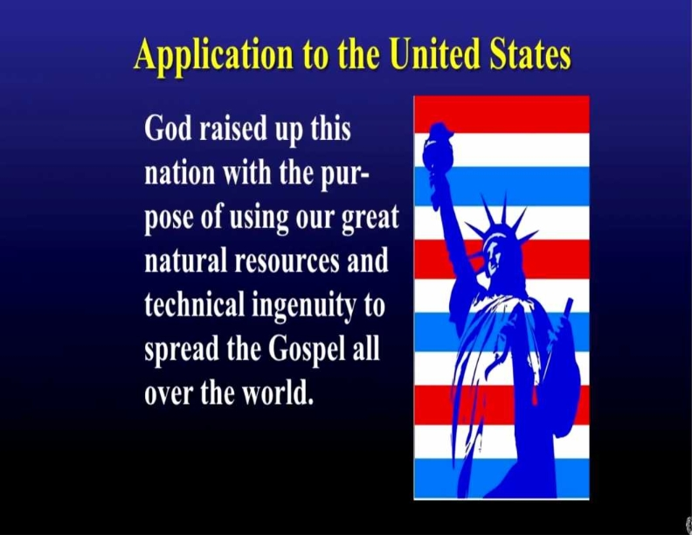
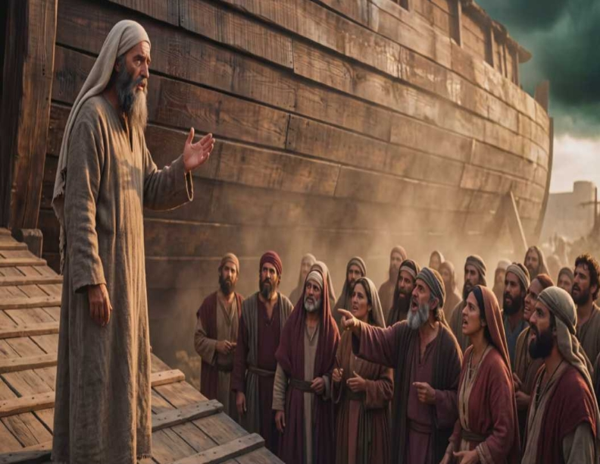
6 For it is the God who commanded light to shine out of darkness, who has shone in our hearts to give the light of the knowledge of the glory of God in the face of Jesus Christ.

Slide 38
The Flood during Noah’s Day was a mirror, a shadow and type of future events that will take place in our Generation

Slide 39
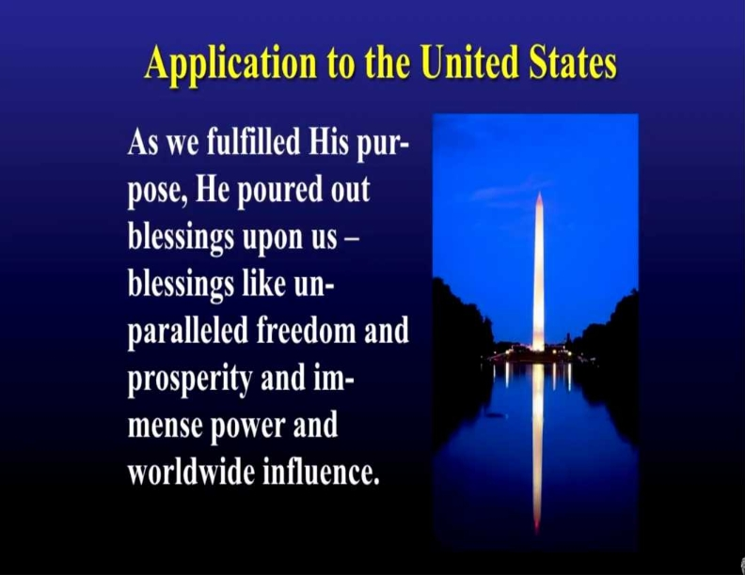
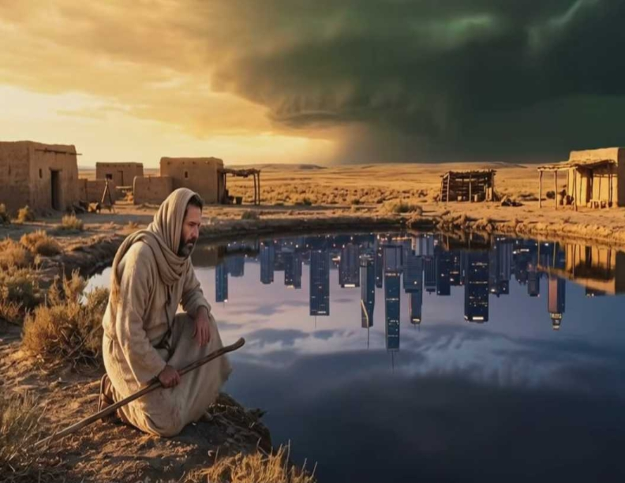
John 8:19-20
19 Then they said to Him, "Where is Your Father?" Jesus answered, "You know neither Me nor My Father. If you had known Me, you would have known My Father also." 20 These words Jesus spoke in the treasury, as He taught in the temple; and no one laid hands on Him, for His hour had not yet come.

Slide 40
We Need to see the parallel between
Noah’s Ark and The Cross of Christ

Slide 41
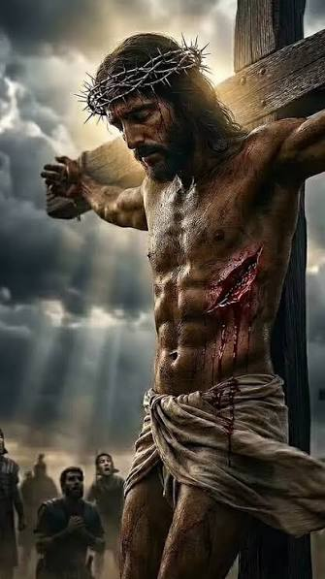
i

Slide 42
Olivet Discourse

Slide 43
Matthew 24:37-39
37 But as the days of Noah were, so also will the coming of the Son of Man be. 38 For as in the days before the flood, they were eating and drinking, marrying and giving in marriage, until the day that Noah entered the ark, 39 and did not know until the flood came and took them all away, so also will the coming of the Son of Man be.

Slide 44
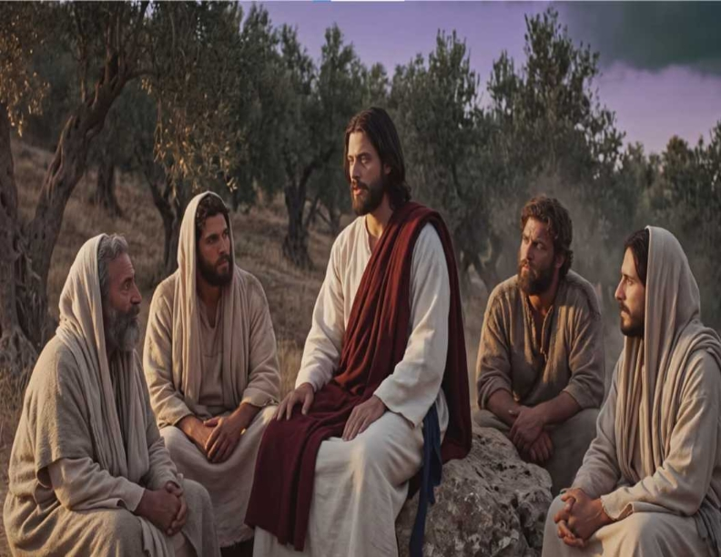
12 For it is shameful even to speak of those things which are done by them in secret. 13 But all things that are exposed are made manifest by the light, for whatever makes manifest is light. 14 Therefore He says: "Awake, you who sleep, Arise from the dead, And Christ will give you light."

Slide 45
People today are still eating and drinking, marrying and giving in marriage

Slide 46

People today are still eating and drinking, marrying and giving in marriage

Slide 47

People today are still eating and drinking, marrying and giving in marriage

Slide 48

People today are still eating and drinking, marrying and giving in marriage

Slide 49
People Today Are Just Too Busy for God and Church and Spiritual Growth in Christ

Slide 50

People today are still eating and drinking, marrying and giving in marriage

Slide 51
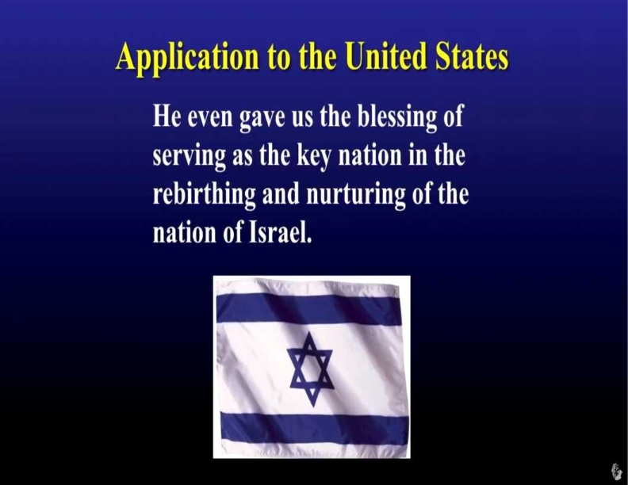
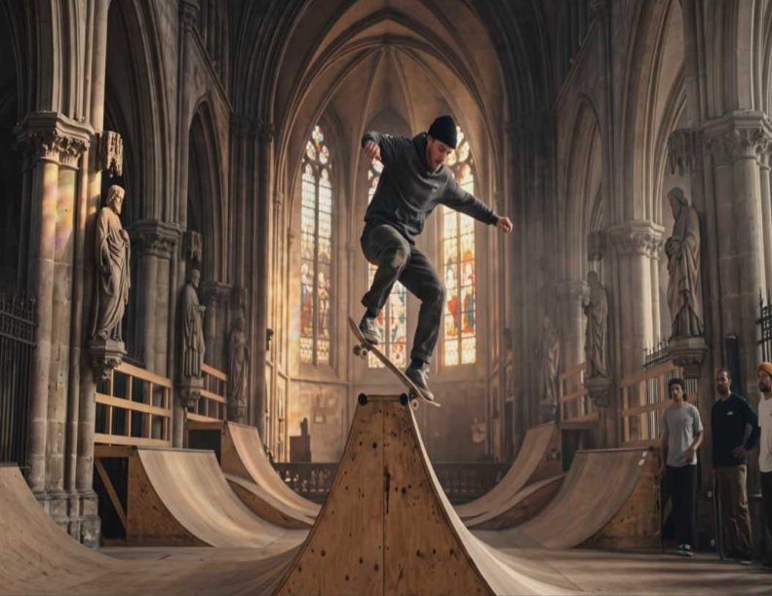
John 8:21-59
21 Then Jesus said to them again, "I am going away, and you will seek Me, and will die in your sin. Where I go you cannot come." 22 So the Jews said, "Will He kill Himself, because He says, 'Where I go you cannot come'?" 23 And He said to them, "You are from beneath; I am from above. You are of this world; I am not of this world.

Slide 52
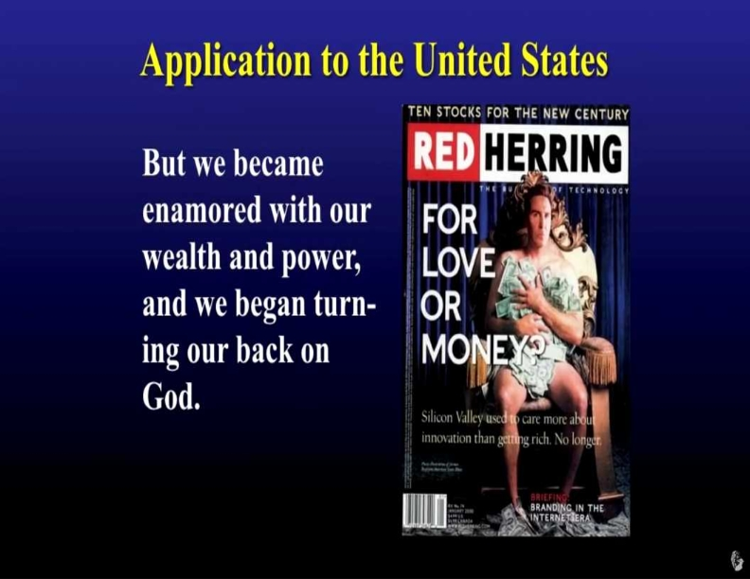
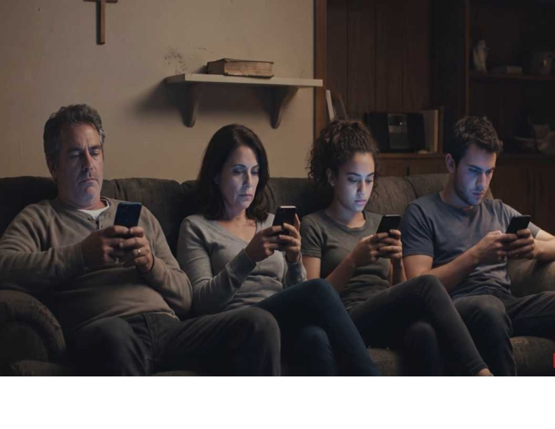
24 Therefore I said to you that you will die in your sins; for if you do not believe that I am He, you will die in your sins." 25 Then they said to Him, "Who are You?" And Jesus said to them, "Just what I have been saying to you from the beginning. 26 I have many things to say and to judge concerning you, but He who sent Me is true; and I speak to the world those things which I heard from Him."

Slide 53
Wars, Rumors of Wars and
Extreme Violence

Slide 54
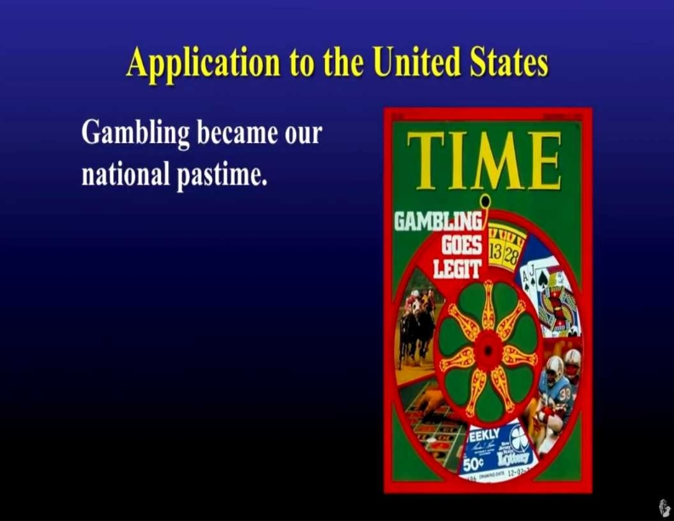
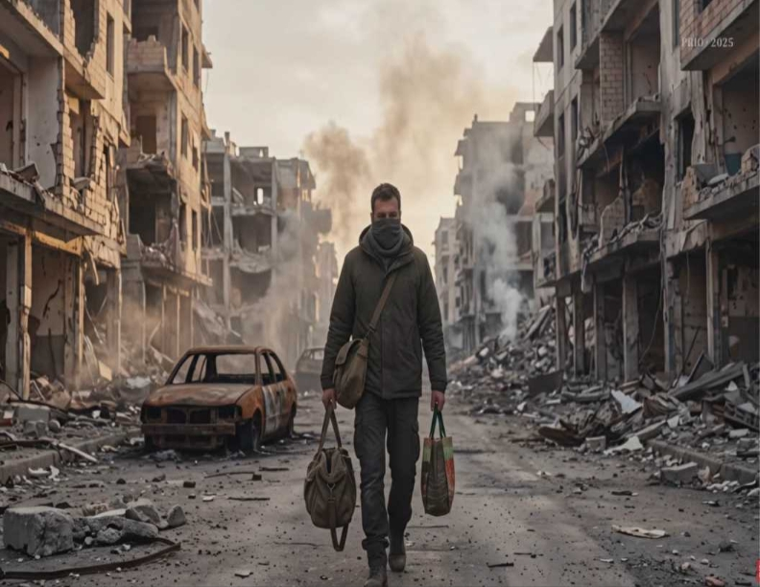
38 I speak what I have seen with My Father, and you do what you have seen with your father." 39 They answered and said to Him, "Abraham is our father." Jesus said to them, "If you were Abraham's children, you would do the works of Abraham. 40 But now you seek to kill Me, a Man who has told you the truth which I heard from God. Abraham did not do this.

Slide 55
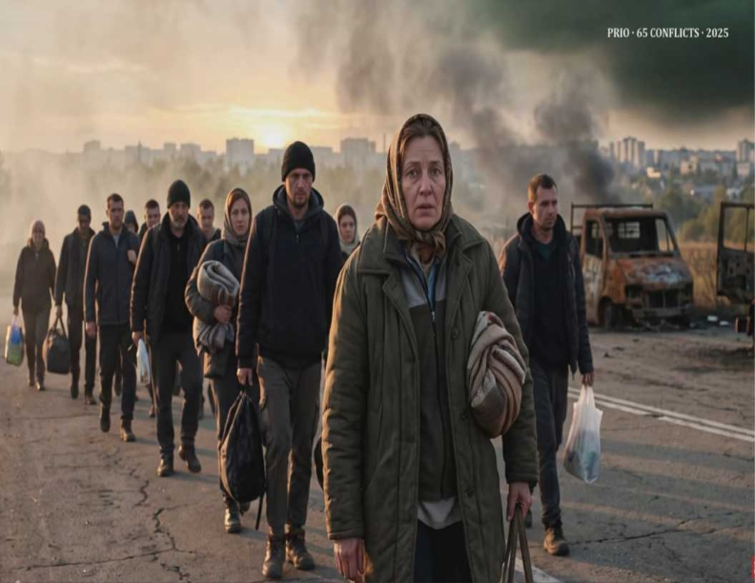
Proverbs 15:27
Whoever is greedy for unjust gain troubles his own household, but he who hates bribes will live.

Slide 56
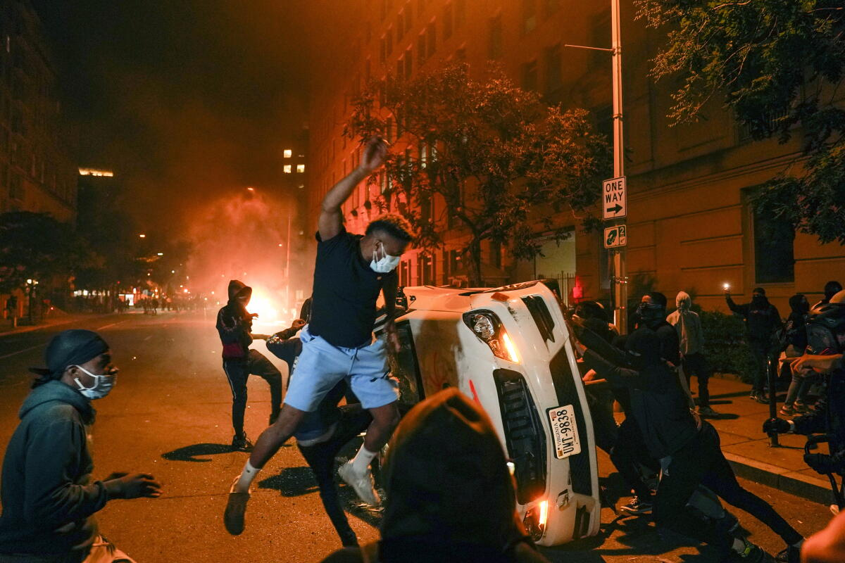
Proverbs 20:21
An inheritance gained hastily in the beginning will not be blessed in the end.

Slide 57
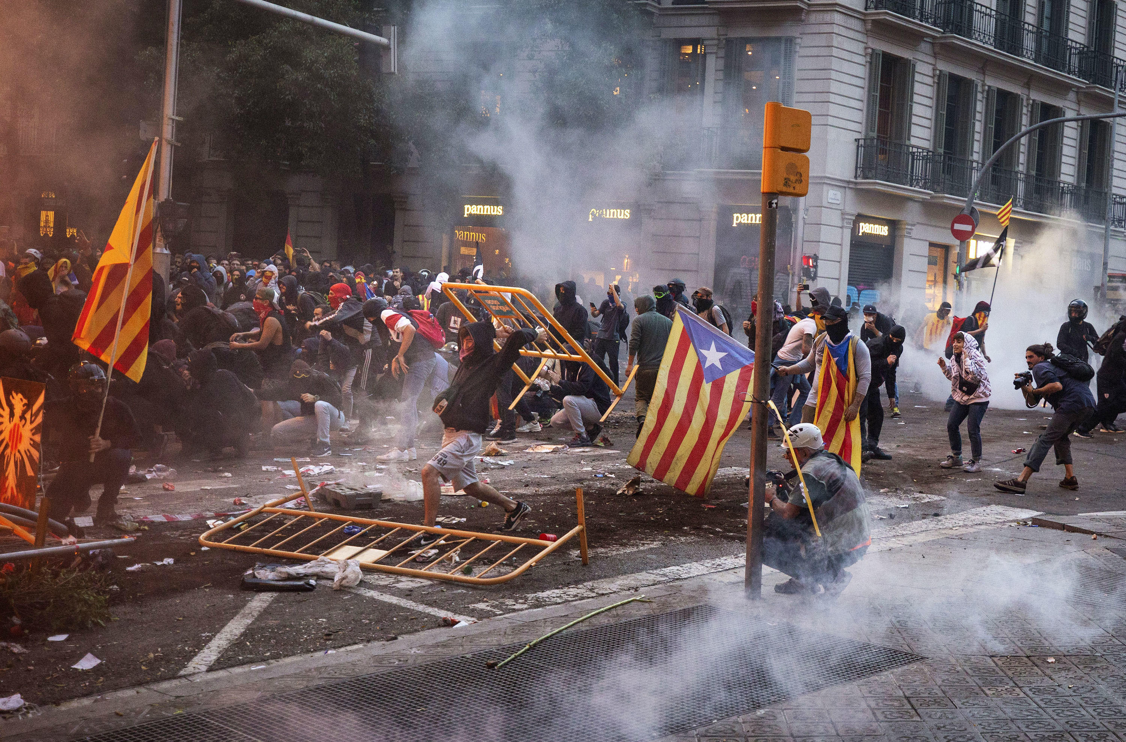
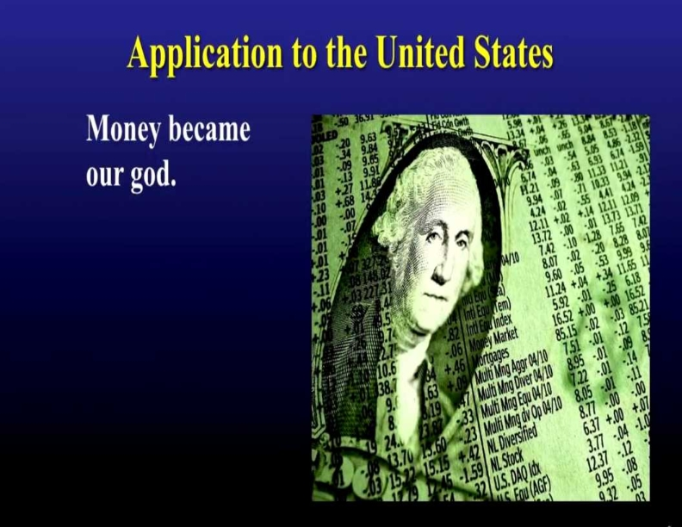
30 As He spoke these words, many believed in Him. 31 Then Jesus said to those Jews who believed Him, "If you abide in My word, you are My disciples indeed. 32 And you shall know the truth, and the truth shall make you free." 33 They answered Him, "We are Abraham's descendants, and have never been in bondage to anyone. How can you say, 'You will be made free'?"

Slide 58
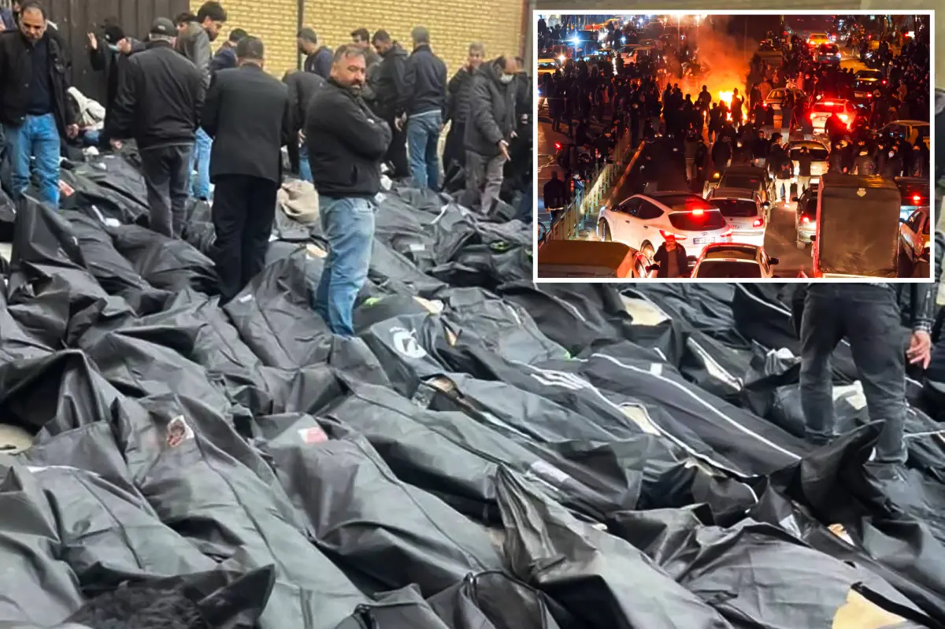
1 Timothy 6:10
For the love of money is a root of all kinds of evil, for which some have strayed from the faith in their greediness, and pierced themselves through with many sorrows.

Slide 59
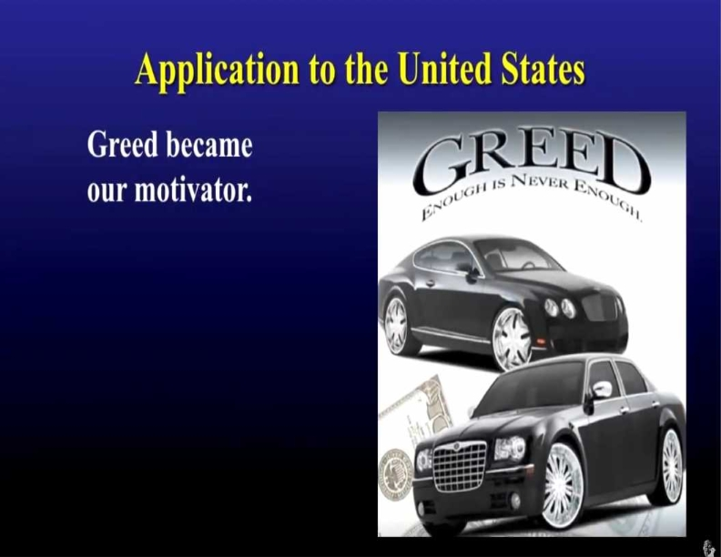
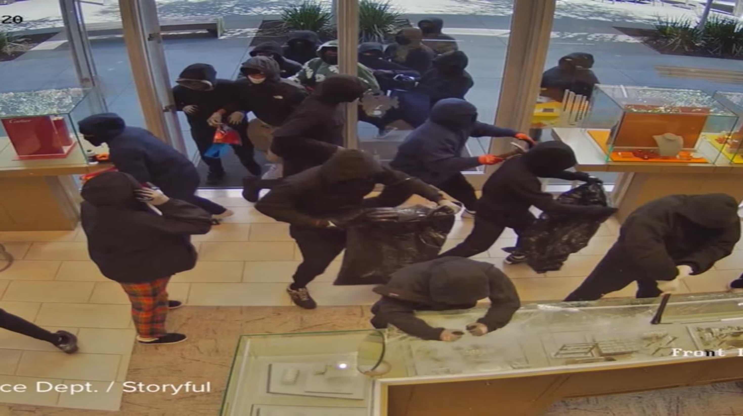
34 Jesus answered them, "Most assuredly, I say to you, whoever commits sin is a slave of sin. 35 And a slave does not abide in the house forever, but a son abides forever. 36 Therefore if the Son makes you free, you shall be free indeed. 37 "I know that you are Abraham's descendants, but you seek to kill Me, because My word has no place in you.

Slide 60
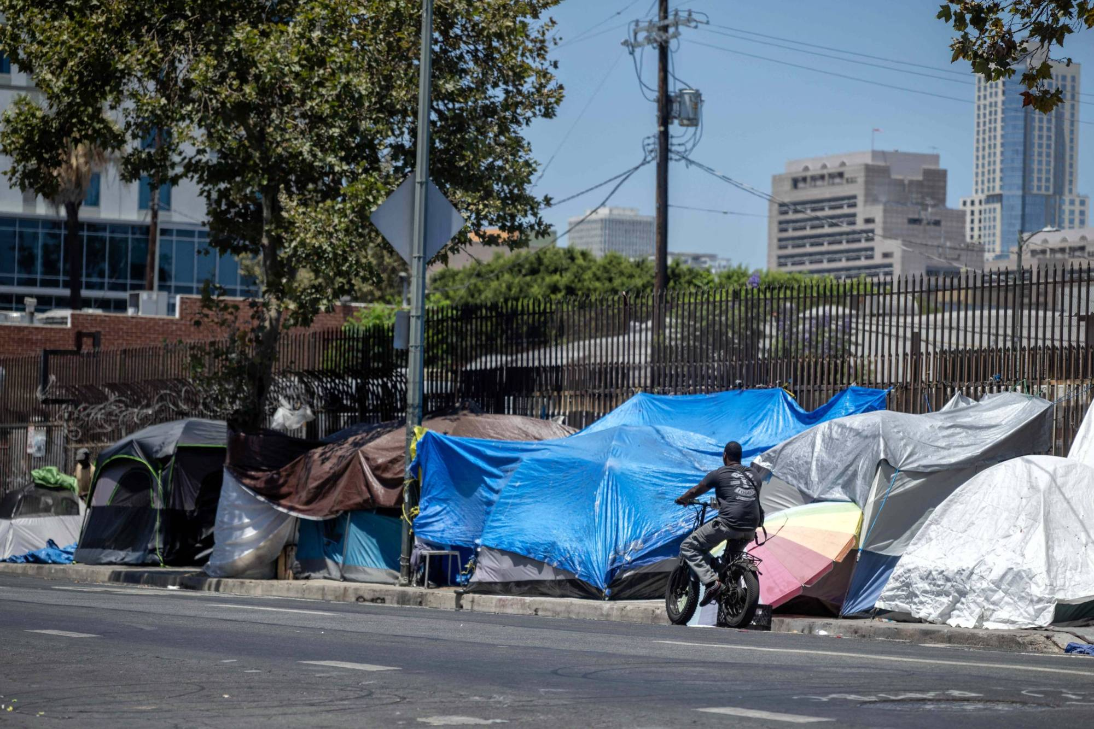
Colossians 3:5-7
5 Therefore put to death your members which are on the earth: fornication, uncleanness, passion, evil desire, and covetousness, which is idolatry. 6 Because of these things the wrath of God is coming upon the sons of disobedience, 7 in which you yourselves once walked when you lived in them

Slide 61
Economic Collapse

Slide 62
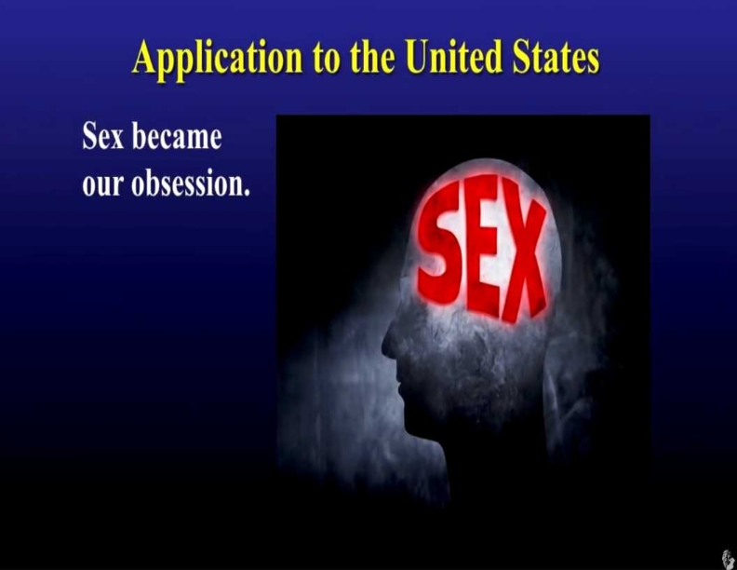

41 You do the deeds of your father." Then they said to Him, "We were not born of fornication; we have one Father--God." 42 Jesus said to them, "If God were your Father, you would love Me, for I proceeded forth and came from God; nor have I come of Myself, but He sent Me. 43 Why do you not understand My speech? Because you are not able to listen to My word.

Slide 63


47 He who is of God hears God's words; therefore you do not hear, because you are not of God." 48 Then the Jews answered and said to Him, "Do we not say rightly that You are a Samaritan and have a demon?" 49 Jesus answered, "I do not have a demon; but I honor My Father, and you dishonor Me. 50 And I do not seek My own glory; there is One who seeks and judges.

Slide 64

1 Corinthians 10:13
No temptation has overtaken you except such as is common to man; but God is faithful, who will not allow you to be tempted beyond what you are able, but with the temptation will also make the way of escape, that you may be able to bear it.

Slide 65

1 Corinthians 10:13
No temptation has overtaken you except such as is common to man; but God is faithful, who will not allow you to be tempted beyond what you are able, but with the temptation will also make the way of escape, that you may be able to bear it.

Slide 66
Proverbs 11:4
Riches do not profit in the day of wrath, But righteousness delivers from death.

Slide 67
Earthquakes, Tsunamis, Hurricanes, Tornados and Fires that Jesus said would be in our present Generation!

Slide 68


54 Jesus answered, "If I honor Myself, My honor is nothing. It is My Father who honors Me, of whom you say that He is your God. 55 Yet you have not known Him, but I know Him. And if I say, 'I do not know Him,' I shall be a liar like you; but I do know Him and keep His word. 56 Your father Abraham rejoiced to see My day, and he saw it and was glad." 57 Then the Jews said to Him, "You are not yet fifty years old, and have You seen Abraham?"

Slide 69


Psalms 9:17
The wicked shall be turned into hell, And all the nations that forget God.

Slide 70


Slide 71


Slide 72
We are living in the Birth Pains that the Bible says!

Slide 73
Mark 13:6-8 NTFE Version
6 You’re going to hear about wars, actual wars and rumored ones; make sure you don’t get alarmed. This has got to happen, but it doesn’t mean the end is coming yet. 7 Nations will rise against one another, and kingdoms against each other. There will be famines and earthquakes here and there. 8 All this is just the start of the birth pangs.

Slide 74
James 4:8
"Draw near to God and He will draw near to you. Cleanse your hands, you sinners; and purify your hearts, you double-minded."

Slide 75
Matthew 19:26
But Jesus looked at them and said to them, "With men this is impossible, but with God all things are possible."

Slide 76
It’s Now Our Turn To Warn The People of The Soon Coming Judgement

Slide 77
Ezekiel 3:4-11
4 And He said to me: "Son of man, go to the house of Israel and speak with My words to them. 5 For you are not sent to a people of unfamiliar speech and of hard language, but to the house of Israel, 6 not to many people of unfamiliar speech and of hard language, whose words you cannot understand. Surely, had I sent you to them, they would have listened to you.

Slide 78
7 But the house of Israel will not listen to you, because they will not listen to Me; for all the house of Israel are impudent and hard-hearted. 8 Behold, I have made your face strong against their faces, and your forehead strong against their foreheads. 9 Like adamant stone, harder than flint, I have made your forehead; do not be afraid of them, nor be dismayed at their looks, though they are a rebellious house."

Slide 79
10 Moreover He said to me: "Son of man, receive into your heart all My words that I speak to you, and hear with your ears. 11 And go, get to the captives, to the children of your people, and speak to them and tell them, 'Thus says the Lord GOD,' whether they hear, or whether they refuse."

Slide 80
Ezekiel 3:16-21
16 Now it came to pass at the end of seven days that the word of the LORD came to me, saying, 17 "Son of man, I have made you a watchman for the house of Israel; therefore hear a word from My mouth, and give them warning from Me: 18 When I say to the wicked, 'You shall surely die,' and you give him no warning, nor speak to warn the wicked from his wicked way, to save his life, that same wicked man shall die in his iniquity; but his blood I will require at your hand.

Slide 81
19 Yet, if you warn the wicked, and he does not turn from his wickedness, nor from his wicked way, he shall die in his iniquity; but you have delivered your soul. 20 Again, when a righteous man turns from his righteousness and commits iniquity, and I lay a stumbling block before him, he shall die; because you did not give him warning, he shall die in his sin, and his righteousness which he has done shall not be remembered; but his blood I will require at your hand.

Slide 82
21 Nevertheless if you warn the righteous man that the righteous should not sin, and he does not sin, he shall surely live because he took warning; also you will have delivered your soul."

Slide 83
2 Chronicles 7:14
If My people who are called by My name will humble themselves, and pray and seek My face, and turn from their wicked ways, then I will hear from heaven, and will forgive their sin and heal their land.

Slide 84

1 Thessalonians 4:16-17
16 For the Lord himself shall descend from heaven with a shout, with the voice of the archangel, and with the trump of God: and the dead in Christ shall rise first: 17 Then we which are alive and remain shall be caught up together with them in the clouds, to meet the Lord in the air: and so shall we ever be with the Lord.

Slide 85



Philippians 3:20-21
20 For our citizenship is in heaven, from which we also eagerly wait for the Savior, the Lord Jesus Christ, 21 who will transform our lowly body that it may be conformed to His glorious body, according to the working by which He is able even to subdue all things to Himself.

Slide 86
1 Thessalonians 4:13-18
13 But I do not want you to be ignorant, brethren, concerning those who have fallen asleep, lest you sorrow as others who have no hope. 14 For if we believe that Jesus died and rose again, even so God will bring with Him those who sleep in Jesus.

Slide 87
15 For this we say to you by the word of the Lord, that we who are alive and remain until the coming of the Lord will by no means precede those who are asleep. 16 For the Lord Himself will descend from heaven with a shout, with the voice of an archangel, and with the trumpet of God. And the dead in Christ will rise first.

Slide 88
17 Then we who are alive and remain shall be caught up together with them in the clouds to meet the Lord in the air. And thus we shall always be with the Lord. 18 Therefore comfort one another with these words.

Slide 89
1 Corinthians 15:50-54
50 Now this I say, brethren, that flesh and blood cannot inherit the kingdom of God; nor does corruption inherit incorruption. 51 Behold, I tell you a mystery: We shall not all sleep, but we shall all be changed-- 52 in a moment, in the twinkling of an eye, at the last trumpet. For the trumpet will sound, and the dead will be raised incorruptible, and we shall be changed.

Slide 90
53 For this corruptible must put on incorruption, and this mortal must put on immortality. 54 So when this corruptible has put on incorruption, and this mortal has put on immortality, then shall be brought to pass the saying that is written: "Death is swallowed up in victory."

Slide 91

20 Again, when a righteous man turns from his righteousness and commits iniquity, and I lay a stumbling block before him, he shall die; because you did not give him warning, he shall die in his sin, and his righteousness which he has done shall not be remembered; but his blood I will require at your hand.

Slide 92
Acts 2:38-39
38 Then Peter said to them, "Repent, and let every one of you be baptized in the name of Jesus Christ for the remission of sins; and you shall receive the gift of the Holy Spirit. 39 For the promise is to you and to your children, and to all who are afar off, as many as the Lord our God will call."

Slide 93

Donate with our QR code app to
Amazing Grace Christian Fellowship
Donations are Deeply Appreciated!

