Slide 1


Slide 2


Slide 3
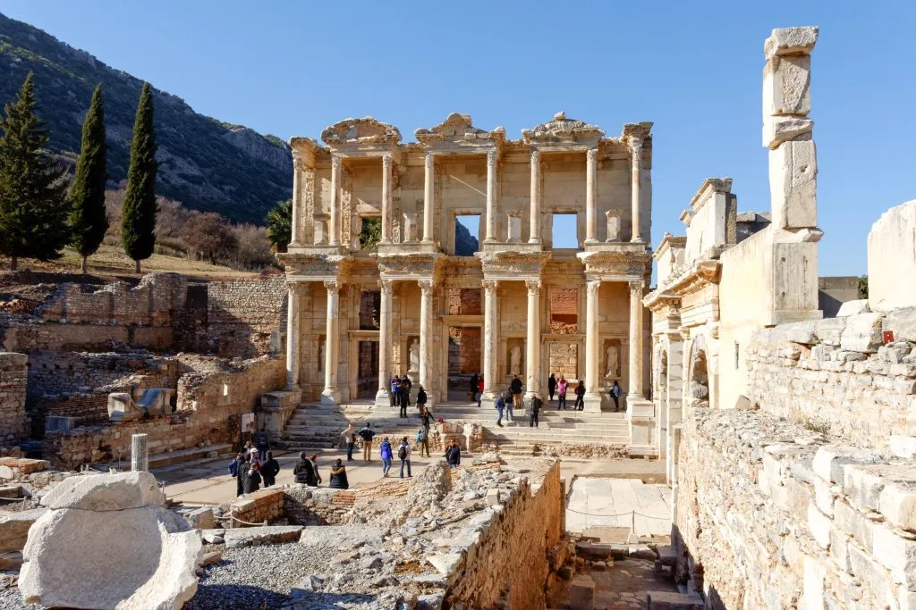

The Last 4 Churches in Revelation
by Pastor Fee Soliven
In Progress
Sunday Morning
October 18, 2026

Slide 4
Acts 3:19-21
19 Repent therefore and be converted, that your sins may be blotted out, so that times of refreshing may come from the presence of the Lord, 20 and that He may send Jesus Christ, who was preached to you before, 21 whom heaven must receive until the times of restoration of all things, which God has spoken by the mouth of all His holy prophets since the world began.

Slide 5
Revelation 2:18
And to the angel of the church in Thyatira
Revelation 3:1
And to the angel of the church in Sardis
Revelation 3:7
And to the angel of the church in Philadelphia
Revelation 3:14
And to the angel of the church of the Laodiceans

Slide 6
Revelation 1:19
Write the things which you have seen, and the things which are, and the things which will take place after this.

Slide 7
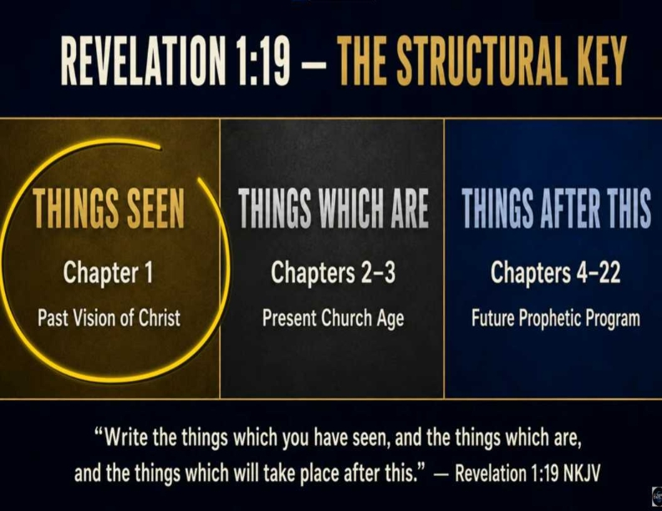
Ephesians 2:8-9
8 For by grace you have been saved through faith, and that not of yourselves; it is the gift of God, 9 not of works, lest anyone should boast.

Slide 8
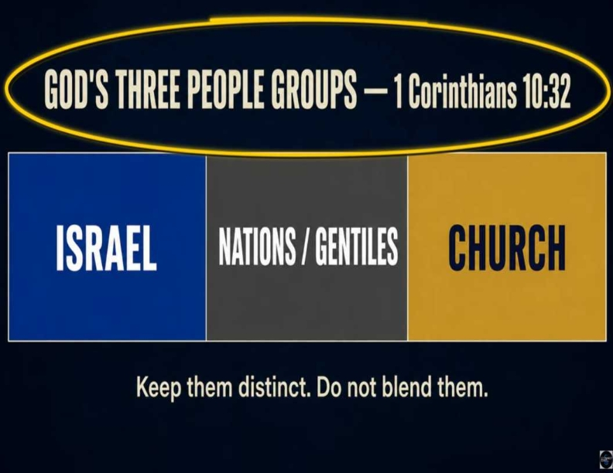
Romans 10:9-10
9 that if you confess with your mouth the Lord Jesus and believe in your heart that God has raised Him from the dead, you will be saved. 10 For with the heart one believes unto righteousness, and with the mouth confession is made unto salvation.

Slide 9
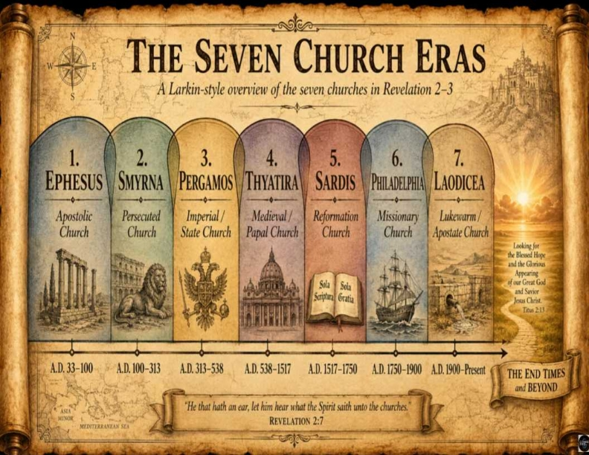
Revelation 1:19
Write the things which you have seen, and the things which are, and the things which will take place after this.

Slide 10
Church number four, Thyatira, the Corrupted Church

Slide 11
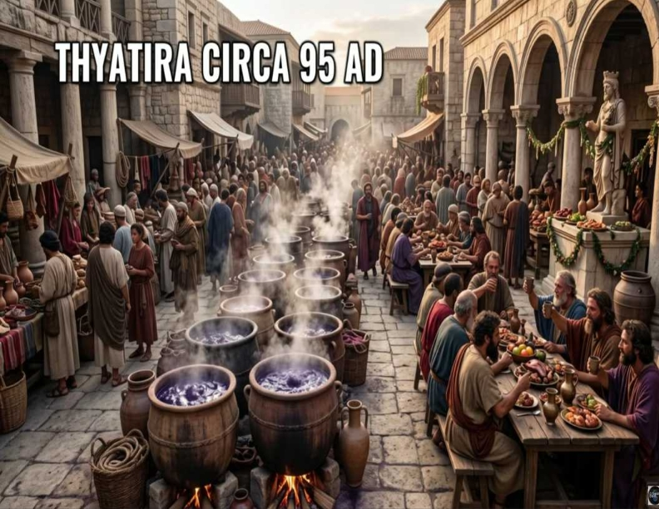
Revelation 1:19
Write the things which you have seen, and the things which are, and the things which will take place after this.

Slide 12
Acts 16:14
Now a certain woman named Lydia heard us. She was a seller of purple from the city of Thyatira, who worshiped God. The Lord opened her heart to heed the things spoken by Paul.

Slide 13
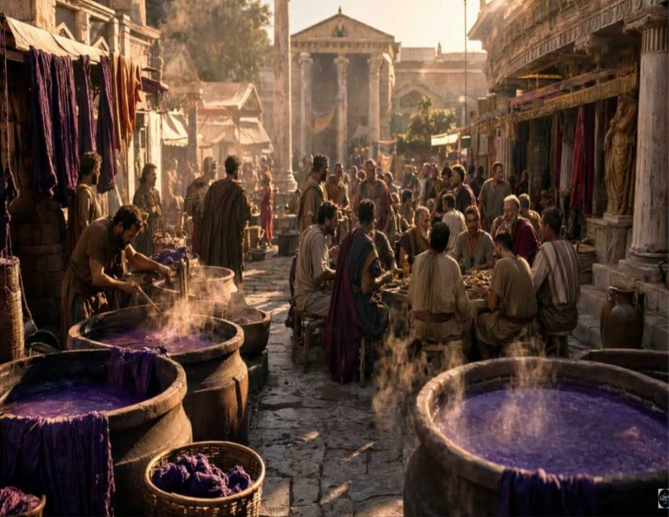
2 Peter 3:18
but grow in the grace and knowledge of our Lord and Savior Jesus Christ. To Him be the glory both now and forever. Amen.

Slide 14
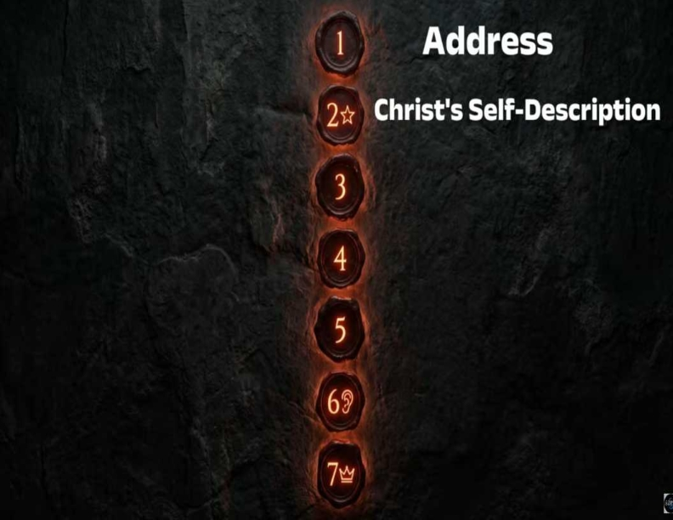
Ecclesiastics 3:1
To everything there is a season, A time for every purpose under heaven:

Slide 15
Revelation 2:18
"And to the angel of the church in Thyatira write these things,' says the Son of God, who has eyes like a flame of fire, and His feet like fine brass."

Slide 16
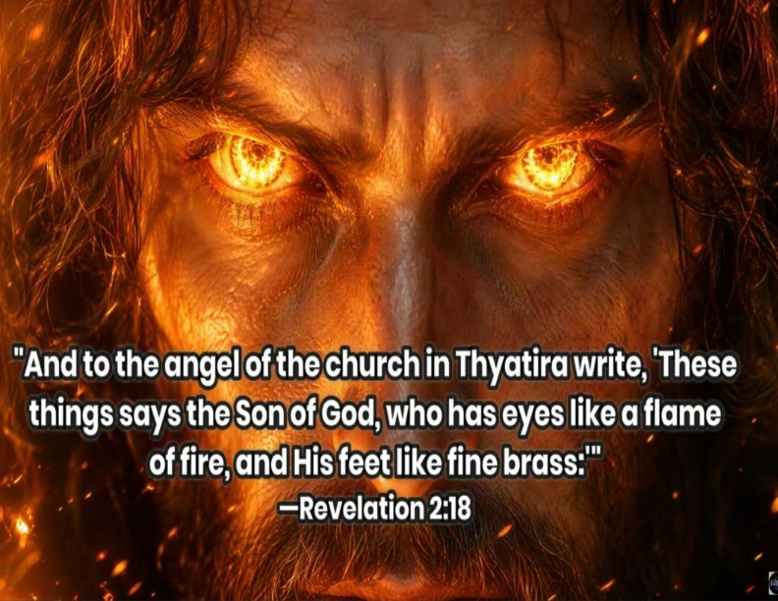
1 Thessalonians 5:23-24
23 Now may the God of peace Himself sanctify you completely; and may your whole spirit, soul, and body be preserved blameless at the coming of our Lord Jesus Christ. 24 He who calls you is faithful, who also will do it.

Slide 17
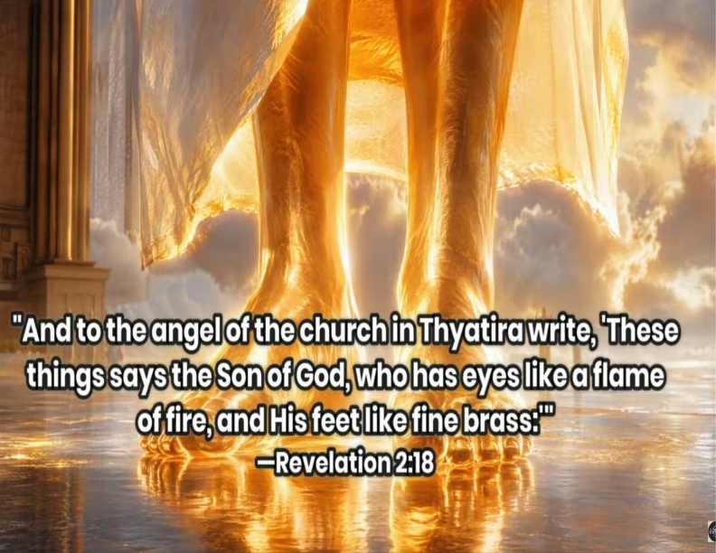
John 17:17
Sanctify them by Your truth. Your word is truth.

Slide 18
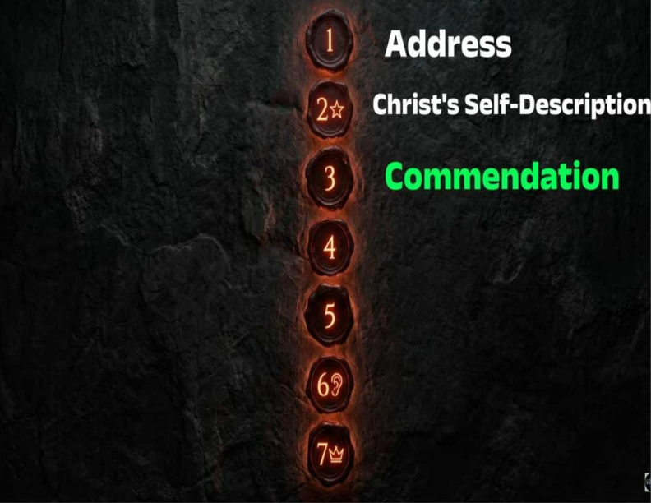
Point 4: Jesus Revival & How
to Proclaim Jesus to Others

Slide 19
Revelation 2:19
"I know your works, love, service, faith, and your patience. And as for your works, the last are more than the first."

Slide 20
Growth, Love, and Service

Slide 21
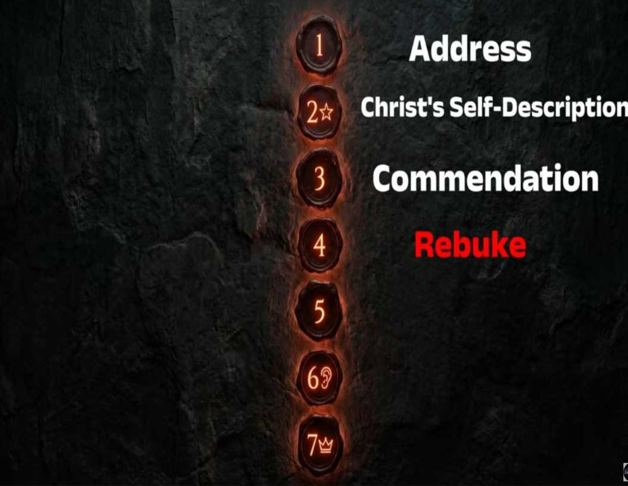
Growth, Love, and Service

Slide 22
Jezebel

Slide 23
Revelation 2:20
"Nevertheless, I have a few things against you because you allow that woman Jezebel, who calls herself a prophetess, to teach and seduce my servants to commit sexual immorality and eat things sacrificed to idols."

Slide 24
Jezebel

Slide 25

•What salvation is
•How God sets us apart (sanctifies us)
•What Jesus revival looks like in our lives
•How we can proclaim Jesus to others

Slide 26
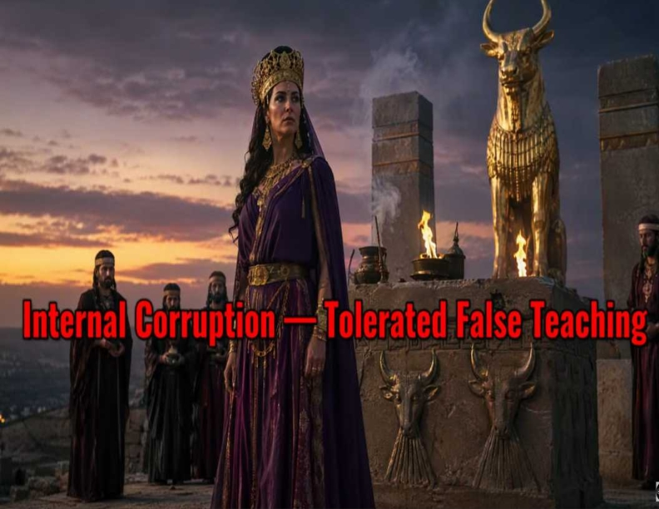
•What salvation is
•How God sets us apart (sanctifies us)
•What Jesus revival looks like in our lives
•How we can proclaim Jesus to others

Slide 27
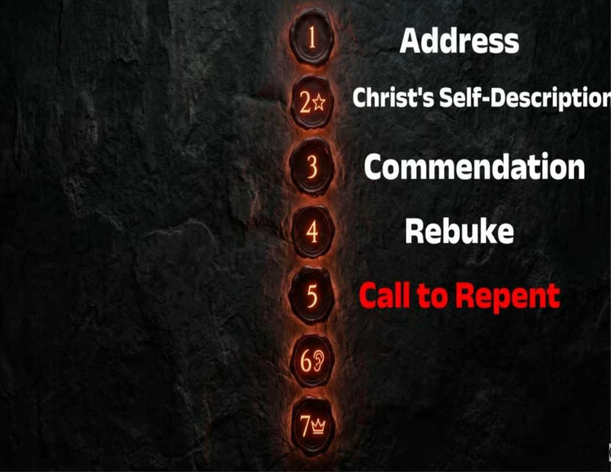
Philippians 1:6
being confident of this very thing, that He who has begun a good work in you will complete it until the day of Jesus Christ;

Slide 28
Revelation 2:21
"And I gave her time to repent of her sexual immorality, and she did not repent."

Slide 29
Revelation 2:22-23
"Indeed, I will cast her into a sickbed, and those who commit adultery with her into great tribulation. Unless they repent of their deeds, I will kill her children with death."

Slide 30
Revelation 2:24-25
24 Now to you I say, and to the rest in Thyatira, as many as do not have this doctrine, who have not known the depths of Satan, as they say, I will put on you no other burden. 25 But hold fast what you have till I come.

Slide 31
Repent and Hold Fast

Slide 32
Revelation 2:23
"And I will give to each according to works."

Slide 33
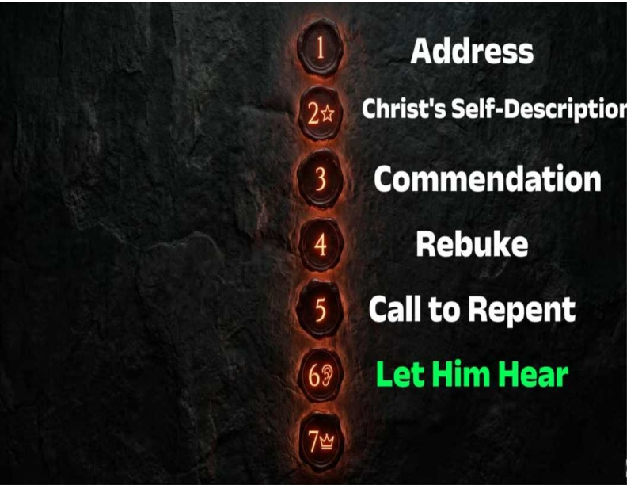
Ecclesiastics 3:1
To everything there is a season, A time for every purpose under heaven:

Slide 34
"To those with ears to hear, listen."

Slide 35
Revelation 2:29
"And he who has an ear, let him hear what the Spirit says to the churches."

Slide 36
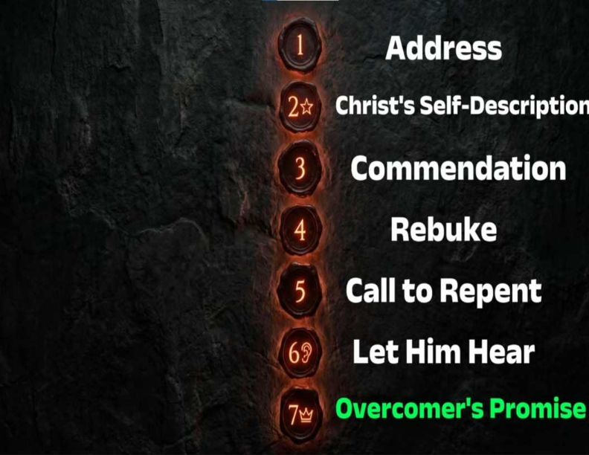
Revelation 2:29
"And he who has an ear, let him hear what the Spirit says to the churches."

Slide 37
Revelation 2:26-28
26 And he who overcomes, and keeps My works until the end, to him I will give power over the nations--27'He shall rule them with a rod of iron; They shall be dashed to pieces like the potter's vessels'--as I also have received from My Father; 28 and I will give him the morning star.

Slide 38
Psalm 2:7-9
7 "I will declare the decree: The LORD has said to Me, 'You are My Son, Today I have begotten You. 8 Ask of Me, and I will give You The nations for Your inheritance, And the ends of the earth for Your possession. 9 You shall break them with a rod of iron; You shall dash them to pieces like a potter's vessel.' "

Slide 39
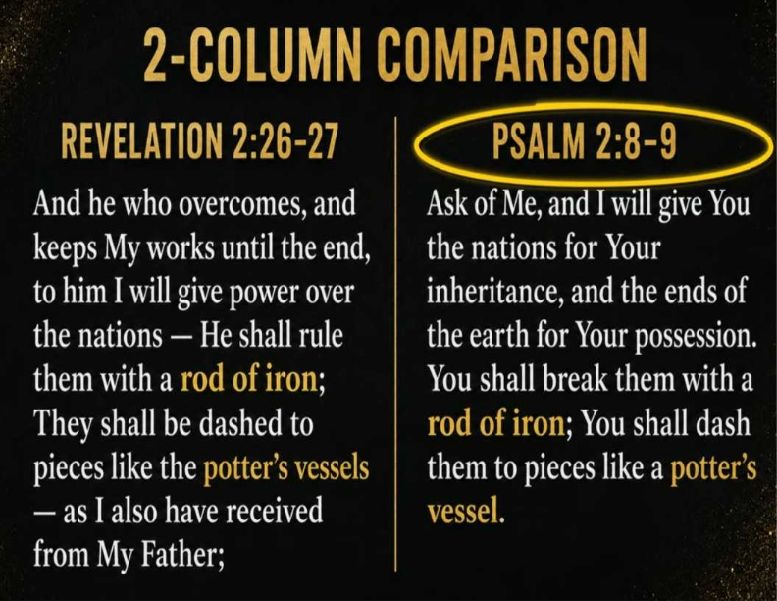

Slide 40
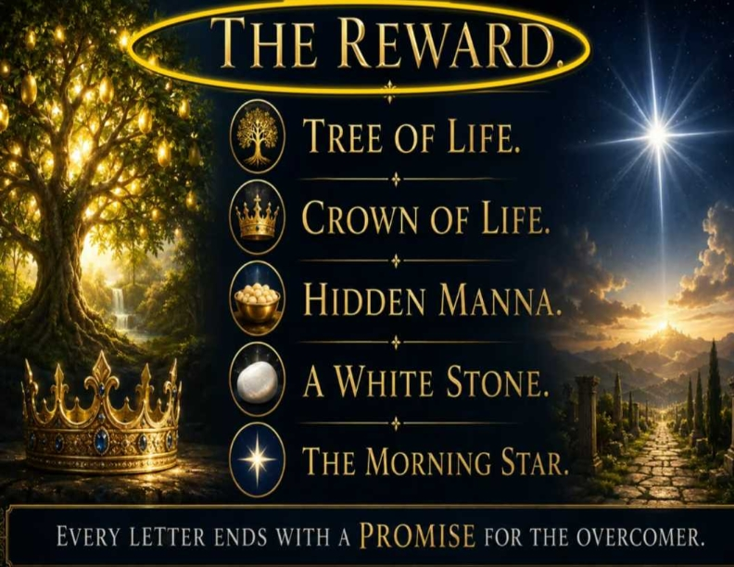
Point 4: Jesus Revival & How
to Proclaim Jesus to Others

Slide 41
The Morning Star is Christ Himself

Slide 42
Revelation 22:16
I, Jesus, have sent My angel to testify to you these things in the churches. I am the Root and the Offspring of David, the Bright and Morning Star."

Slide 43
1 John 5:4-5
For whatever is born of God overcomes the world. And this is the victory that has overcome the world--our faith. 5 Who is he who overcomes the world, but he who believes that Jesus is the Son of God?

Slide 44
Guard Doctrine, Confront Error Lovingly, but Confront It.

Slide 45
Church Number Five
“Sardis”
The Dead Church

Slide 46
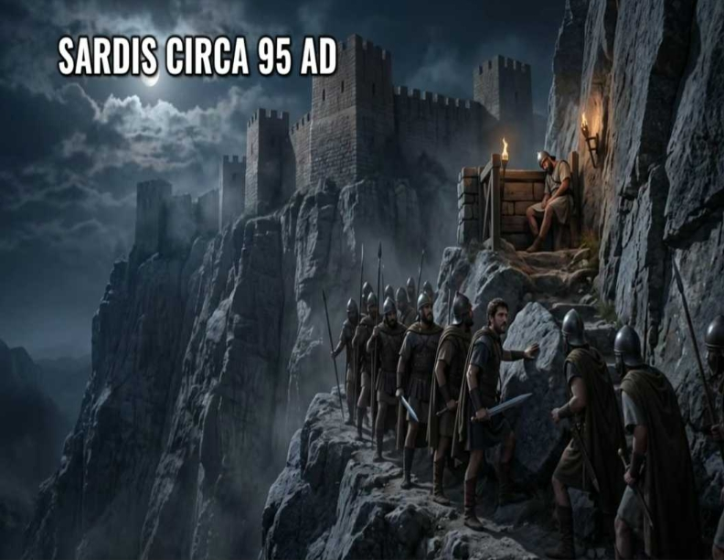
Philippians 1:6
being confident of this very thing, that He who has begun a good work in you will complete it until the day of Jesus Christ;

Slide 47
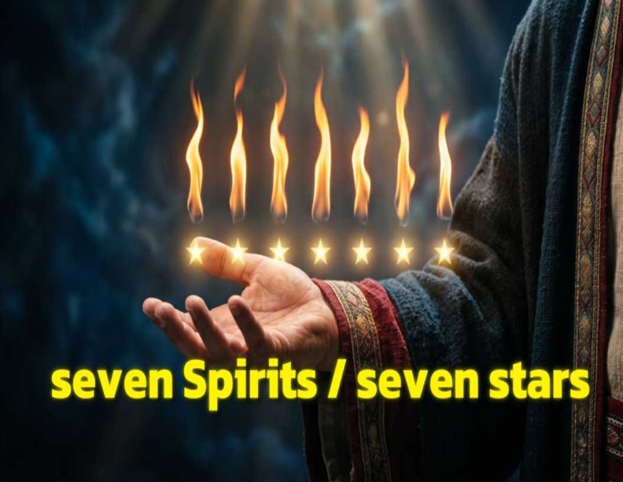
•What salvation is
•How God sets us apart (sanctifies us)
•What Jesus revival looks like in our lives
•How we can proclaim Jesus to others

Slide 48
Revelation 3:1
"And to the angel of the church in Sardis write, 'These things says He who has the seven Spirits of God and the seven stars.'"

Slide 49

Ephesians 2:8-9
8 For by grace you have been saved through faith, and that not of yourselves; it is the gift of God, 9 not of works, lest anyone should boast.

Slide 50
Slide

Slide 51
Revelation 3:1
"And to the angel of the church in Sardis write, 'These things says He who has the seven Spirits of God and the seven stars.'"

Slide 52
Revelation 3:1
"And to the angel of the church in Sardis write, 'These things says He who has the seven Spirits of God and the seven stars.'"

Slide 53
He is exposing their spiritual deadness masked by religious reputation, ritual-based without regeneration, image without substance

Slide 54
Slide

Slide 55
Revelation 3:2
"Be watchful, and strengthen the things which remain, that are ready to die, for I have not found your works perfect before God."

Slide 56
Slide

Slide 57
Revelation 3:3
"Remember therefore how you have received and heard; hold fast and repent. Therefore if you will not watch, I will come upon you as a thief, and you will not know what hour I will come upon you.

Slide 58
Revelation 3:4
You have a few names even in Sardis who have not defiled their garments; and they shall walk with Me in white, for they are worthy.

Slide 59
"Go back to the gospel you first received." He comes like a thief to the unwatchful church”

Slide 61
Revelation 3:6
He who has an ear, let him hear what the Spirit says to the churches." '

Slide 62
Slide

Slide 63
Revelation 3:4
You have a few names even in Sardis who have not defiled their garments; and they shall walk with Me in white, for they are worthy.

Slide 64
Revelation 3:5
He who overcomes shall be clothed in white garments, and I will not blot out his name from the Book of Life; but I will confess his name before My Father and before His angels.

Slide 65
Sardis is the reformed, activity-filled, program-heavy church that impresses people but not Christ. He measures the remnant, not the roster.

Slide 66
Church Number Six,
Philadelphia
“The Faithful Church”

Slide 67
Revelation 3:7
"And to the angel of the church in Philadelphia write, 'These things says He who is holy, He who is true, "He who has the key of David, He who opens and no one shuts, and shuts and no one opens

Slide 68
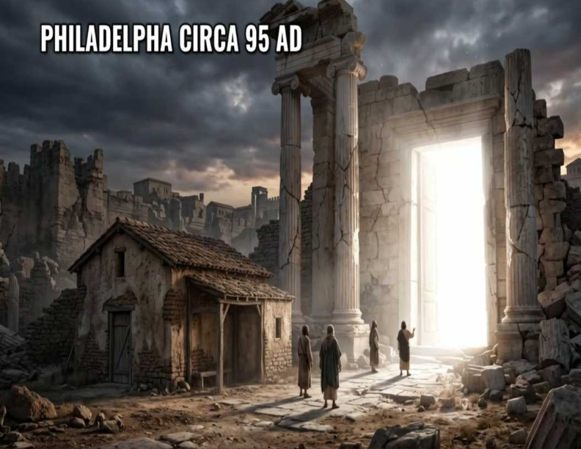
Church number six, Philadelphia
“The Faithful Church”

Slide 69
Church number six, Philadelphia
“The Faithful Church”

Slide 70
Revelation 3:7
"And to the angel of the church in Philadelphia write, 'These things says He who is holy, He who is true, "He who has the key of David, He who opens and no one shuts, and shuts and no one opens

Slide 71
Holy, True, Key Holder and the
Door Opener

Slide 72
Slide

Slide 73
Revelation 3:8
"I know your works. See, I have set before you an open door, and no one can shut it; for you have a little strength, have kept My word, and have not denied My name.

Slide 74
Little Strength, Big Faithfulness

Slide 75
Revelation 3:9
Indeed I will make those of the synagogue of Satan, who say they are Jews and are not, but lie--indeed I will make them come and worship before your feet, and to know that I have loved you.

Slide 76
Who is the Synagogue of Satan?

Slide 77
Isaiah 60:14
Also the sons of those who afflicted you shall come bowing to you, And all those who despised you shall fall prostrate at the soles of your feet; And they shall call you The City of the LORD, Zion of the Holy One of Israel.

Slide 78
Slide 1>

Slide 79
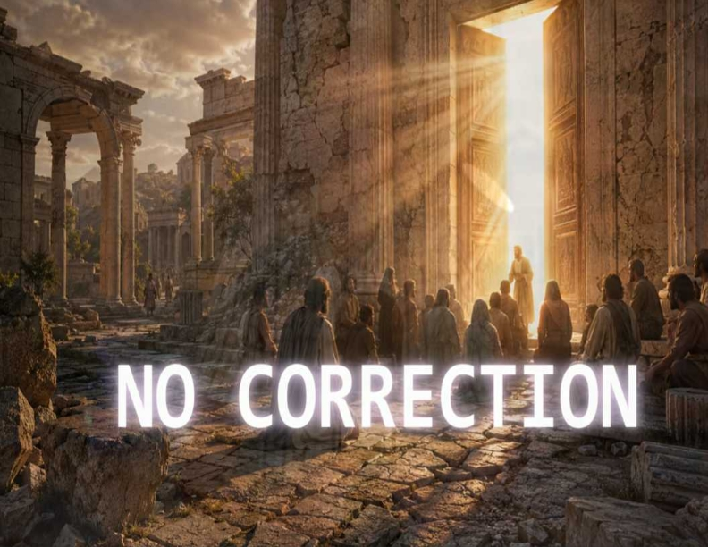
Slide 1>

Slide 80
Revelation 3:10
Because you have kept My command to persevere, I also will keep you from the hour of trial which shall come upon the whole world, to test those who dwell on the earth.

Slide 81
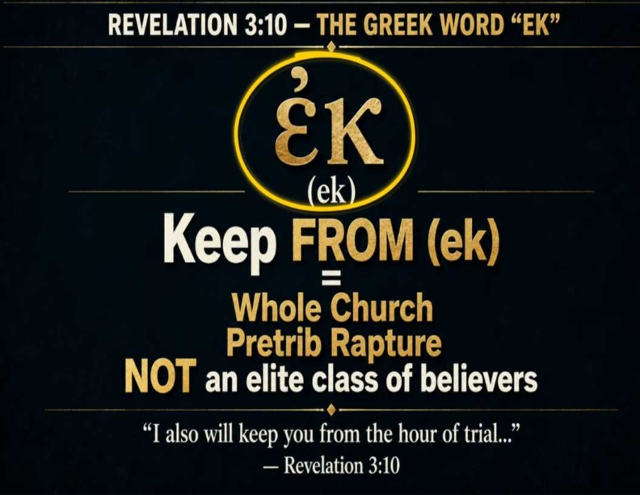
Slide 1>

Slide 82
Revelation 3:11
"Behold, I am coming quickly! Hold fast to what you have, that no one may take your crown."

Slide 83
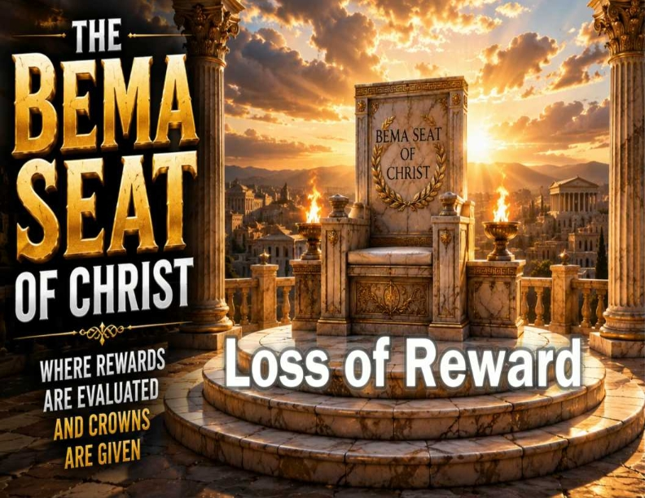
Slide 1>

Slide 84
1 Corinthians 3:14-15
14 If anyone's work which he has built on it endures, he will receive a reward. 15 If anyone's work is burned, he will suffer loss; but he himself will be saved, yet so as through fire.

Slide 85
Slide 1>

Slide 86
Revelation 3:12
"He who overcomes, I will make him a pillar in the temple of my God, and he shall go out no more. I will write on him the name of my God and the name of my city of my God, the new Jerusalem, which comes down out of heaven from my God. And I will write on him my new name.

Slide 87
Revelation 3:13
"He who has an ear, let him hear what the Spirit says to the churches."

Slide 88
Church number Seven,
Laodicea
“The Lukewarm Church”

Slide 89
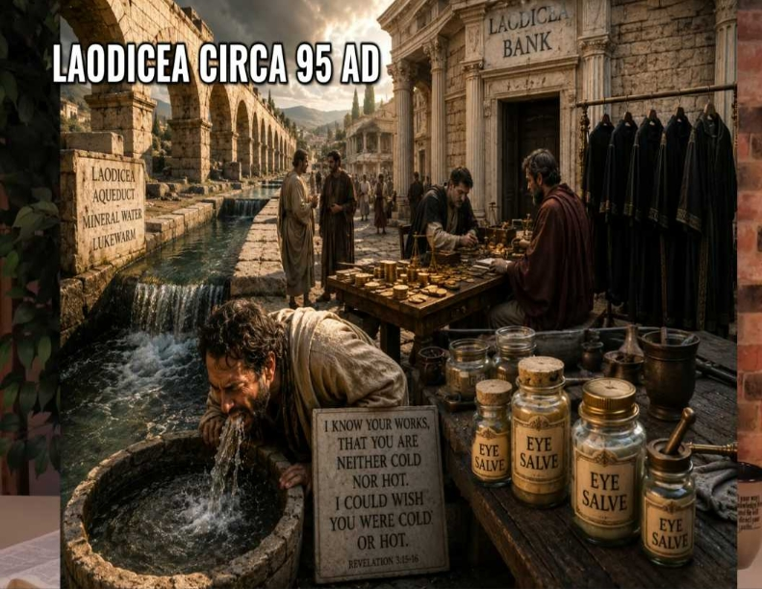
Slide 1>

Slide 90
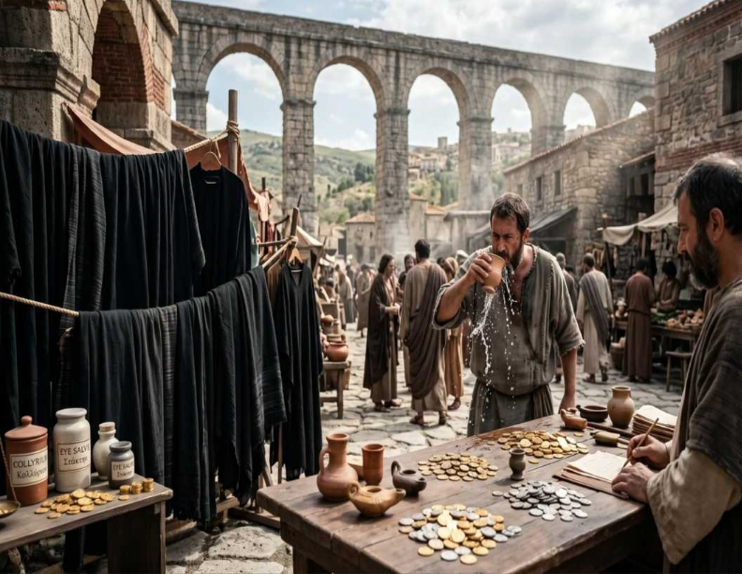
Revelation 3:11
"Behold, I am coming quickly! Hold fast to what you have, that no one may take your crown."

Slide 91
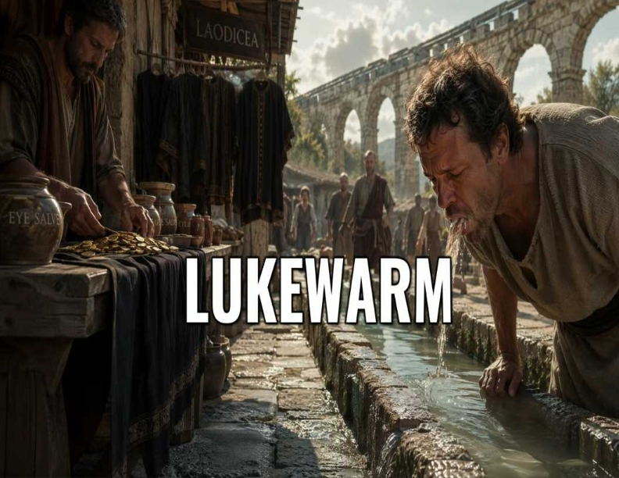
Slide 1>

Slide 92
1 Corinthians 3:14-15
14 If anyone's work which he has built on it endures, he will receive a reward. 15 If anyone's work is burned, he will suffer loss; but he himself will be saved, yet so as through fire.

Slide 93
Revelation 3:14
"And to the angel of the church of the Laodiceans write, 'These things says the Amen, the Faithful and True Witness, the Beginning of the creation of God.'"

Slide 94
Revelation 3:12
"He who overcomes, I will make him a pillar in the temple of my God, and he shall go out no more. I will write on him the name of my God and the name of my city of my God, the new Jerusalem, which comes down out of heaven from my God. And I will write on him my new name.

Slide 95
Revelation 3:15
"I know your works, that you are neither hot nor cold. I could wish you were cold or hot."

Slide 96
Why

Slide 97
Slide 1>

Slide 98
Revelation 3:16-17
16 "So then, because you are lukewarm, and neither hot nor cold, I will vomit you out of My mouth. 17 Because you say, 'I am rich, have become wealthy, and have need of nothing—and do not know that you are wretched, miserable, poor, blind, and naked.'"

Slide 99
Slide 1>

Slide 100
Revelation 3:18
I counsel you to buy from Me gold refined in the fire, that you may be rich; and white garments, that you may be clothed, that the shame of your nakedness may not be revealed; and anoint your eyes with eye salve, that you may see.

Slide 101
Revelation 3:19
As many as I love, I rebuke and chasten. Therefore be zealous and repent.

Slide 102
Revelation 3:20
Behold, I stand at the door and knock. If anyone hears My voice and opens the door, I will come in to him and dine with him, and he with Me."

Slide 103
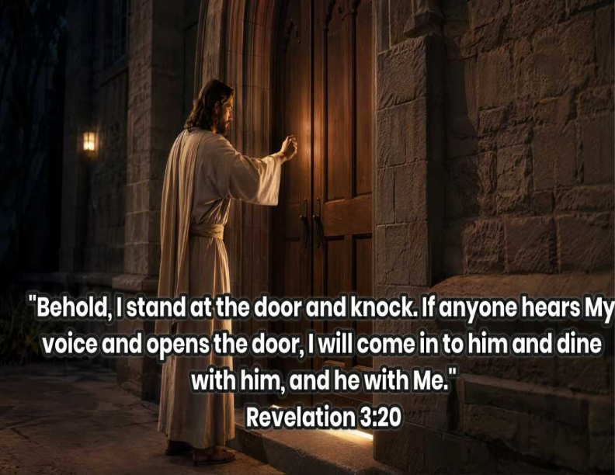
Revelation 3:13
"He who has an ear, let him hear what the Spirit says to the churches."

Slide 104
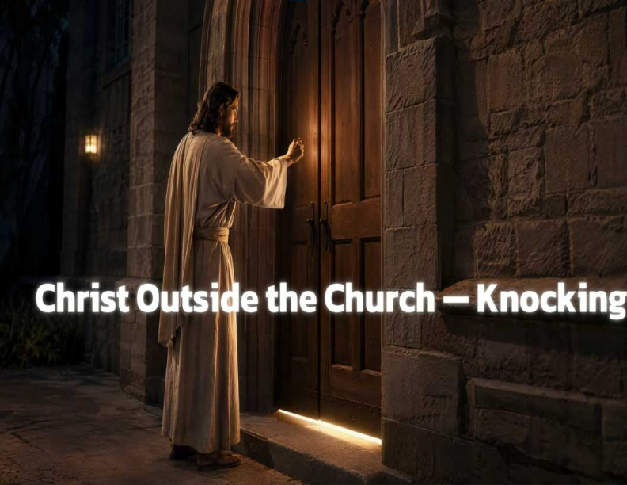
Slide 1>

Slide 105
Revelation 3:11
"Behold, I am coming quickly! Hold fast to what you have, that no one may take your crown."

Slide 106
Revelation 3:21
"And to him who overcomes I will grant to sit with Me on My throne, as I have overcome and sat down with My Father on His throne."

Slide 107
1 Corinthians 3:14-15
14 If anyone's work which he has built on it endures, he will receive a reward. 15 If anyone's work is burned, he will suffer loss; but he himself will be saved, yet so as through fire.

Slide 108
Revelation 3:22
"And he who has an ear, let him hear what the Spirit says to the churches."

Slide 109
Revelation 3:12
"He who overcomes, I will make him a pillar in the temple of my God, and he shall go out no more. I will write on him the name of my God and the name of my city of my God, the new Jerusalem, which comes down out of heaven from my God. And I will write on him my new name.

Slide 110
Compromise tolerated for growth, that's Thyatira.
2. Reputation mistaken for life, that's Sardis.
3. Small and faithful, that's Philadelphia.
4. Wealth mistaken for health, that's Laodicea. Which one are you?

Slide 111
1 Thessalonians 4:13-18
13 But I do not want you to be ignorant, brethren, concerning those who have fallen asleep, lest you sorrow as others who have no hope. 14 For if we believe that Jesus died and rose again, even so God will bring with Him those who sleep in Jesus.

Slide 112
15 For this we say to you by the word of the Lord, that we who are alive and remain until the coming of the Lord will by no means precede those who are asleep. 16 For the Lord Himself will descend from heaven with a shout, with the voice of an archangel, and with the trumpet of God. And the dead in Christ will rise first.

Slide 113
17 Then we who are alive and remain shall be caught up together with them in the clouds to meet the Lord in the air. And thus we shall always be with the Lord. 18 Therefore comfort one another with these words.

Slide 114
1 Corinthians 15:50-54
50 Now this I say, brethren, that flesh and blood cannot inherit the kingdom of God; nor does corruption inherit incorruption. 51 Behold, I tell you a mystery: We shall not all sleep, but we shall all be changed-- 52 in a moment, in the twinkling of an eye, at the last trumpet. For the trumpet will sound, and the dead will be raised incorruptible, and we shall be changed.

Slide 115
53 For this corruptible must put on incorruption, and this mortal must put on immortality. 54 So when this corruptible has put on incorruption, and this mortal has put on immortality, then shall be brought to pass the saying that is written: "Death is swallowed up in victory."

Slide 116

20 Again, when a righteous man turns from his righteousness and commits iniquity, and I lay a stumbling block before him, he shall die; because you did not give him warning, he shall die in his sin, and his righteousness which he has done shall not be remembered; but his blood I will require at your hand.

Slide 117
Acts 2:38-39
38 Then Peter said to them, "Repent, and let every one of you be baptized in the name of Jesus Christ for the remission of sins; and you shall receive the gift of the Holy Spirit. 39 For the promise is to you and to your children, and to all who are afar off, as many as the Lord our God will call."

Slide 118
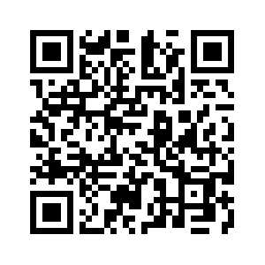
Donate with our QR code app to
Amazing Grace Christian Fellowship
Donations are Deeply Appreciated!

